Slide 1
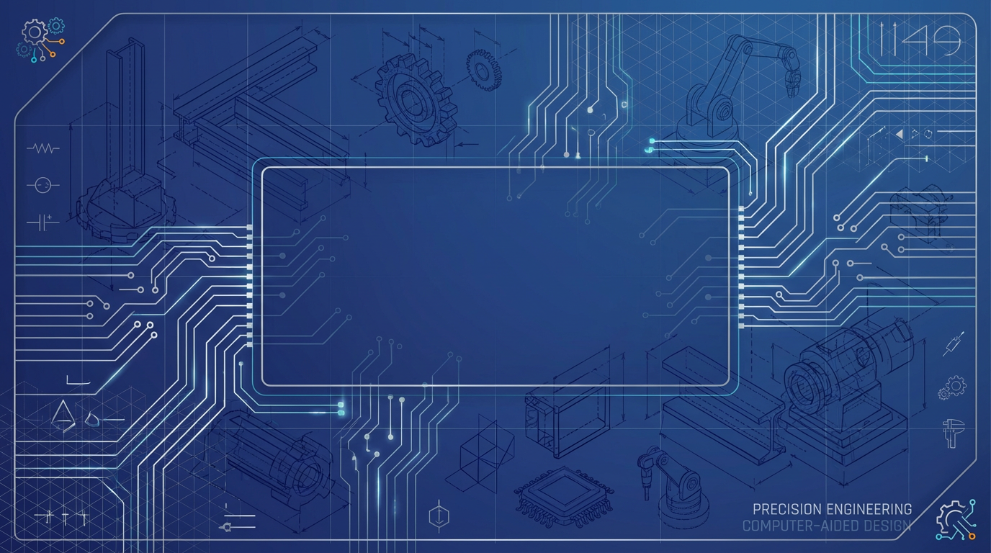
B.TECH ME • 6TH SEMESTER
Session Jan – May 2026
Product Cycle and CAD Systems
Computer Aided Design Lecture 1 Module 1
PREPARED BY
Dinesh Kumar
D Y PATIL INTERNATIONAL UNIVERSITY
Assistant Professor
School of Continuing Education

Slide 2









Learning Objectives
COURSE PROGRESSION
& Course Agenda
Product Lifecycle
Understand the complete product cycle from concept to End-of-Life (EOL)
Concurrent Eng.
Master design processes, engineering methodologies, and CAD systems
CAD Systems
Explore CAD architecture, hardware components, and system integration
Graphics Basics
Derive and apply 2D/3D transformations and coordinate systems
3D Transforms
B.Tech ME • 6th Semester • Product Cycle and CAD Systems
02

Slide 3
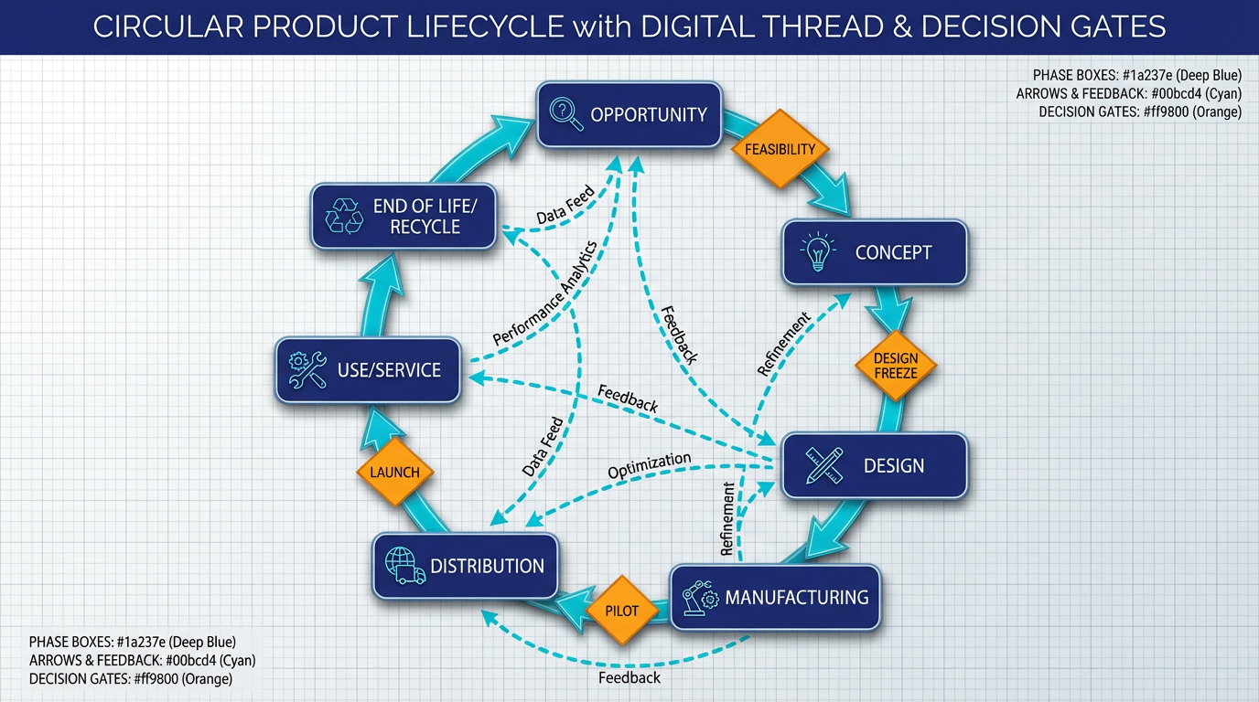


Product Cycle
End-to-End Overview
Lifecycle Phases
Opportunity: Market needs & VOC
Concept & Design: R&D, Prototyping
Manufacturing: Production ramp-up
Use & Service: Maintenance & Updates
EOL: Recycle, Remanufacture, Dispose
Key Stage Gates
Feasibility: Technical & Economic check
Design Freeze: Specs locked for tooling
Pilot Run: Validation of process
Launch: Full scale commercialization
KEY PERFORMANCE INDICATORS
Time-to-Market
Cost
Quality
Reliability
Sustainability
B.Tech ME • 6th Semester • Product Cycle and CAD Systems
03

Slide 4






Product Lifecycle
STAGE-GATE GOVERNANCE MODEL
PHASES & GOVERNANCE
Concept
1. Concept Phase
Market & Tech Assessment
Analyze market needs, capture Voice of Customer (VOC), and perform competitive analysis. Output: Product Mission Statement.
Gate 1: Feasibility
Design
2. Development Phase
Prototyping & Testing
System design, detailed engineering, prototyping, and validation (V-Model). Defining requirements and constraints.
Gate 2: Design Freeze
3. Production Phase
Pilot
Manufacturing ramp-up, Supply chain setup, SPC (Statistical Process Control), and PPAP (Production Part Approval Process).
Mfg Process Validation
Gate 3: Launch Approval
4. In-Service Phase
Launch & Sustain
Distribution, customer use, maintenance, software updates, and field data collection for future improvements.
Mass Production
5. End of Life (EOL)
Product retirement, remanufacturing, recycling, and ensuring regulatory compliance (e.g., WEEE, RoHS).
B.Tech ME • 6th Semester • Product Cycle and CAD Systems
04

Slide 5
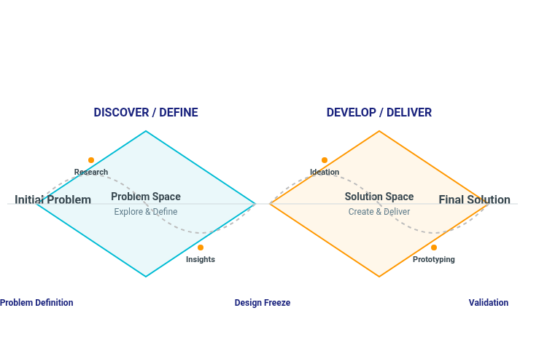


Design Process
From Problem to Solution
Systematic Steps
Definition: Problem statement & goals
Requirements: Functional specs & constraints
Concept: Brainstorming & Generation
Selection: Evaluation (Pugh Matrix)
Embodiment: Architecture & Preliminary layout
Detail Design: Technical drawings & specs
V&V: Verification & Validation
Key Methodologies
Morphological Charts
Pugh Matrix
TRIZ
Rapid Prototyping
Brainstorming
SCAMPER
B.Tech ME • 6th Semester • Product Cycle and CAD Systems
05

Slide 6






Design Methods
Methodologies for Quality, Manufacturability, and Reliability
QFD
DFM / DFA
FMEA
Quality Function Deployment
Design for Mfg / Assembly
Failure Mode & Effect Analysis
Translates "Voice of Customer" (VOC) into engineering specs (CTQs).
DFM: Optimize part manufacturing (tolerances, materials).
Identify potential failures before they occur.
RPN Calculation:Severity × Occurrence × Detection
Uses "House of Quality" matrix to correlate needs vs. features.
DFA: Minimize part count, standardize fasteners, ease of handling.
Focuses mitigation on high RPN items (Safety/Reliability).
Prioritizes design requirements based on customer value.
Reduces production cost and assembly time.
RPN = S × O × D
WHATs
Relationship Matrix
HOWs
Complex
Simplified
Risk Priority Number
Part Count Reduction
Low Risk
Medium
High Risk
House of Quality
B.Tech ME • 6th Semester • Product Cycle and CAD Systems
06

Slide 7
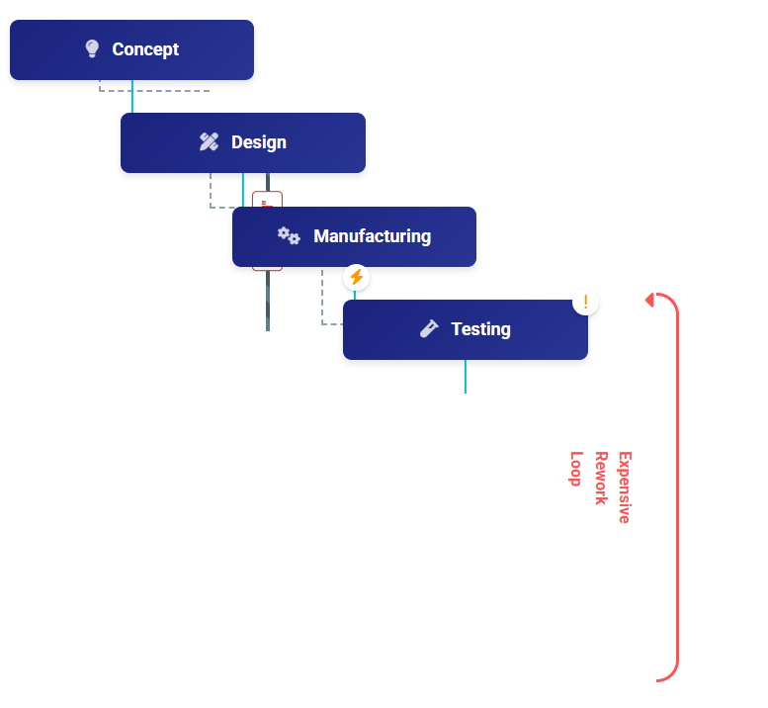




Sequential Engineering
Traditional "Over-the-Wall" Approach
Concept
Characteristics
Linear Process: Strict order of phases
Siloed Teams: Limited communication
Handoffs: Completed work passed blindly
Late Validation: Testing only at the end
Advantages
Clear ownership & accountability
Simpler project management
Well-defined milestones
Limitations
Long time-to-market
Late discovery of design defects
Expensive rework cycles
B.Tech ME • 6th Semester • Product Cycle and CAD Systems
Poor design-for-manufacturing fit

Slide 8



Concurrent Engineering
Parallel Workflows vs. Traditional Sequential Handoffs
Sequential
Concurrent
Impact
Traditional "Over-the-Wall"
Integrated Product Dev
Why Switch?
Linear workflow: Design → Mfg → Test.
Parallel execution of phases (overlap).
Speed: 30-50% reduced time-to-market.
Late discovery of defects leads to costly rework.
Cross-functional teams (Design, Mfg, Mkt).
Cost: Fewer Engineering Change Orders (ECOs).
Early supplier involvement & feedback.
Siloed teams with minimal communication.
Quality: Design for Manufacturability (DFM) built-in.
100%
-40%
Time & Cost
Concept
Concept
Design
Design
Collaboration
Mfg
Mfg Planning
Rework
Production
Sequential
Concurrent
Long Lead Time
B.Tech ME • 6th Semester • Product Cycle and CAD Systems
08

Slide 9












CAD Systems
VISUAL PROGRESSION: 2D TO MBD
INTRODUCTION, EVOLUTION & APPLICATIONS
1
2D Drafting
Evolution of CAD
Electronic drawing board, lines & arcs.
Transitioned from simple 2D electronic drafting to complex 3D Parametric Solid Modeling, and now to Model-Based Definition (MBD) where 3D models carry all PMI data.
2
3D Solid Modeling
Wireframe → Surface → Solid geometry.
Key Applications
Used extensively for Part & Assembly Design, Complex Surfacing, Simulation Pre-processing (FEA/CFD), and Tooling Design (Molds/Dies).
Parametric Feature-Based
3
History tree, constraints, associativity.
Parametric & Feature-Based
Modern CAD uses constraints, dimensions, and relations. Design intent is captured through a history-based feature tree, allowing easy updates.
MBD / PMI
4
3D Annotated Models (No 2D drawings).
Role in Product Cycle
CORE BENEFITS
Acts as the central source of truth for the "Digital Thread," feeding data downstream to CAM, CAE, and quality inspection.
Precision
Associativity
Collaboration
Reuse
B.Tech ME • 6th Semester • Product Cycle and CAD Systems
09

Slide 10
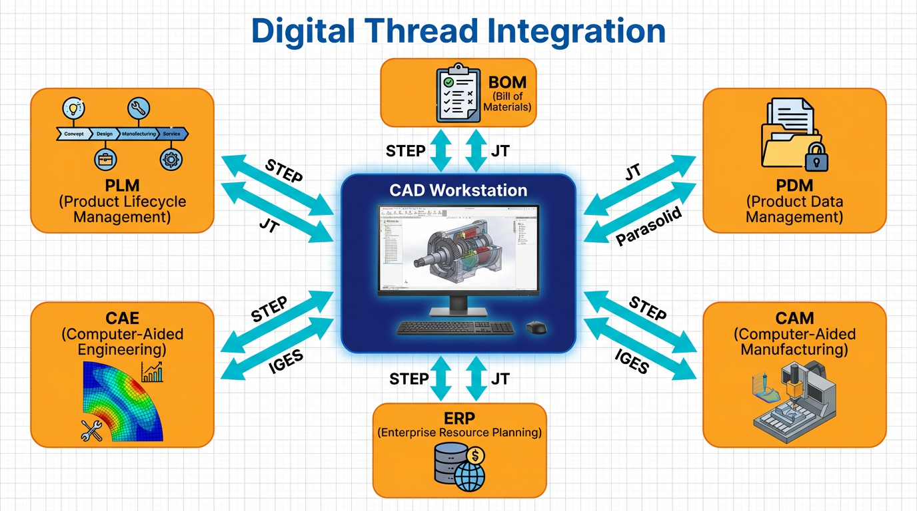


CAD Workflow
Digital Thread Integration
Workflow Pipeline
Input: Problem Definition & Requirements
Modeling: Parametric 3D CAD Creation
Management: PDM Check-in / Version Control
Output: BOM Generation & 2D Drawings
Downstream: CAM Toolpaths & CAE Sim
System Interoperability
Core Integration: PLM, ERP, CAM, CAE
Change Control: Revision Mgmt & ECOs
NEUTRAL FORMATS
STEP
IGES
JT
Parasolid
B.Tech ME • 6th Semester • Product Cycle and CAD Systems
10

Slide 11








CAD Hardware
WORKSTATION PERFORMANCE STACK
WORKSTATION ARCHITECTURE & REQUIREMENTS
Processor (CPU)
High clock speed (>4.0 GHz) is crucial for parametric modeling (linear). Multi-core helps with rendering and simulation.
Display I/O
Input Devices
Rec: Intel Core i9/Xeon or AMD Ryzen 9
4K Color Accurate
3D Mouse / Tablet
Graphics (GPU)
DATA BUS (PCIe / DDR)
Professional cards offer certified drivers for stability and ECC VRAM. Handles viewport rotation and shading.
Rec: NVIDIA RTX A-Series / Quadro (≥ 8GB VRAM)
CPU
GPU
Geometry Engine
Viewport Rendering
Memory (RAM)
Holds full assembly data in active memory. Prevents swapping to disk which kills performance.
HIGH SPEED STORAGE FABRIC
Rec: 32GB (Entry) - 64GB+ (Complex Assemblies)
System RAM
NVMe Storage
Active Workspace
File Repository
Storage & I/O
Fast loading of large assemblies. High-res display for detail.
Rec: NVMe SSD (Gen4/5), 4K IPS Monitor, SpaceMouse
B.Tech ME • 6th Semester • Product Cycle and CAD Systems
11

Slide 12
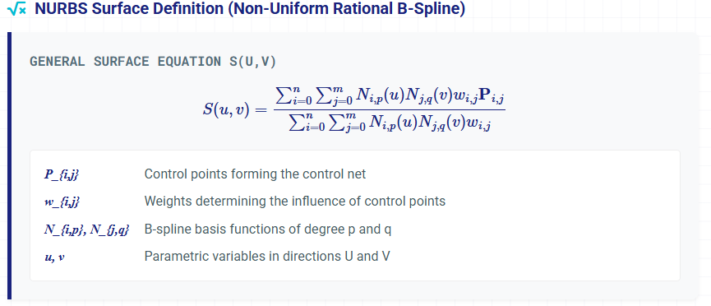




CAD System Architecture
Software Architecture
Software Kernel & Geometry Mathematics
User Interface (GUI)
Application Logic
Feature Manager, Constraints
Geometric Kernel
Parasolid
ACIS
Graphics Engine (OpenGL/DirectX)
Data Structures
B-Rep (Boundary Rep)
CSG (Constructive Solid)
Half-Edge Structure: Efficient for mesh traversal.
Scene Graph: Hierarchical arrangement of assembly components.
Object defined by topological limits: Vertices, Edges, Faces. Uses Euler-Poincaré Formula: V - E + F = 2 (for simple convex polyhedra).
Object constructed via Boolean operations (Union ∪, Intersection ∩, Difference -) on primitives like spheres, cubes, cylinders.
Octree/BSP: Spatial partitioning for collision detection.
B.Tech ME • 6th Semester • Product Cycle and CAD Systems
12

Slide 13









Computer Graphics
THE RENDERING PIPELINE
FUNDAMENTALS & PIPELINE
Raster vs. Vector
Model & World Transform
Two fundamental ways to represent 2D images.
1
Object Coords → World Space
Raster: Grid of pixels (Bitmap, JPEG). Resolution dependent. Good for complex textures/photos.
Vector: Geometric primitives (Lines, Curves). Infinite scaling without quality loss. Used in CAD.
2
Viewing & Projection
Camera Space → Clip Space (Frustum)
Graphics Buffers
Memory areas storing data for each pixel on the screen.
3
Rasterization
Frame Buffer: Stores final color values (RGBA).
Primitives → Fragments (Pixels)
Z-Buffer (Depth): Stores depth (distance) to handle object occlusion.
Stencil Buffer: Limits rendering area (masking/clipping).
4
Fragment Processing
Shading, Texturing, Depth Test
Shading Models
Methods to calculate light intensity on surfaces.
Flat: One color per polygon face (blocky).
Gouraud: Vertex lighting interpolated across face (smooth, no specular).
5
Display
Phong: Normal interpolation per pixel (high quality specular highlights).
Frame Buffer → Screen
B.Tech ME • 6th Semester • Product Cycle and CAD Systems
13

Slide 14

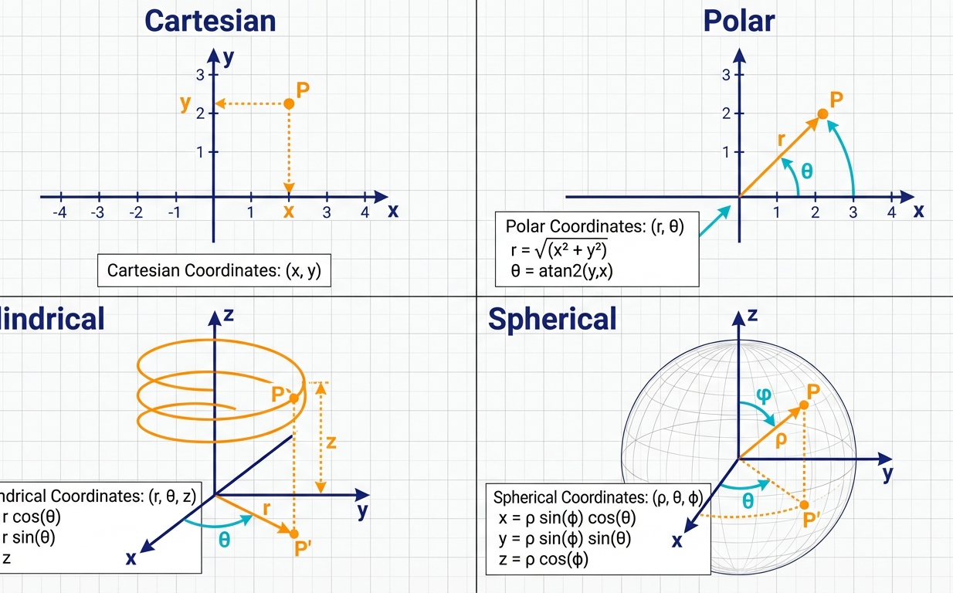
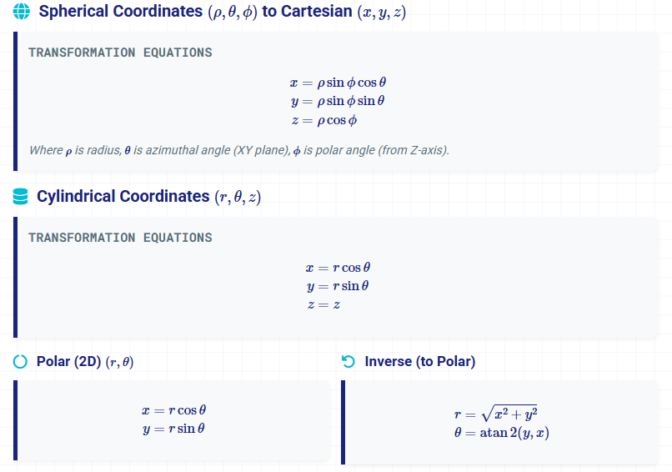


Coordinate Systems
System Visualization
Conversions and Mathematical Definitions
Visual comparison of reference frames and basis vectors
Key Applications
Spherical: Camera rotations, environment mapping, orbital mechanics.
Cylindrical: Modeling shafts, pipes, and rotational symmetry objects.
Homogeneous Coords: Unified handling of translation and rotation (essential for 3D matrices).
Convention Note
14
B.Tech ME • 6th Semester • Product Cycle and CAD Systems
In graphics (OpenGL), Y often points up. In physics/engineering, Z often points up. Always verify the "up" vector and handedness.

Slide 15
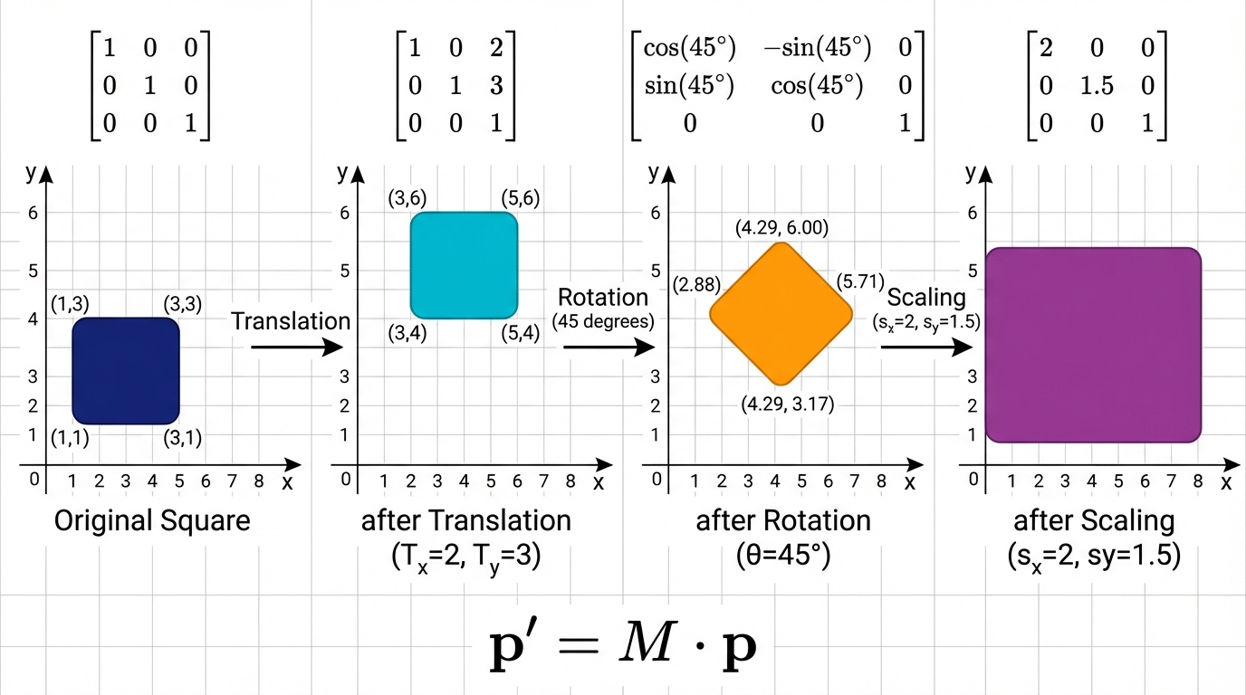
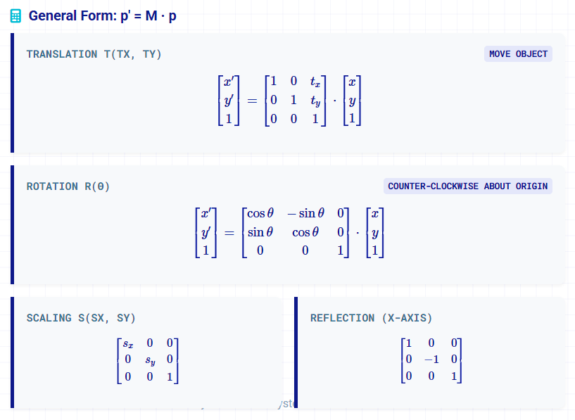

2D Transformations
Homogeneous Matrix Operations (3×3)
Step-by-step transformation: Original → Translate → Rotate → Scale
Composite Transformations
Matrix multiplication is non-commutative ($A \cdot B \neq B \cdot A$). Order matters!
M = T · R · S
(Scale first, then Rotate, then Translate)
Why Homogeneous?
15
Unifies Translation (addition) with Rotation/Scaling (multiplication) into a single matrix format.
Allows chaining multiple transforms via matrix multiplication.

Slide 16
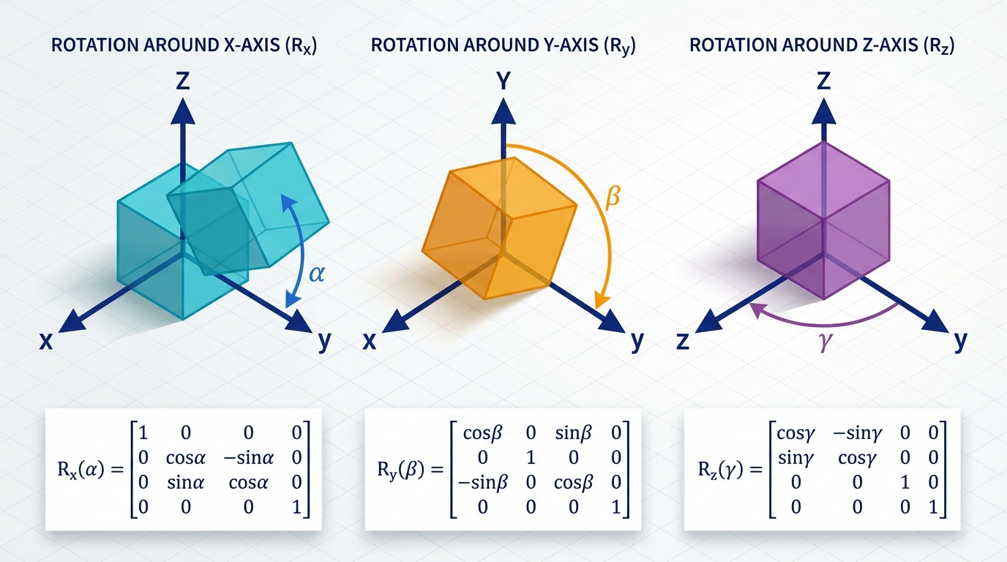
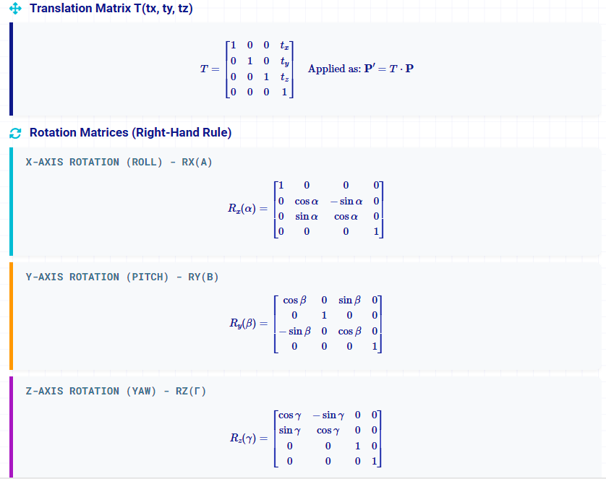

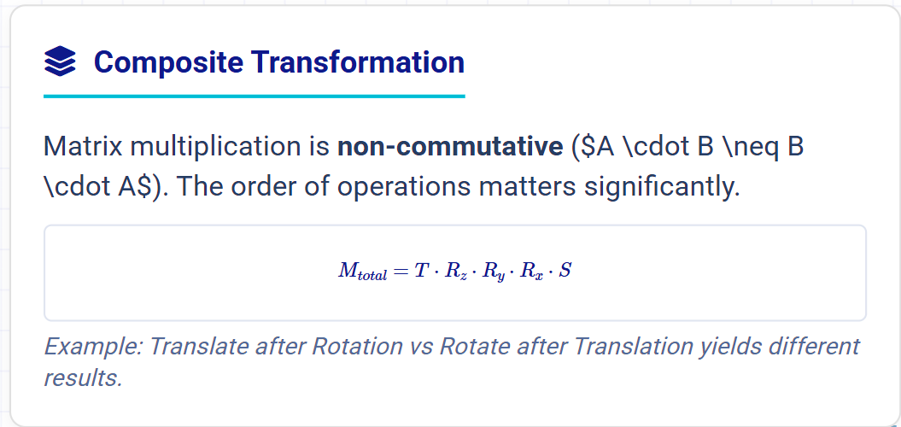
3D Transformations
Homogeneous Coordinates (4×4 Matrices)
Visualizing Rotations
The diagram demonstrates rotations around the three principal axes. Note that in a right-handed system, positive rotation is counter-clockwise when looking towards the origin from the positive axis.

Slide 17

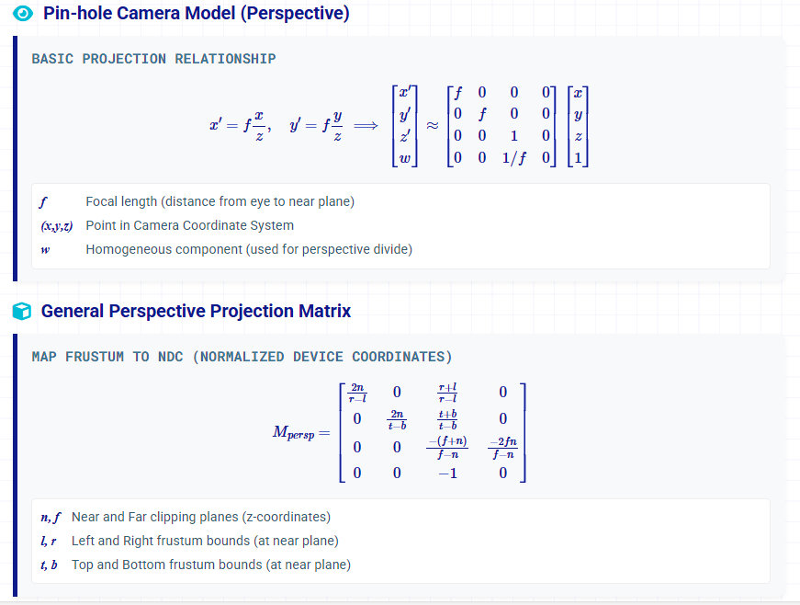
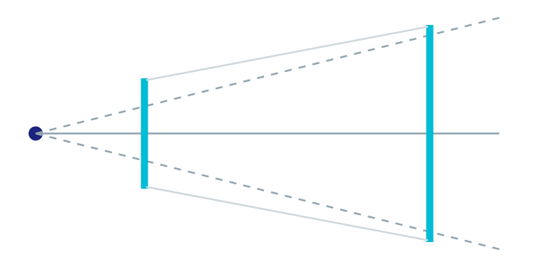

Projection & Viewing
Projection Types
Camera Models & Transformation Matrices
Perspective
Objects appear smaller as they get further away. Parallel lines converge at vanishing points. Mimics human vision.
Orthographic
Parallel projection. No depth perception scaling. Essential for engineering drawings and CAD measurements.
View Frustum
Volume visible to the camera (Truncated Pyramid)
Camera Transform
Transforms world coordinates to camera coords.
𝑃
=
𝑅
⋅
(
𝑃
−
𝐶
)
𝑐
𝑎
𝑚
𝑤
𝑜
𝑟
𝑙
𝑑
17

Slide 18









VIEWING PIPELINE
Advanced 3D Concepts
Object Space
Viewing Pipeline & Precision
Transformation Pipeline Object → World → Camera → Clip → NDC → Screen Space sequence.
World Space
Clipping & Culling Discarding geometry outside frustum and back-facing polygons to optimize rendering.
Camera/View
Depth Precision (Z-Buffer) Non-linear distribution of depth values. Importance of Near/Far plane ratio to avoid Z-fighting.
Clip / NDC
Coordinate Conventions Right-handed (OpenGL) vs Left-handed (DirectX) systems affect matrix composition.
Screen Space
B.Tech ME • 6th Semester • Product Cycle and CAD Systems
18

Slide 19




Summary
Key Takeaways & Conclusions
End-to-End Integration
Product success relies on the seamless integration of design, manufacturing, and lifecycle management (PLM) from concept to disposal.
Concurrent Efficiency
Shifting from sequential to concurrent engineering significantly reduces time-to-market and minimizes late-stage design changes.
Digital Foundation
CAD systems and geometric modeling are the backbone of modern engineering, enabling precise simulation and digital twin capabilities.
Integrated Lifecycle Model
Questions & Discussion
Mathematical Core
Thank you for your attention
Mastery of coordinate systems and matrix transformations is essential for understanding 3D graphics, robotics, and advanced CAD operations.
Prepared by:
Dinesh Kumar
| Assistant Professor
Session Jan – May 2026 | B.Tech ME

