Slide 1
DESIGN OF MACHINE ELEMENTS-I
BME 2201
Lecture 1 Module 1
Dinesh Kumar
Assistant Professor
School of Engineering
DYPIU

Slide 2
INTRODUCTION TO MACHINE DESIGN
Machine Design is the creation of new and better machines and improving the existing ones. A new or better machine is one which is more economical in the overall cost of production and operation
OR
Machine design is deﬁned as the use of scientiﬁc principles, technical information and imagination in the description of a machine or a mechanical system to perform speciﬁc functions with maximum economy and efﬁciency.

Slide 3
CLASSIFICATIONS OF MACHINE DESIGN
Adaptive design: - This type of design needs no special knowledge or skill and can be attempted by designers of ordinary technical training. The designer only makes minor alternation or modification in the existing designs of the product.
Development design: - This type of design needs considerable scientific training and design ability in order to modify the existing designs into a new idea by adopting a new material or different method of manufacture.
New design: - This type of design needs lot of research, technical ability and creative thinking.

Slide 4
CLASSIFICATIONS OF MACHINE DESIGN
Rational design. This type of design depends upon mathematical formulae of principle of mechanics.
Empirical design. This type of design depends upon empirical formulae based on the practice and past experience.
Industrial design. This type of design depends upon the production aspects to manufacture any machine component in the industry.

Slide 5
CLASSIFICATIONS OF MACHINE DESIGN
Optimum design. It is the best design for the given objective function under the specified constraints. It may be achieved by minimising the undesirable effects.
System design. It is the design of any complex mechanical system like a motor car.
Element design. It is the design of any element of the mechanical system like piston, crankshaft, connecting rod, etc.
Computer aided design. This type of design depends upon the use of computer systems to assist in the creation, modification, analysis and optimisation of a design.

Slide 6
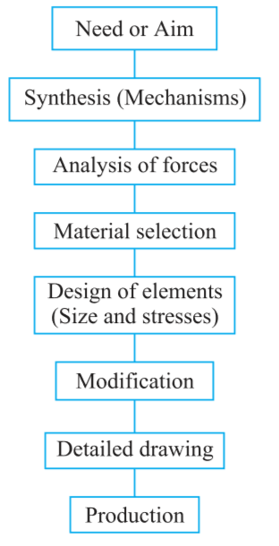
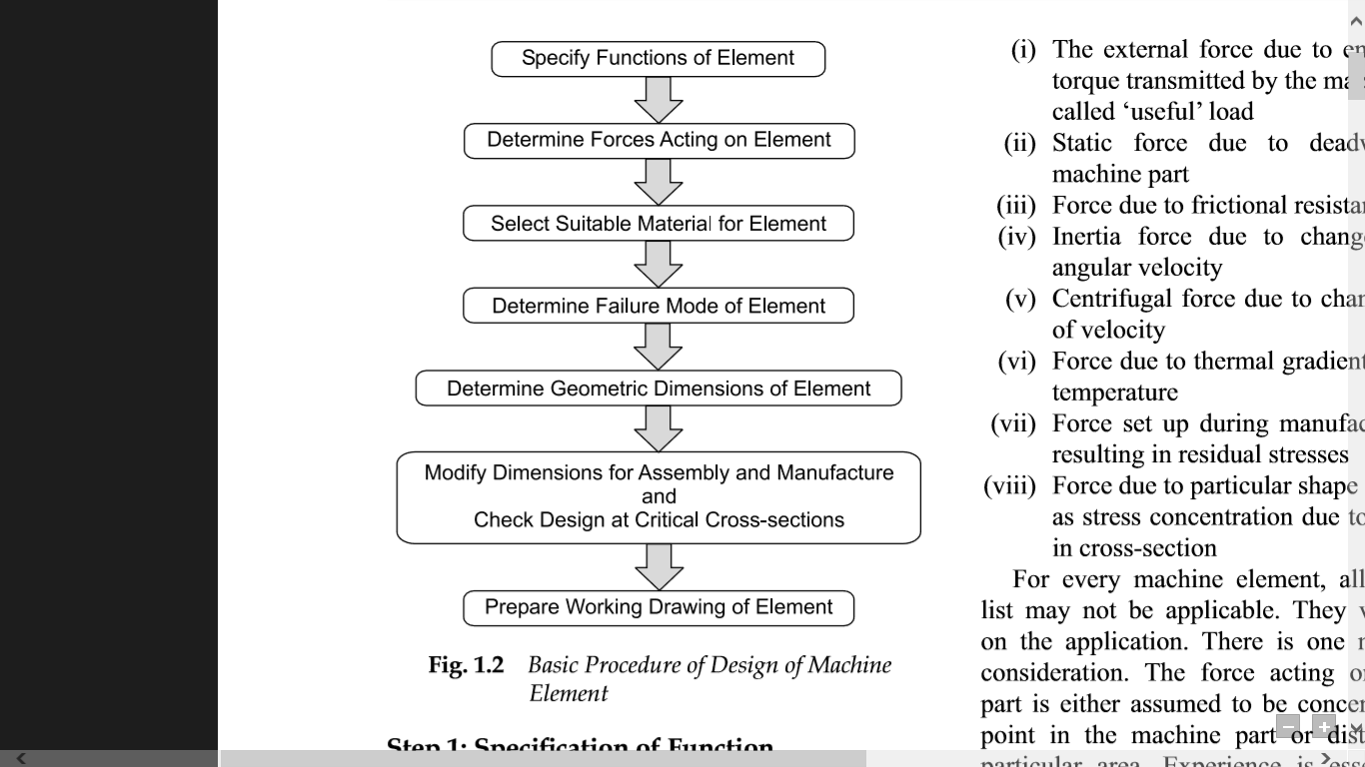
GENERAL PROCEDURE IN MACHINE DESIGN

