Slide 1
DESIGN OF MACHINE ELEMENTS-I
BME 2201
Lecture 10 Module 2
Dinesh Kumar
Assistant Professor
School of Engineering
DYPIU

Slide 2
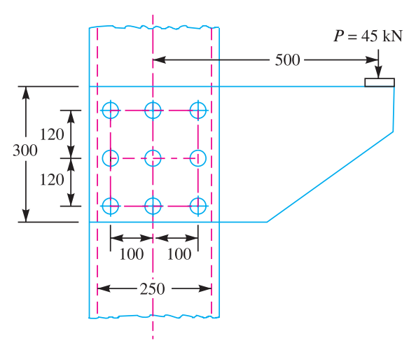
ECCENTRIC LOADING OF RIVETS
The bracket as shown in Figure, is to carry a load of 45 kN. Determine the size of the rivet if the shear stress is not to exceed 40 MPa. Assume all rivets of the same size.

Slide 5
