Slide 1
DESIGN OF MACHINE ELEMENTS-I
BME2201
Lecture 10.1 Module 2
Dinesh Kumar
Assistant Professor
School of Engineering
DYPIU

Slide 2
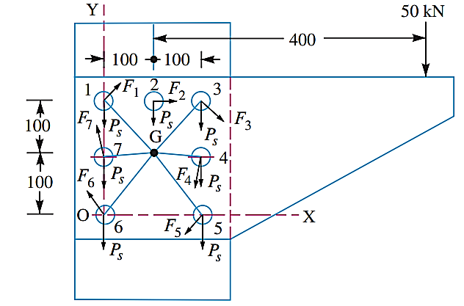
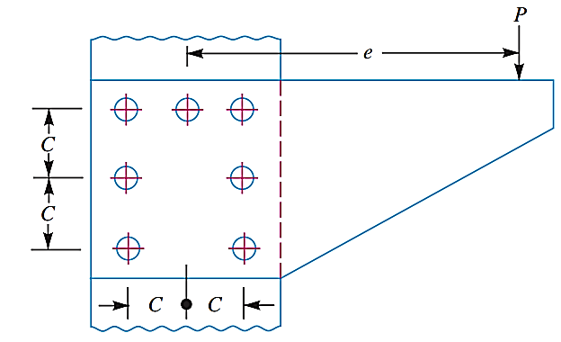
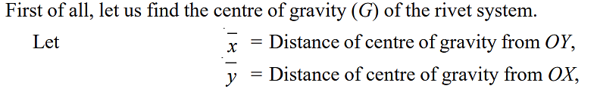
An eccentrically loaded lap riveted joint is to be designed for a steel bracket as shown in Figure. The bracket plate is 25 mm thick. All rivets are to be of the same size. Load on the bracket, P = 50 kN ; rivet spacing, C = 100 mm; load arm, e = 400 mm. Permissible shear stress is 65 MPa and crushing stress is 120 MPa. Determine the size of the rivets to be used for the joint.

Slide 3
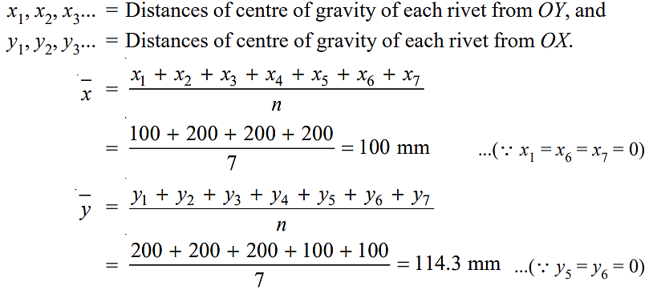
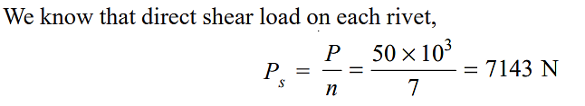

Slide 4
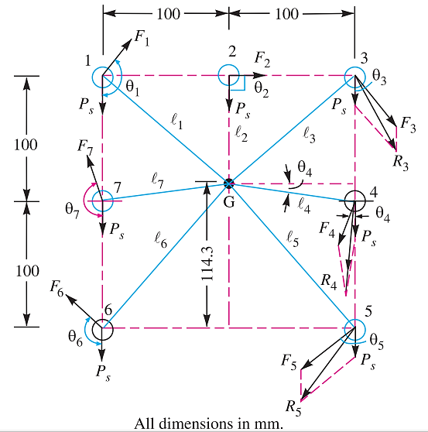

Slide 5
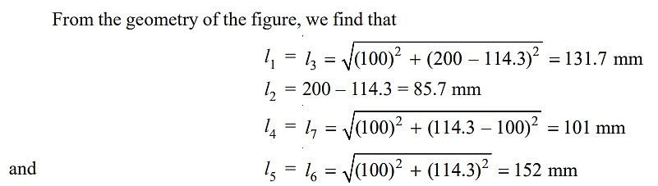
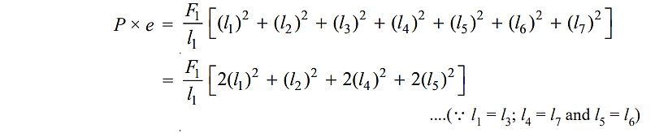

Slide 6
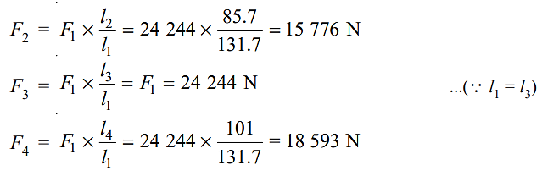
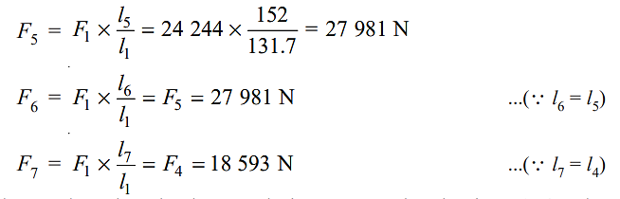

Slide 7
By drawing the direct and secondary shear loads on each rivet, we see that the rivets 3, 4 and 5 are heavily loaded.

Slide 8
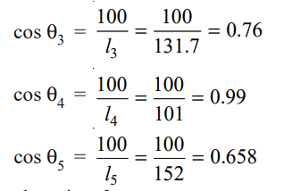
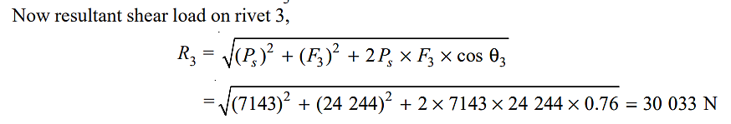
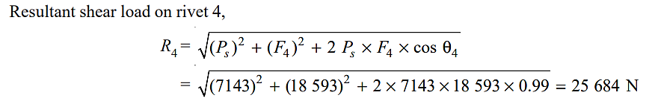

Slide 9
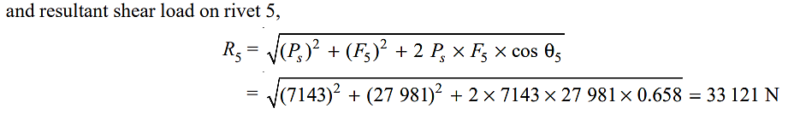
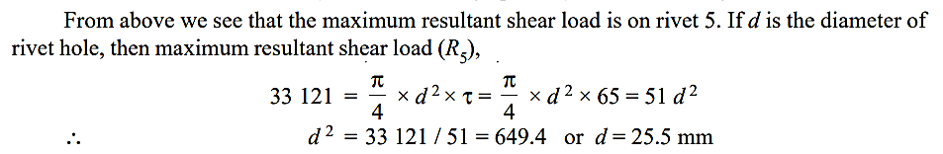

Slide 10
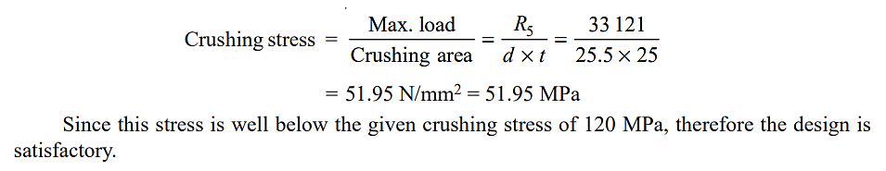
Crushing Force Check

