Slide 1
DESIGN OF MACHINE ELEMENTS-I
BME 2201
Lecture 11 Module 2
Dinesh Kumar
Assistant Professor
School of Engineering
DYPIU

Slide 2
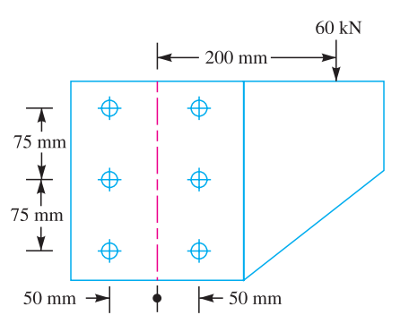
A bracket is riveted to a column by 6 rivets of equal size as shown in Figure. It carries a load of 60 kN at a distance of 200 mm from the centre of the column. If the maximum shear stress in the rivet is limited to 150 MPa, determine the diameter of the rivet.

Slide 6
