Slide 1
DESIGN OF MACHINE ELEMENTS-I
BME 2201
Lecture 12 Module 2
Dinesh Kumar
Assistant Professor
School of Engineering
DYPIU

Slide 2
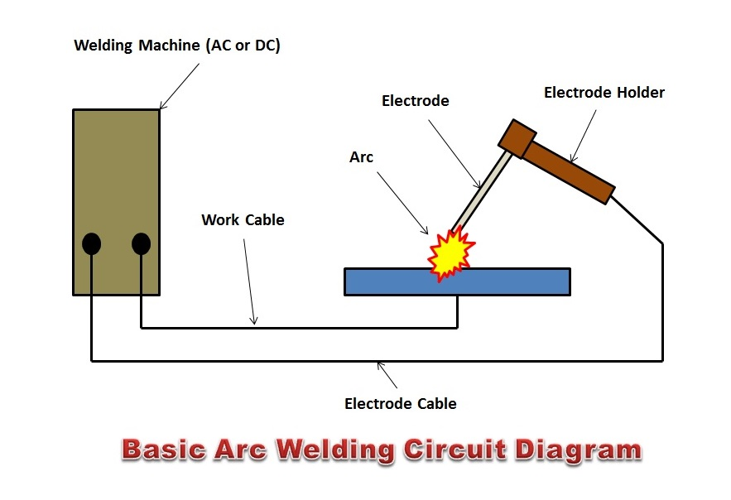
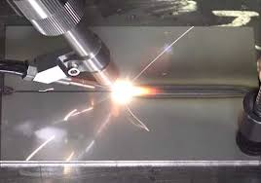
WELDED JOINT
Welding can be deﬁned as a process of joining metallic parts by heating to a suitable temperature with or without the application of pressure. Welding is an economical and efﬁcient method for obtaining a permanent joint of metallic parts.

Slide 3
ADVANTAGES AND DISADVANTAGES OF WELDED JOINTS OVER RIVETED JOINTS
The welded structures are usually lighter than riveted structures. This is due to the reason, that in welding, gussets or other connecting components are not used.
The welded joints provide maximum efficiency (may be 100%) which is not possible in case of riveted joints.
Alterations and additions can be easily made in the existing structures.
As the welded structure is smooth in appearance, therefore it looks pleasing.
In welded connections, the tension members are not weakened as in the case of riveted joints.
A welded joint has a great strength. Often a welded joint has the strength of the parent metal itself.

Slide 4
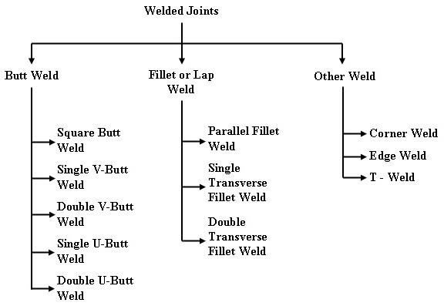

Slide 5
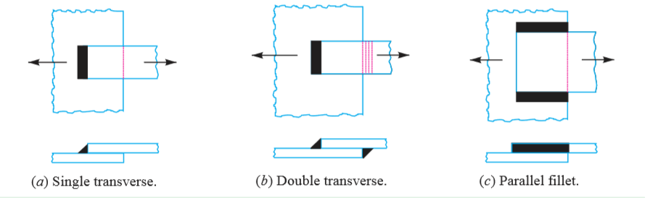
TYPES OF WELDED JOINTS
1. LAP JOINT
The lap joint or the fillet joint is obtained by overlapping the plates and then welding the edges of the plates.
The cross-section of the fillet is approximately triangular. The fillet joints may be
1. Single transverse fillet, 2. Double transverse fillet, and 3. Parallel fillet joints.

Slide 6
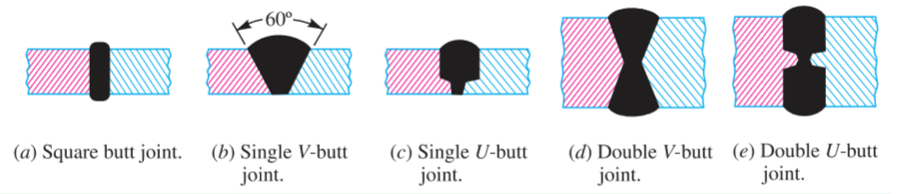
2. BUTT JOINT
The butt joint is obtained by placing the plates edge to edge as shown in Figure
The butt joints may be
1. Square butt joint, 2. Single V-butt joint
3. Single U-butt joint, 4. Double V-butt joint, and 5. Double U-butt joint.

Slide 7
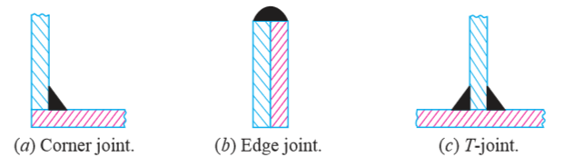
The other type of welded joints are corner joint, edge joint and T-joint

Slide 8
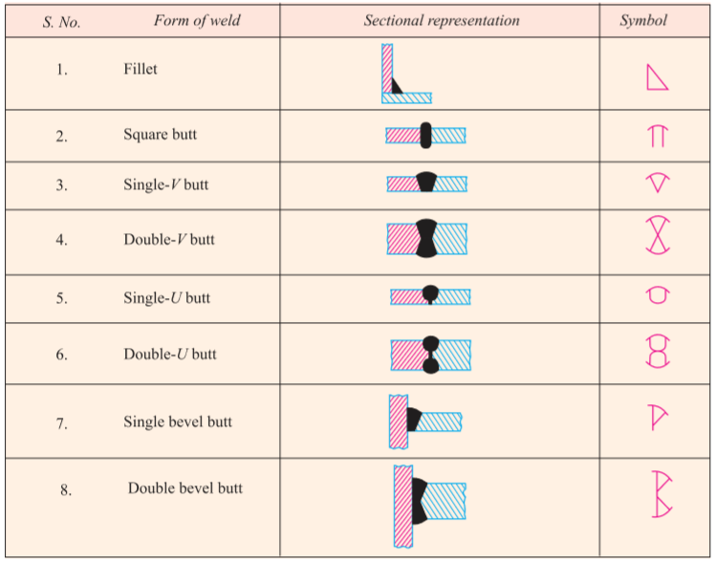
BASIC WELD SYMBOLS

Slide 9
ASSUMPTIONS MADE IN DESIGN OF WELDED JOINTS:
The load distributed uniformly along the
entire length of weld.
The stress is spread over the effective section uniformly.
Suitable stress concentration factors and factors of safety are employed to account for the unknown factors like,
  Change in physical properties due to high rate of cooling.
  Thermal stresses in welds.
  Homogeneity of weld metal.
Proper type of welded joint is used.

Slide 10
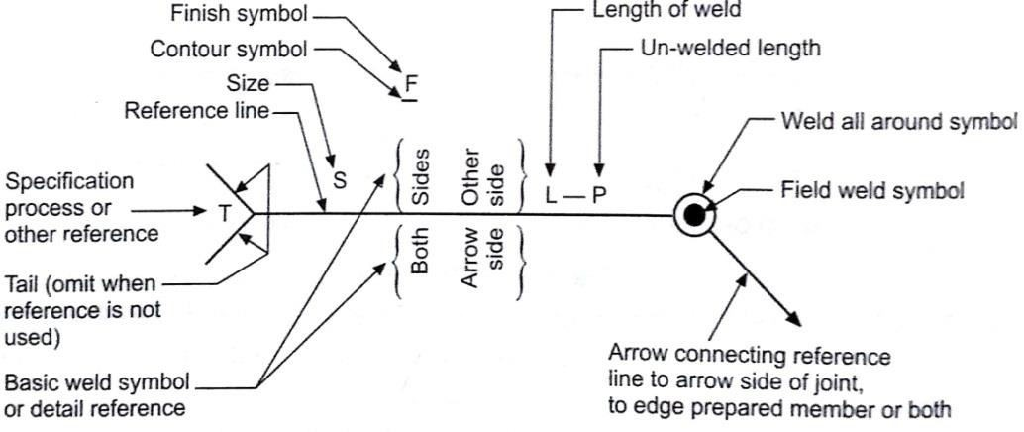
WELDING SYMBOL:

