Slide 1
DESIGN OF MACHINE ELEMENTS-I
BME 2201
Lecture 13 Module 2
Dinesh Kumar
Assistant Professor
School of Engineering
DYPIU

Slide 2
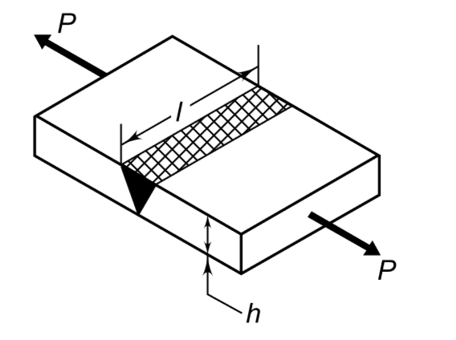
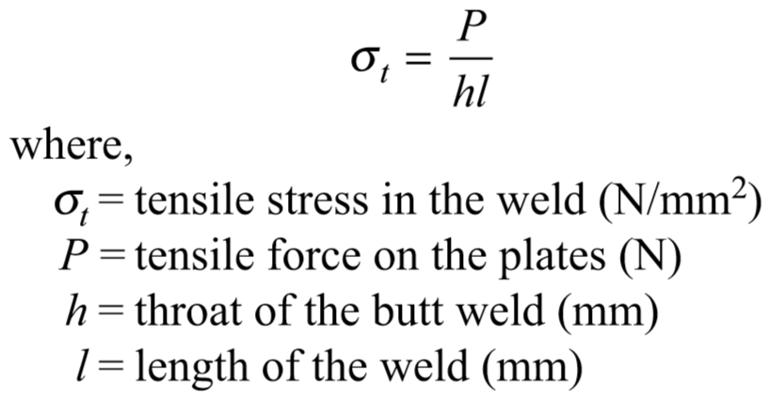
STRENGTH OF BUTT WELDS
A butt welded joint, subjected to tensile force P, is shown in Figure The average tensile stress in the weld is given by
The throat of the weld does not include the bulge or reinforcement. The reinforcement is provided to compensate for ﬂaws in the weld. Equating the throat of the weld h to the plate thickness t

Slide 3
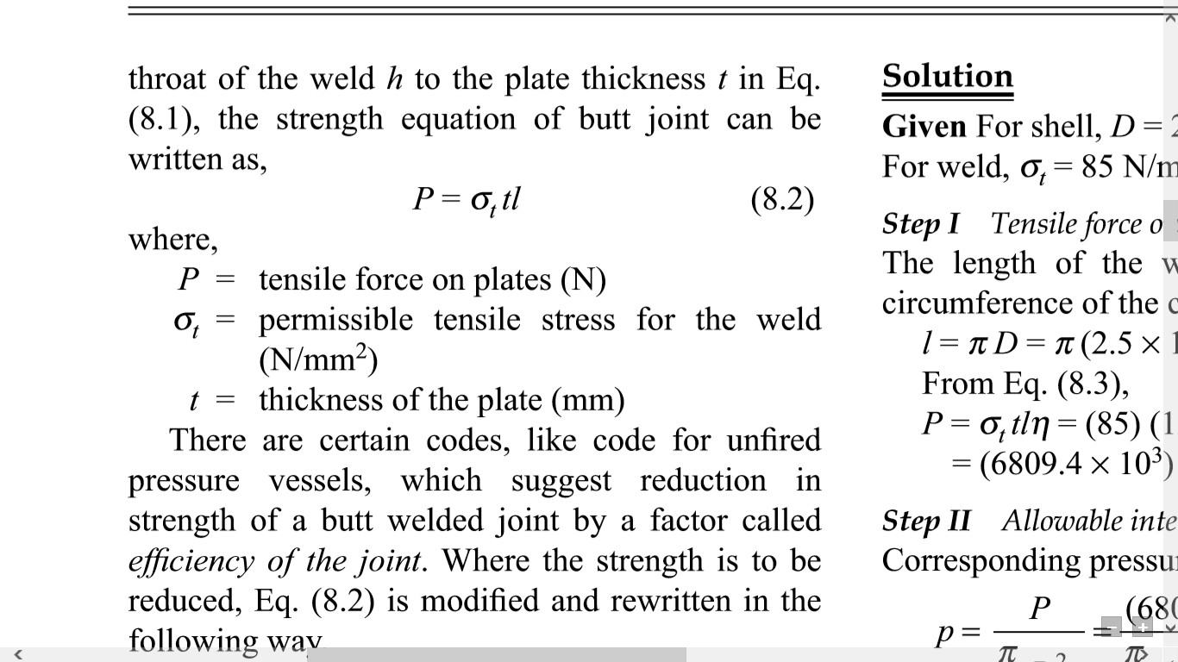

Slide 4
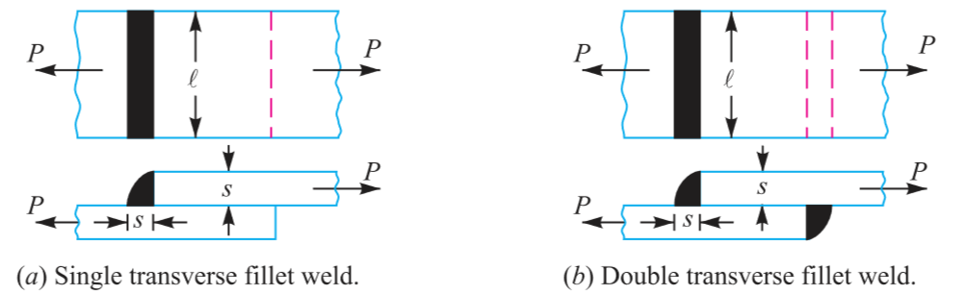
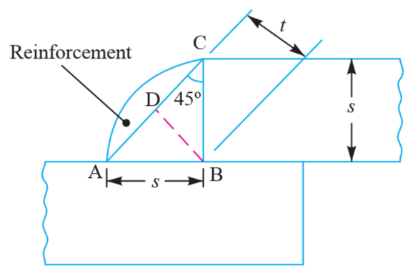
STRENGTH OF TRANSVERSE FILLET WELDED JOINTS
Let t = Throat thickness (BD),
s = Leg or size of weld, = Thickness of plate,
and l = Length of weld,

Slide 5
we find that the throat thickness,
t = s × sin 45° = 0.707 s
∴ *Minimum area of the weld or throat area, A=Throat thickness × Length of weld = t × l = 0.707 s × l
If σ_{t} is the allowable tensile stress for the weld metal, then the tensile strength of the joint for single fillet weld,
P = Throat area × Allowable tensile stress = 0.707 s × l × σ_{t}
and tensile strength of the joint for double fillet weld,
P = 2 × 0.707 s × l × σ_{t} = 1.414 s × l × σ_{t}

Slide 6
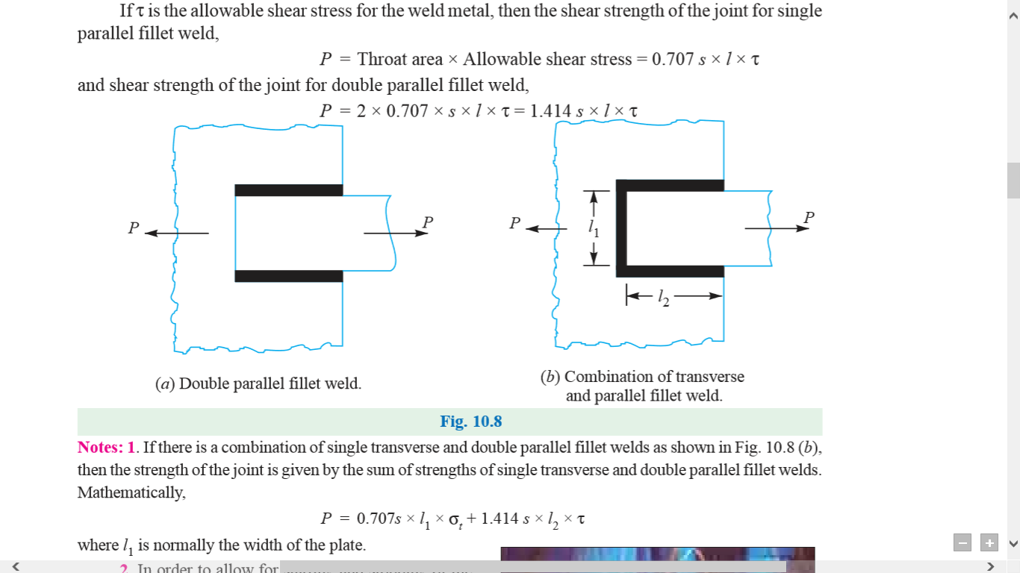
STRENGTH OF PARALLEL FILLET WELDED JOINTS
The minimum area of weld or the throat area,
A = 0.707 s × l
If τ is the allowable shear stress for the weld metal, then the shear strength of the joint for single parallel fillet weld,
P = Throat area × Allowable shear stress = 0.707 s × l × τ

Slide 7
and shear strength of the joint for double parallel fillet weld,
P = 2 × 0.707 × s × l × τ = 1.414 s × l × τ
If there is a combination of single transverse and double parallel fillet welds as shown in Figure (b) then the strength of the joint is given by the sum of strengths of single transverse and double parallel fillet welds. Mathematically,
P = 0.707s × l₁ × σ_{t} + 1.414 s × l₂ × τ

Slide 8
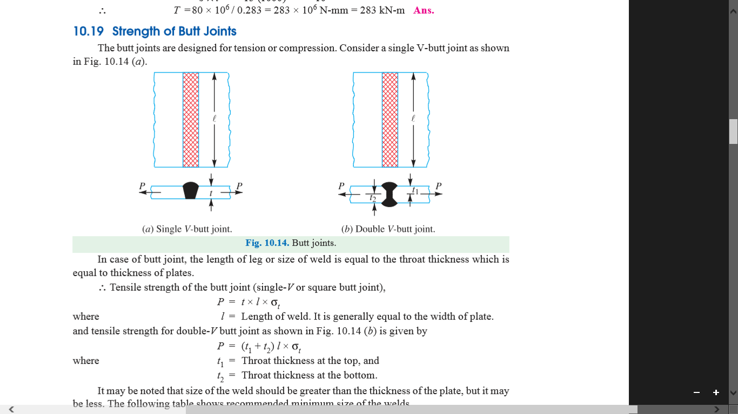
STRENGTH OF BUTT JOINTS
In case of butt joint, the length of leg or size of weld is equal to the throat thickness which is equal to thickness of plates.
∴ Tensile strength of the butt joint (single-V or square butt joint),
P = t × l × σ_{t}
where l = Length of weld. It is generally equal to the width of plate.

Slide 9
and tensile strength for double-V butt joint as shown in Figure is given by
P =( t1 + t2) l × σ_{t}
where t1 = Throat thickness at the top,
and t2 = Throat thickness at the bottom.

