Slide 1
DESIGN OF MACHINE ELEMENTS-I
BME 2201
Lecture 14 Module 2
Dinesh Kumar
Assistant Professor
School of Engineering
DYPIU

Slide 2
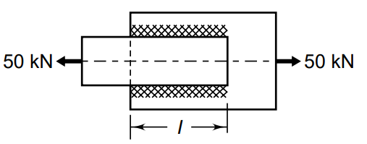
A steel plate, 100 mm wide and 10 mm thick, is welded to another steel plate by means of double parallel fillet welds as shown in Figure. The plates are subjected to a static tensile force of 50 kN. Determine the required length of the welds if the permissible shear stress in the weld is 94 N/mm².

Slide 3
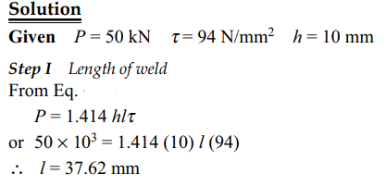
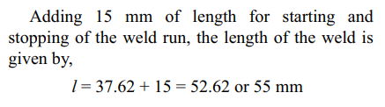

Slide 4
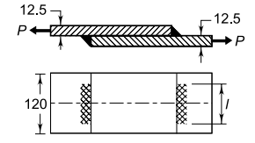
Two steel plates, 120 mm wide and 12.5 mm thick, are joined together by means of double transverse fillet welds as shown in Figure. The maximum tensile stress for the plates and the welding material should not exceed 110 N/mm² . Find the required length of the weld, if the strength of weld is equal to the strength of the plates.

Slide 5
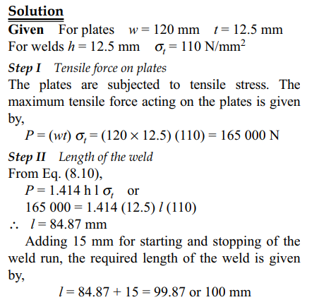

Slide 6
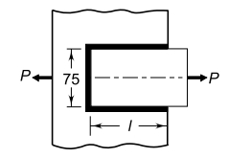
A plate, 75 mm wide and 10 mm thick, is joined with another steel plate by means of single transverse and double parallel fillet welds, as shown in Figure. The joint is subjected to a maximum tensile force of 55 kN. The permissible tensile and shear stresses in the weld material are 70 and 50 N/mm² respectively. Determine the required length of each parallel fillet weld

Slide 7
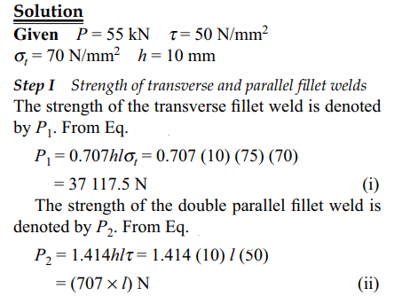

Slide 8
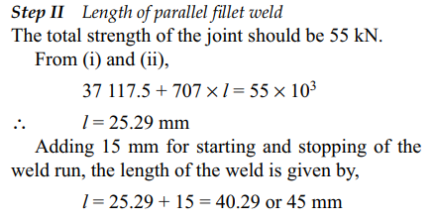

Slide 9
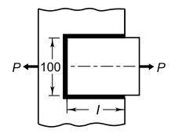
A steel plate, 100 mm wide and 10 mm thick, is joined with another steel plate by means of single transverse and double parallel fillet welds, as shown in Figure. The strength of the welded joint should be equal to the strength of the plates to be joined. The permissible tensile and shear stresses for the weld material and the plates are 70 and 50 N/mm² respectively. Find the length of each parallel fillet weld. Assume the tensile force acting on the plates as static.

Slide 10
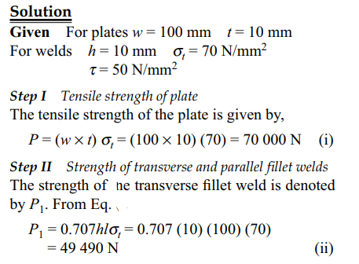

Slide 11
