Slide 1
DESIGN OF MACHINE ELEMENTS-I
BME 2201
Lecture 14.2 Module 2
Dinesh Kumar
Assistant Professor
School of Engineering
DYPIU

Slide 2
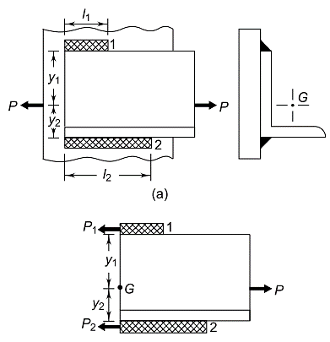
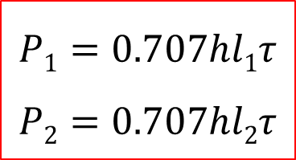
AXIALLY LOADED UNSYMMETRICAL WELDED JOINTS
In some applications, unsymmetrical sections like angles or T-sections are welded to steel plates or beams. For example, an angle section can be attached to a vertical beam using two parallel fillet welds. The external force acting on the joint passes through the section's center of gravity (G), and the welds develop resisting forces to counteract this load. These resisting forces, denoted as P₁​ and P₂​, follow equilibrium equations to ensure structural stability.
$$P1=0.707hl1τ$$
$$P2=0.707hl2τ$$

Slide 3

Since the sum of horizontal forces is equal to zero,
P = P₁ + P₂
Since the moment of forces about the centre of gravity is equal to zero,
P₁ .y₁ = P₂ .y₂
$$0.707hl1τ.y1=0.707hl2τ.y2$$
$$l1y1=l2y2$$
Assuming total length of welds as l,
l₁ + l₂ = l

Slide 4
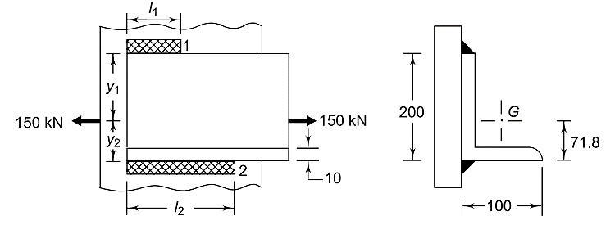
An ISA 200 × 100 × 10 angle is welded to a steel plate by means of fillet welds as shown in Fig. The angle is subjected to a static force of 150 kN and the permissible shear stress for the weld is 70 N/mm². Determine the lengths of weld at the top and bottom.
P = 150 kN t = 70 N/mm² h = 10 mm

Slide 5
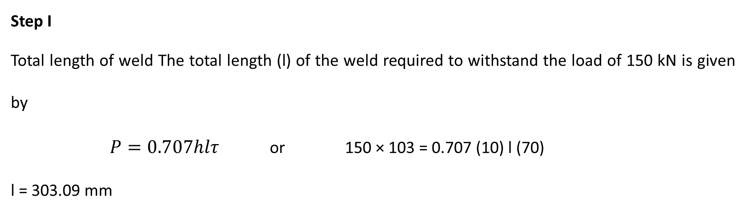
Step I
Total length of weld The total length (l) of the weld required to withstand the load of 150 kN is given by
$P=0.707hlτ$or 150 × 103 = 0.707 (10) l (70)
l = 303.09 mm
Step II Weld lengths l1 and l2
l₁y₁ = l₂y₂ or l₁(200 – 71.8) = l₂ (71.8)
128.2 l₁ = 71.8 l₂
Also, l₁ + l₂ = l = 303.09 mm
l₁ = 108.81 mm and l₂ = 194.28 mm

Slide 6
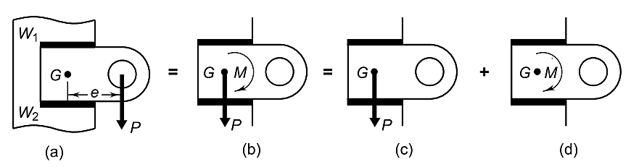

ECCENTRIC LOAD IN THE PLANE OF WELDS
The design of welded joint subjected to an eccentric load in the plane of welds, consists of calculations of primary and secondary shear stresses.
The force P acting through the centre of gravity causes direct shear stress in the welds [Fig. (c) ]It is called the primary shear stress. It is assumed that the primary shear stress is uniformly distributed over the throat area of all welds.

Slide 7
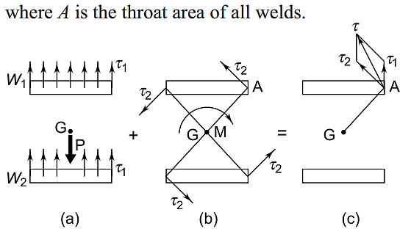

The couple M causes torsional shear stresses in the throat area of welds [Fig. (b)].
They are called secondary shear stresses and given by
where
r = distance of a point in the weld from G
J = polar moment of inertia of all welds about G
The secondary shear stress at any point in the weld is proportional to its distance from the centre of gravity. Obviously, it is maximum at the farthest point such as A. The resultant shear stress at any point is obtained by vector addition of primary and secondary shear stresses

Slide 8
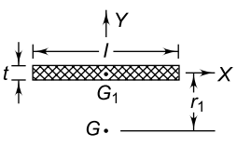
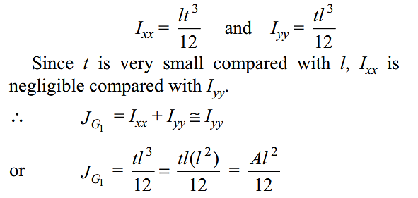
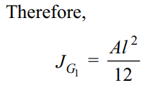
Figure shows a weld of length l and throat t.
G₁ is the centre of gravity of the weld, while
G is the centre of gravity of a group of welds.
The moment of inertia of this weld about its centre of gravity G₁ is given by,

Slide 9



where A is the throat area of the weld and J_{G1} is the polar moment of inertia of the weld about its centre of gravity. The polar moment of inertia about an axis passing through G is determined by the parallel axis theorem.
where r₁ is the distance between G and G₁.
Where there are a number of welds, with polar moment of inertias J₁, J₂, J₃,…, etc., about the centre of gravity G, the resultant polar moment of inertia is given by
The above value of J is to be to determine secondary shear stresses.

Slide 10
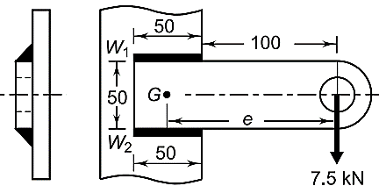


A welded connection, as shown in Figure is subjected to an eccentric force of 7.5 kN. Determine the size of welds if the permissible shear stress for the weld is 100 N/mm². Assume static conditions.
Given
P = 7.5 kN
τ = 100 N/mm²
Step I Primary shear stress
The primary shear stress is given by,
Step II Secondary shear stress

Slide 11
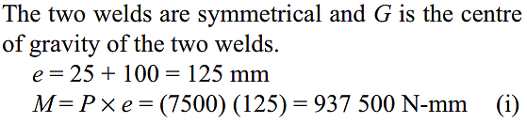
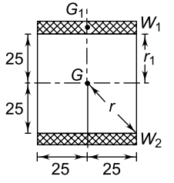

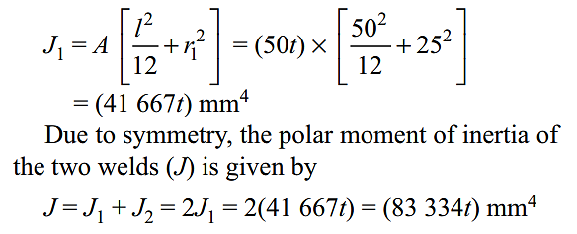
The distance r of the farthest point in the weld from the centre of gravity is given by figure
The polar moment of inertia J₁ of the weld W₁ about G is given by

Slide 12

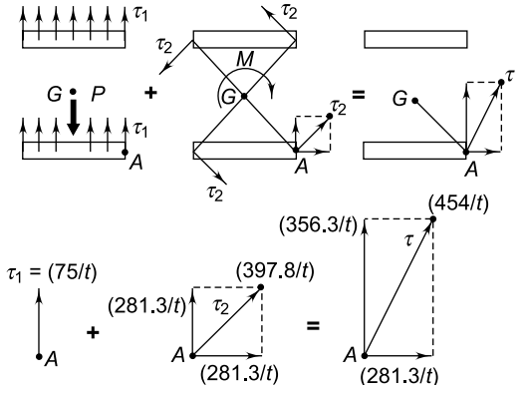

The secondary shear stress is given by
Step III Resultant shear stress
Figure shows the primary and secondary shear stresses. The vertical and horizontal components of these shear stresses are added and the resultant shear stress is determined.

Slide 13
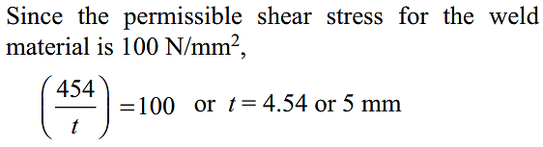
Step IV Size of weld

