Slide 1
DESIGN OF MACHINE ELEMENTS-I
BME 2201
Lecture 15 Module 3
Dinesh Kumar
Assistant Professor
School of Engineering
DYPIU

Slide 2
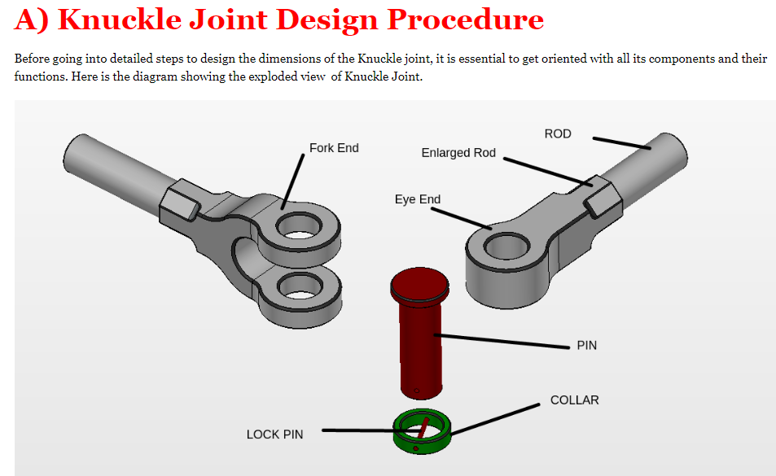

Slide 3
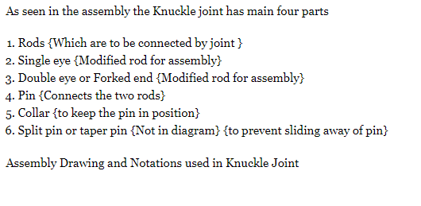

Slide 4
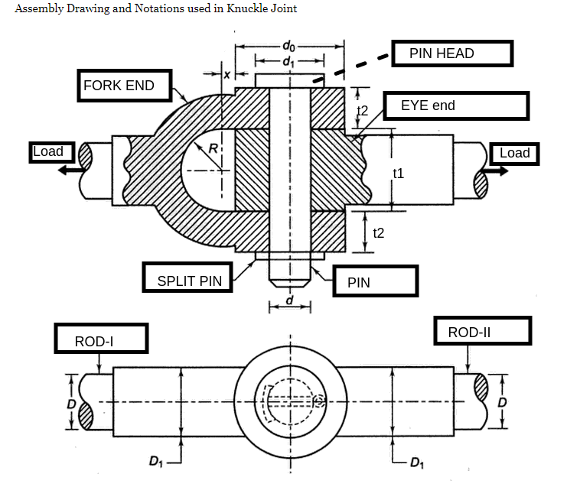
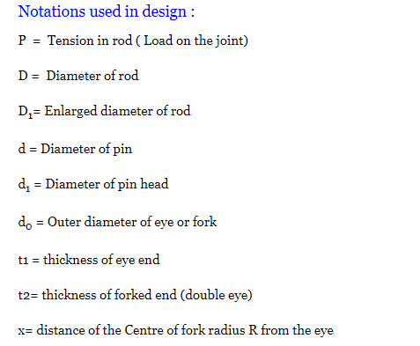

Slide 5
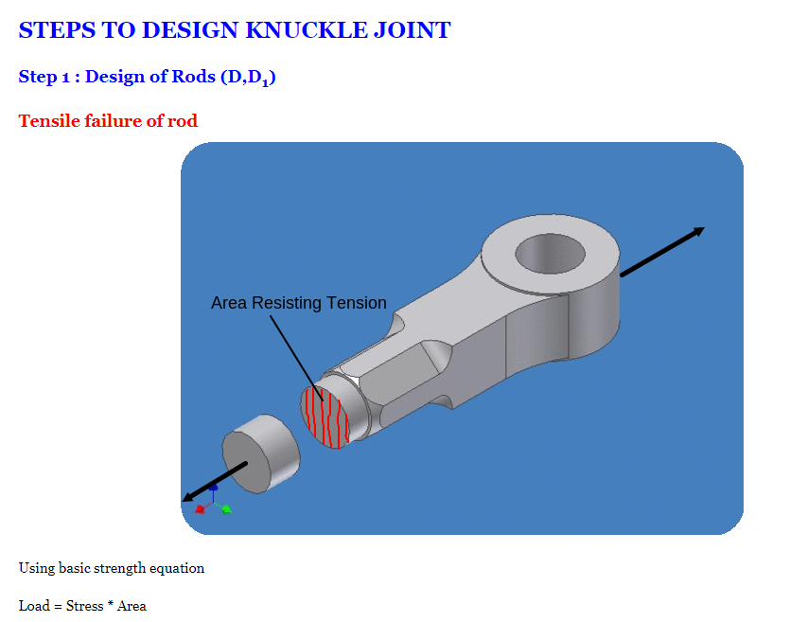

Slide 6
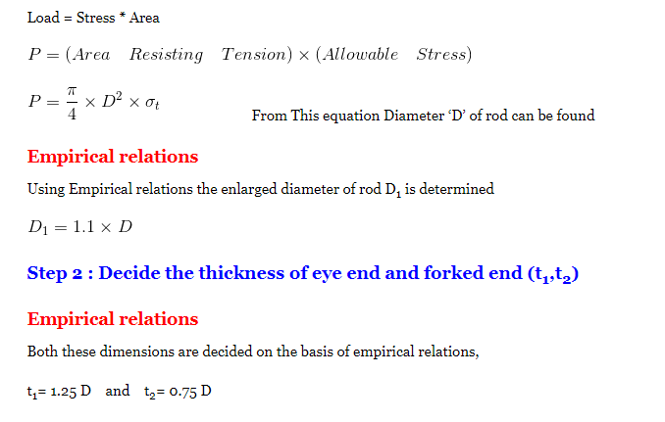

Slide 7
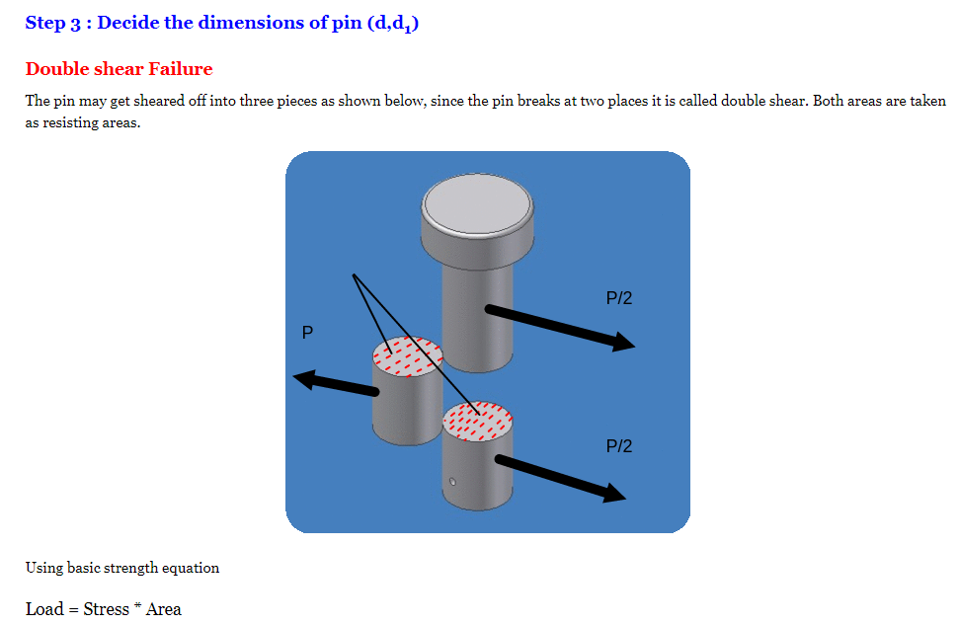

Slide 8
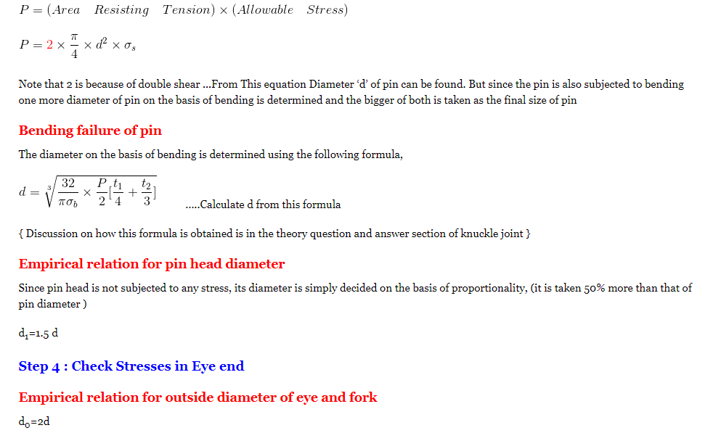

Slide 9
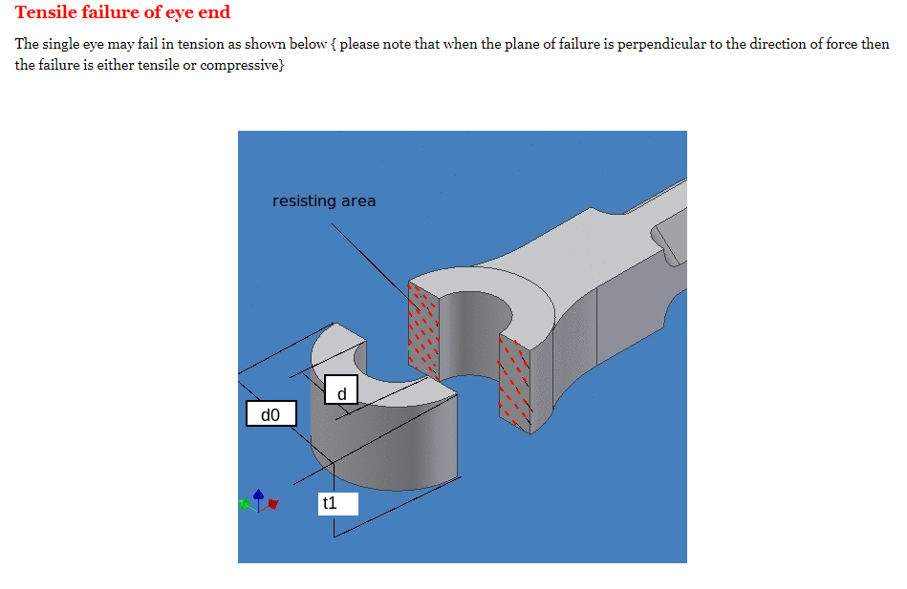

Slide 10
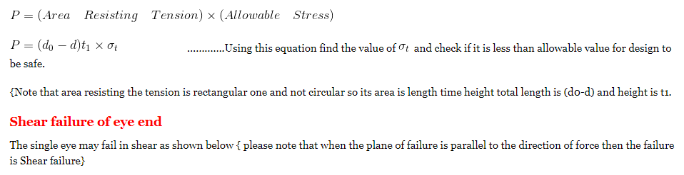

Slide 11
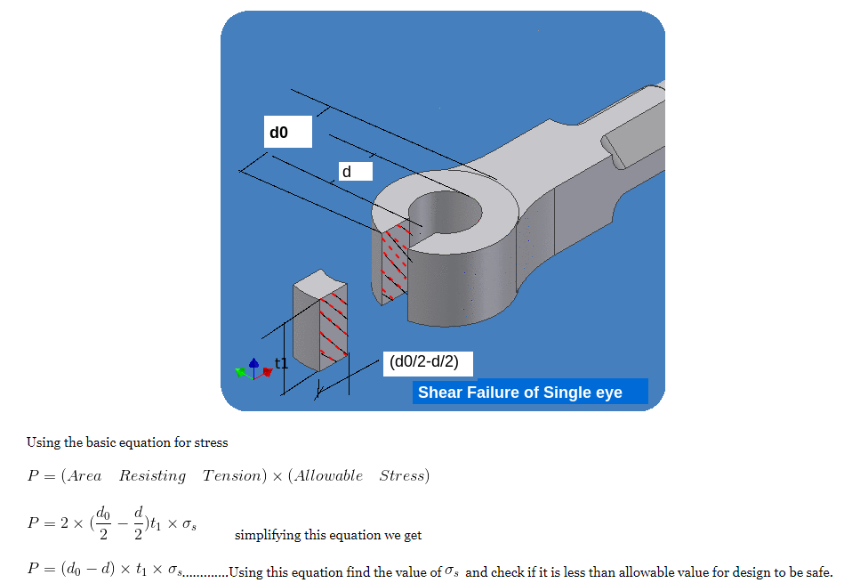

Slide 12
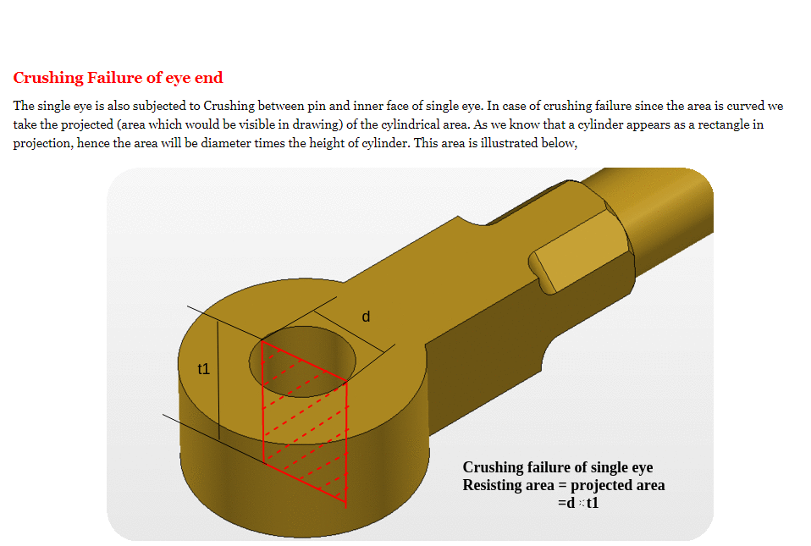

Slide 13
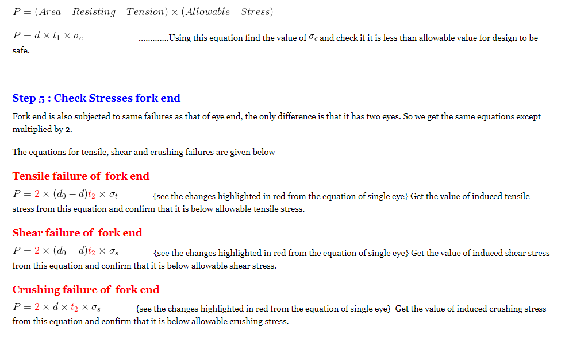

Slide 14
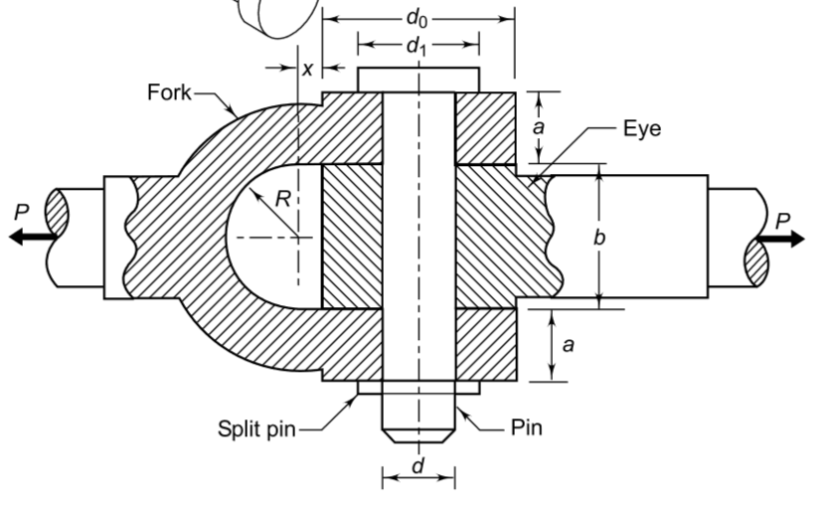

Slide 15
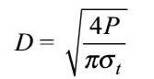
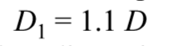
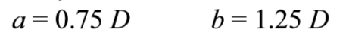
DESIGN OF KNUCKLE JOINT
1. Calculate the diameter of each rod
2. Calculate the enlarged diameter of each rod by empirical relationship
3. Calculate the dimensions a and b by empirical relationship

Slide 16
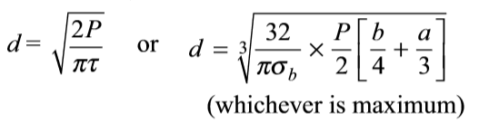
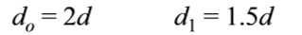
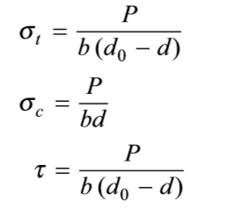
4. Calculate the diameters of the pin by shear consideration and bending consideration and select the diameter, whichever is maximum
5. Calculate the dimensions do and d1 by empirical relationship
6. Check the tensile, crushing and shear stresses in the eye

Slide 17
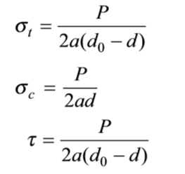
7. Check the tensile, crushing and shear stresses in the fork

