Slide 1
DESIGN OF MACHINE ELEMENTS-I
BME 2201
Lecture 16 Module 3
Dinesh Kumar
Assistant Professor
School of Engineering
DYPIU

Slide 2
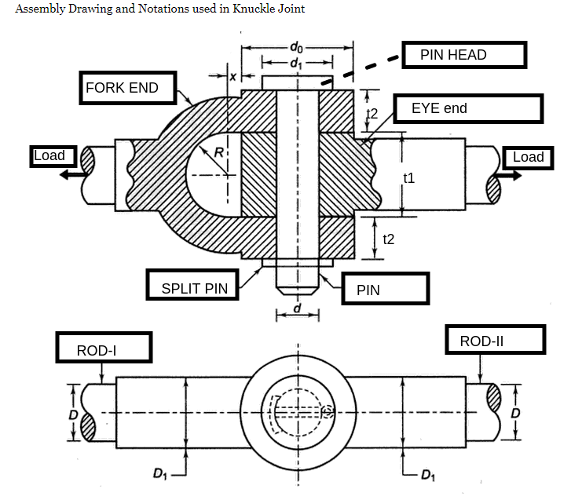
Ex:- It is required to design a knuckle joint to connect two circular rods subjected to an axial tensile force of 50 kN. The rods are co-axial and a small amount of angular movement between their axes is permissible. Design the joint and specify the dimensions of its components. Select suitable materials for the parts.

Slide 3
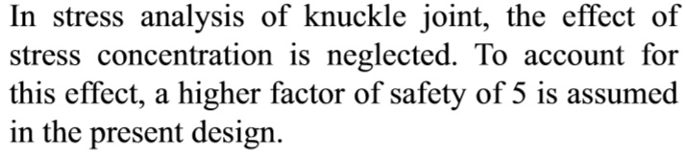
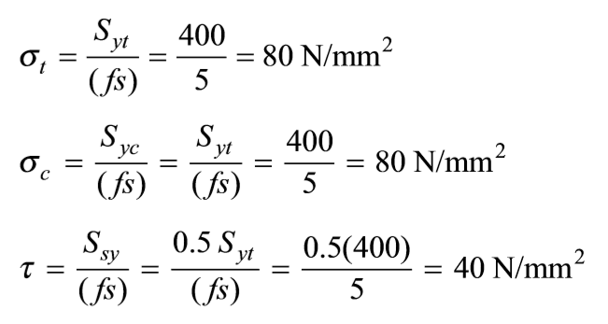

Slide 4
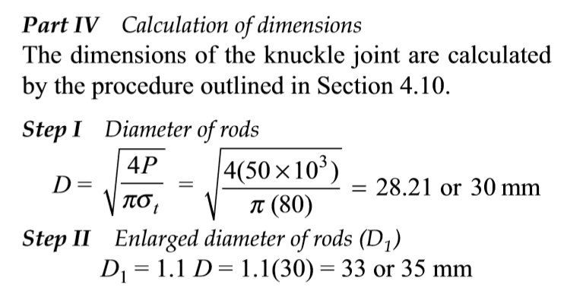
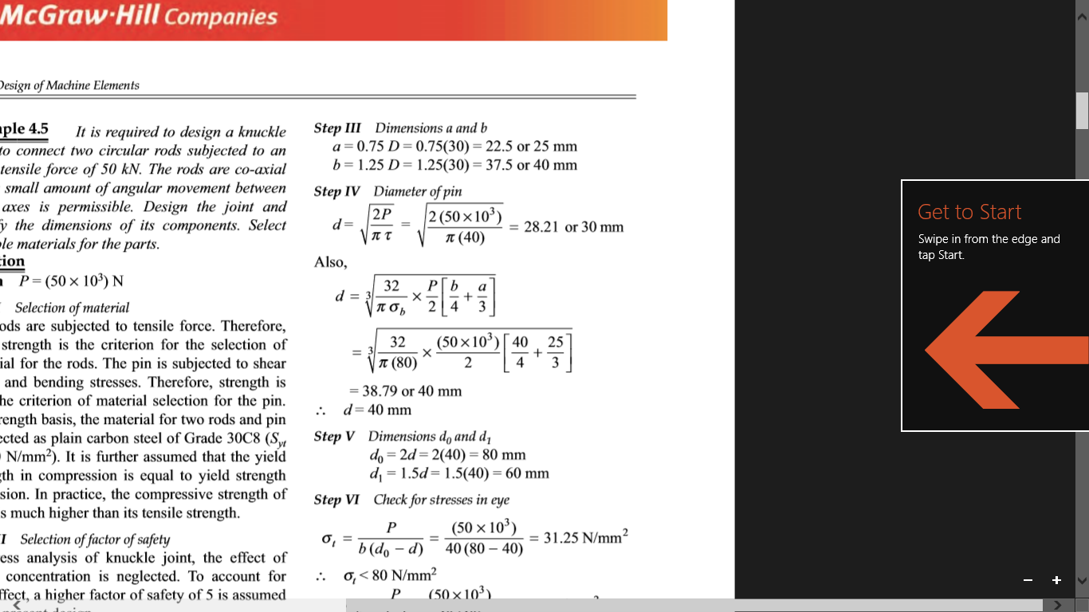

Slide 5
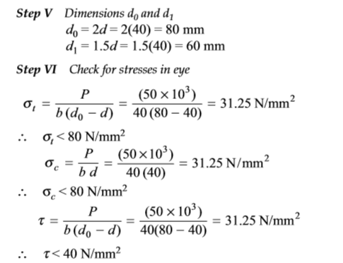

Slide 6
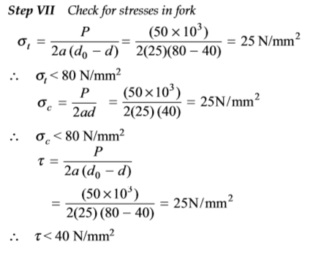
It is observed that stresses are within limits.

Slide 7
Ex:- It is required to design a knuckle joint to connect two circular rods subjected to an axial tensile force of 75 kN. The rods are co-axial and a small amount of angular movement between their axes is permissible. Design the joint and specify the dimensions of its components. The joint is made up of plain carbon steel 30C8 (S_{yt}=360 N/mm²). Take Factor of safety for all parts as 3.

