Slide 1
DESIGN OF MACHINE ELEMENTS-I
BME 2201
Lecture 17 Module 3
Dinesh Kumar
Assistant Professor
School of Engineering
DYPIU

Slide 2
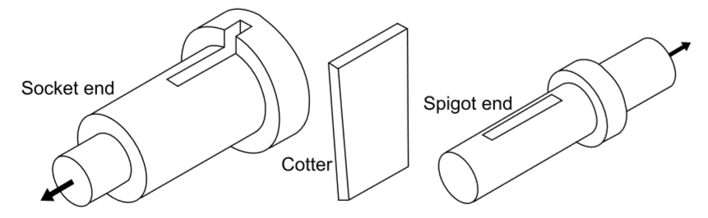
COTTER JOINT
A cotter joint is used to connect two co-axial rods, which are subjected to either axial tensile force or axial compressive force. It is also used to connect a rod on one side with some machine part like a crosshead or base plate on the other side. It is not used for connecting shafts that rotate and transmit torque.

Slide 3
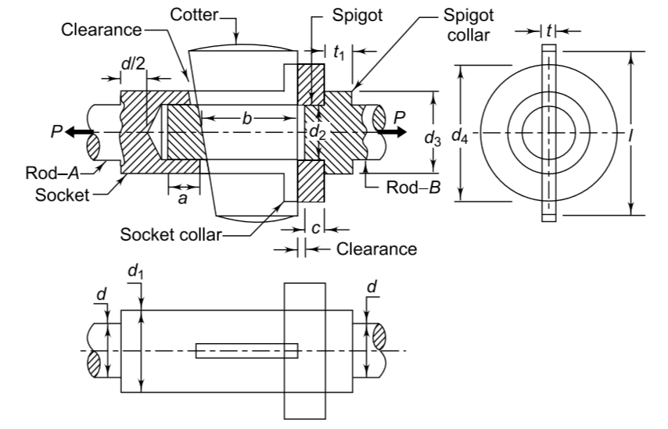
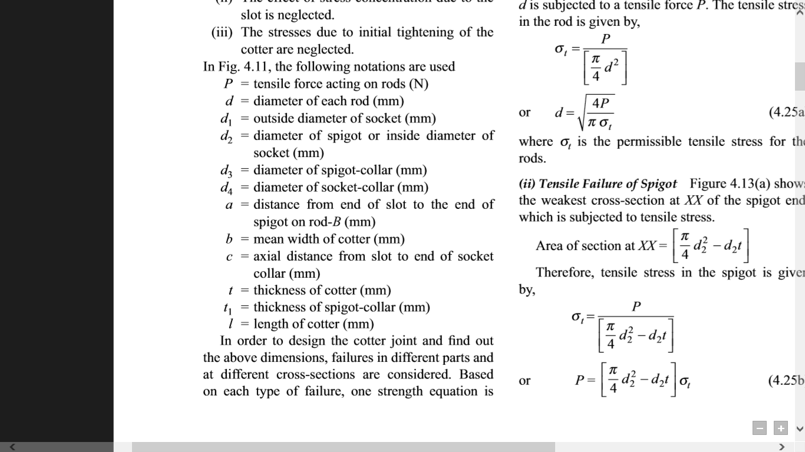

Slide 4
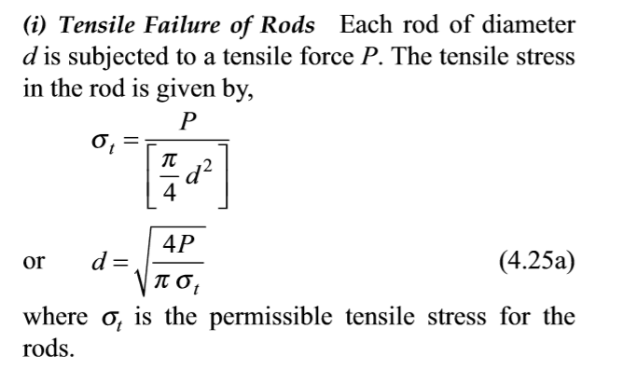
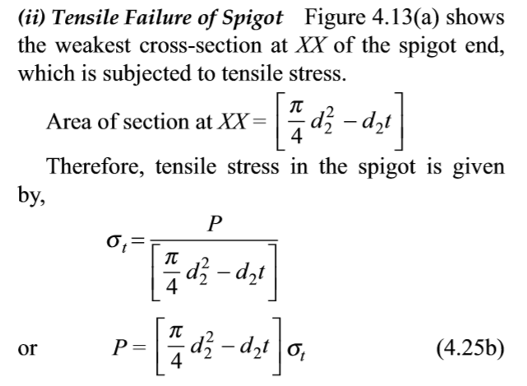

Slide 5
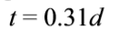
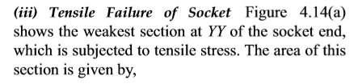
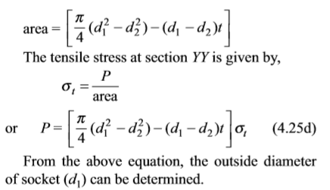
The thickness of the cotter is usually determined by the following empirical relationship,

Slide 6
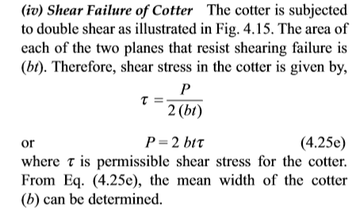
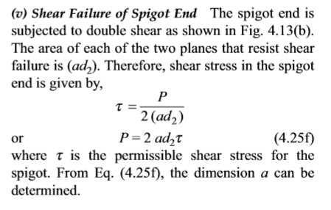

Slide 7
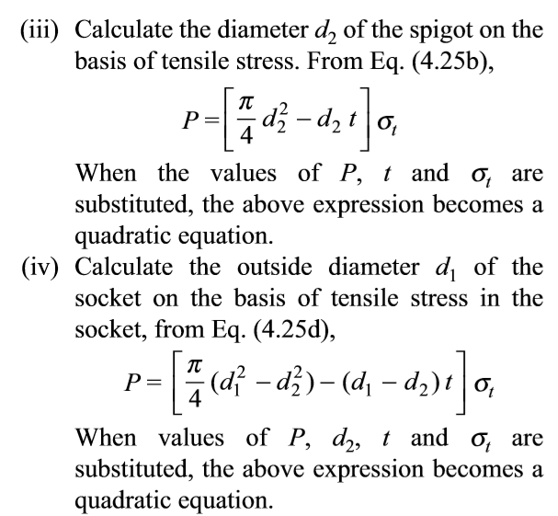
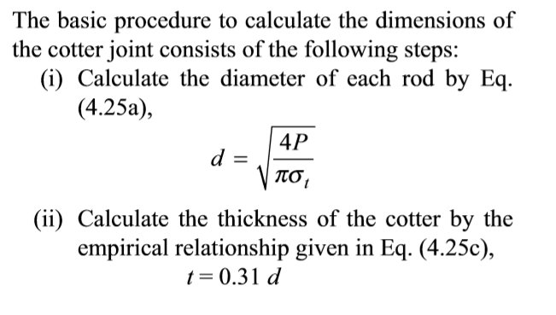
DESIGN PROCEDURE FOR COTTER JOINT

Slide 8
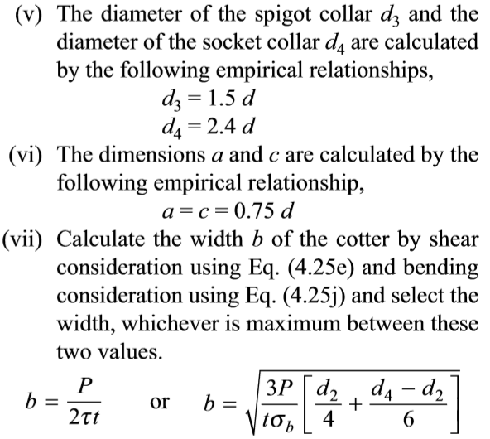
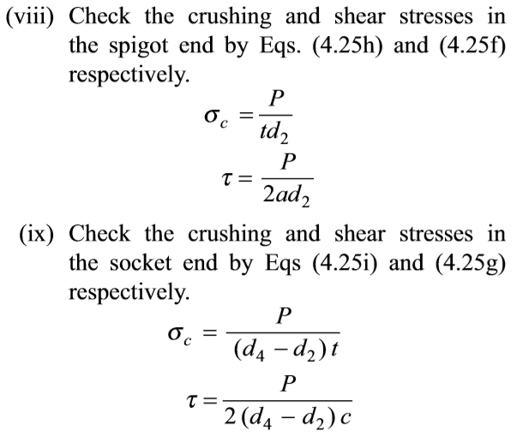

Slide 9
