Slide 1
DESIGN OF MACHINE ELEMENTS-I
BME 2201
Lecture 18 Module 3
Dinesh Kumar
Assistant Professor
School of Engineering
DYPIU

Slide 2
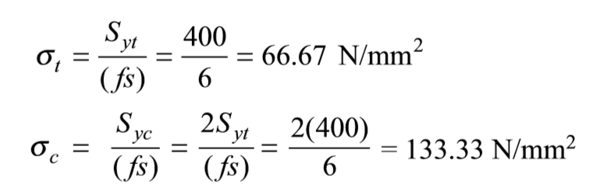
It is required to design a cotter joint to connect two steel rods of equal diameter. Each rod is subjected to an axial tensile force of 50 kN. Design the joint and specify its main dimensions.
Solution. Step-1: The cotter is selected as plain carbon steel of Grade 30C8 (Syt = 400 N/mm2).
Step-2: The factor of safety for the rods, spigot end and socket end is assumed as 6, while for the cotter, it is taken as 4.
Step-3: Calculation of permissible stresses

Slide 3
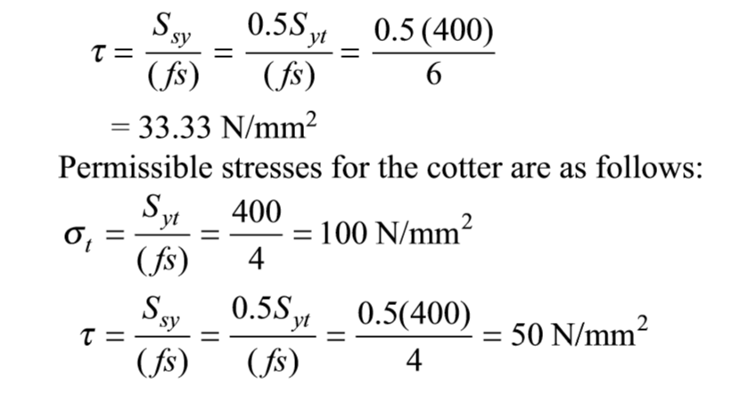

Slide 4
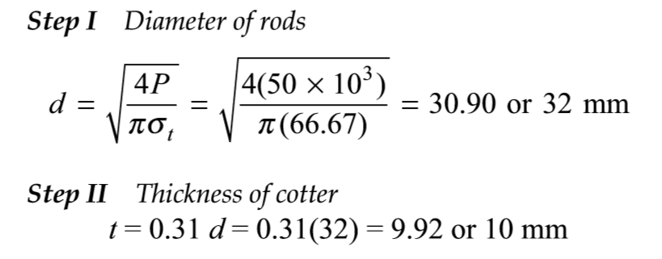
Step-4: Calculation of dimensions

Slide 5
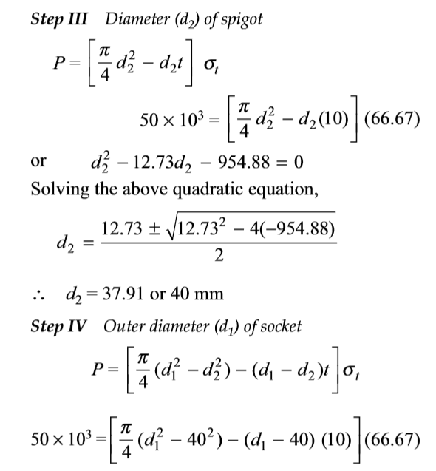

Slide 6
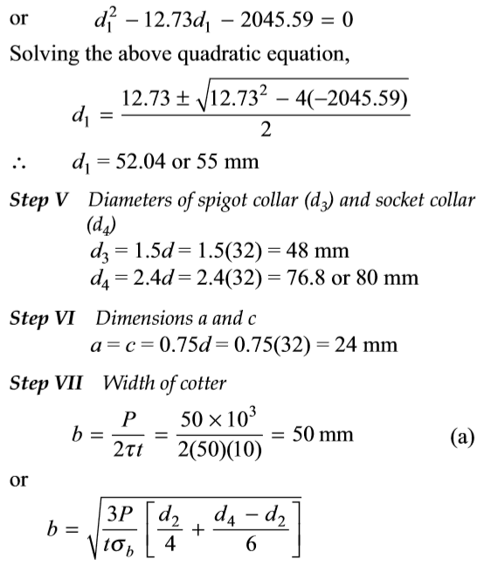

Slide 7
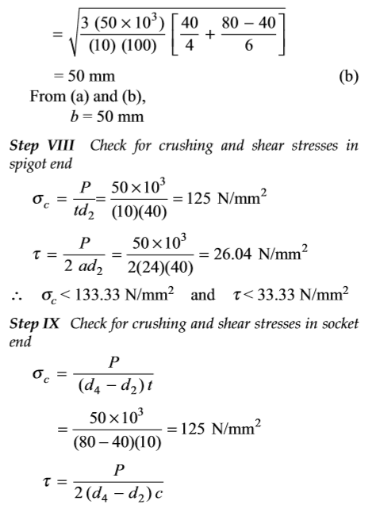

Slide 8
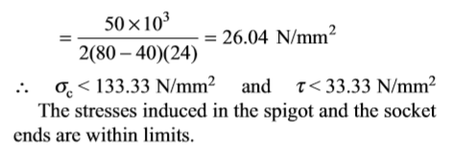
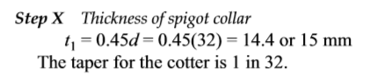

Slide 9
