Slide 1
DESIGN OF MACHINE ELEMENTS-I
BME 2201
Lecture 2 Module 1
Dinesh Kumar
Assistant Professor
School of Engineering
DYPIU

Slide 2
BASIC REQUIREMENTS OF MACHINE ELEMENTS
Machine elements can be classiﬁed into two groups—general-purpose and special-purpose machine elements. General purpose machine elements include shafts, couplings, clutches, bearings, springs, gears and machine frames Special-purpose machine elements include pistons, valves or spindles. Special-purpose machine elements are used only in certain types of applications. On the contrary, general-purpose machine elements are used in a large number of machines.

Slide 3
BASIC REQUIREMENTS OF MACHINE ELEMENTS
Strength 2. Rigidity
3. Wear Resistance 4. Minimum Dimensions and Weight
5. Manufacturability 6. Safety
7. Conformance to Standards 8. Reliability
9. Maintainability 10. Minimum: Life-cycle Cost

Slide 4
BASIC REQUIREMENTS OF MACHINE ELEMENTS
Strength: A machine part should not fail under the effect of the forces that act on it. It should have sufficient strength to avoid failure either due to fracture or due to general yielding.
Rigidity: A machine component should be rigid, that is, it should not deflect or bend too much due to forces or moments that act on it.
Wear Resistance: Wear is the main reason for putting the machine part out of order. It reduces useful life of the component. Wear also leads to the loss of accuracy of machine tools. There are different types of wear such as abrasive wear, corrosive wear and pitting. Surface hardening can increase the wear resistance of the machine components, such as gears and cams.

Slide 5
BASIC REQUIREMENTS OF MACHINE ELEMENTS
Minimum Dimensions and Weight: A machine part should be sufficiently strong, rigid and wear resistant and at the same time, with minimum possible dimensions and weight. This will result in minimum material cost.
Manufacturability: Manufacturability is the ease of fabrication and assembly. The shape and material of the machine part should be selected in such a way that it can be produced with minimum labour cost.

Slide 6
BASIC REQUIREMENTS OF MACHINE ELEMENTS
Safety: The shape and dimensions of the machine parts should ensure safety to the operator of the machine. The designer should assume the worst possible conditions and apply ‘fail-safe’ or ‘redundancy’ principles in such cases.
Conformance to Standards: A machine part should conform to the national or international standard covering its profile, dimensions, grade and material.
Reliability: Reliability is the probability that a machine part will perform its intended functions under desired operating conditions over a specified period of time.

Slide 7
BASIC REQUIREMENTS OF MACHINE ELEMENTS
Maintainability: A machine part should be maintainable. Maintainability is the ease with which a machine part can be serviced or repaired.
Minimum: Life-cycle Cost: Life-cycle cost of the machine part is the total cost to be paid by the purchaser for purchasing the part and operating and maintaining it over its life span.

Slide 8
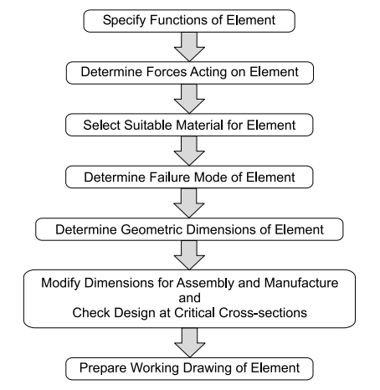
DESIGN OF MACHINE ELEMENTS
Step 1: Specification of Function
The design of machine elements starts by specifying their functions, which include:
Bearing: Supports and confines the motion of a rotating shaft.
Key: Transmits torque between a shaft and its adjoining machine parts.
Spring in Clock: Stores and releases energy for timekeeping.
Spring in Spring Balance: Measures force.
Screw Fastening: Holds together two or more machine parts.
Power Screw: Generates uniform and slow motion while transmitting force.
Basic Procedure of Design of Machine Element

Slide 9
Step 2: Determination of Forces
For force analysis in machine elements, free-body diagrams are constructed. Various external and internal forces are considered:
External force: from energy, power, or torque transmission.
Static force: due to the deadweight of the machine part.
Frictional resistance force.
Inertia force: resulting from changes in velocity.
Centrifugal force: due to changes in velocity direction.
Thermal gradient force and residual stress force also play roles, depending on the application.

Slide 10
Step 3: Selection of Material
Material selection in engineering considers availability, cost, mechanical properties, and manufacturing ease. For complex-shaped components like flywheels or gearbox housings, cast iron is preferred due to its casting process. Transmission shafts use plain carbon steels for their availability and strength. Automobile bodies use low carbon steels for cold formability. Free cutting steels, with added sulphur, are suitable for easily machinable parts like bolts. Components enduring fluctuating forces, such as crankshafts, utilize nickel-chromium steel for its high fatigue strength.

Slide 11
Step 4: Failure Criterion
Prior to dimensioning components, understanding potential failure modes is crucial. Three primary types of failure are elastic deflection, general yielding, and fracture. For instance, in transmission shafts supporting gears, excessive deflection disrupts gear meshing, leading to elastic deflection failure. Ductile materials like steel may fail due to yielding, whereas brittle materials like cast iron may experience sudden fracture. Gear-tooth failure modes include breakage and surface pitting, indicative of surface fatigue. Ball bearing components may fail from fatigue cracks, while sliding contact bearings may suffer from corrosion and abrasive wear by foreign particles.

Slide 12
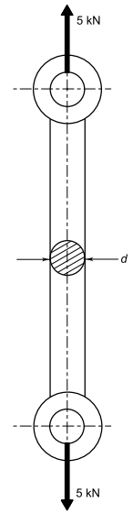
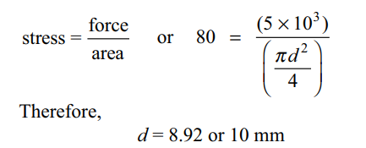
Step 5: Determination of Dimensions
The shape of the machine element depends on two factors, viz., the operating conditions and the shape of the adjoining machine element. Permissible tensile stress is 80 N/mm2.

Slide 13
Step 6: Working Drawing
The last design step entails creating a comprehensive working drawing for the machine element, detailing dimensions, tolerances, surface finish grades, and special production requirements like heat treatment. It must be clear, concise, and include ample views and cross-sections to depict all details accurately. The main view should show the element's service position, with every dimension specified to avoid guesswork or scaling. Critical dimensions for assembly and interchangeability must be accompanied by tolerances to ensure precision.

