Slide 1
DESIGN OF MACHINE ELEMENTS-I
BME 2201
Lecture 22 Module 4
Dinesh Kumar
Assistant Professor
School of Engineering
DYPIU

Slide 2
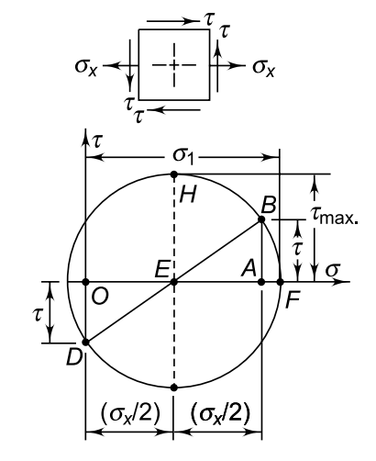
SHAFT SUBJECTED TO BENDING AND TWISTING MOMENT
When the shaft is subjected to combination of loads, the principal stress and principal shear stress are obtained by constructing Mohr’s circle as shown in the figure. The normal stress is denoted by σ_{x} while the shear stress, by τ.

Slide 3
σ_{x}/2
σ_{x}/2
B
τ
O
E
A
τ
D
σ_{x}

Slide 4
