Slide 1
DESIGN OF MACHINE ELEMENTS-I
BME 2201
Lecture 25 Module 5
Dinesh Kumar
Assistant Professor
School of Engineering
DYPIU

Slide 2
SHAFT COUPLING
Shafts are usually available up to 7 metres length due to inconvenience in transport. In order to have a greater length, it becomes necessary to join two or more pieces of the shaft by means of a coupling.
Shaft couplings are used in machinery for several purposes, the most common of which are the following : 1. To provide for the connection of shafts of units that are manufactured separately such as a motor and generator and to provide for disconnection for repairs or alternations.
2. To provide for misalignment of the shafts or to introduce mechanical flexibility.
3. To reduce the transmission of shock loads from one shaft to another.
4. To introduce protection against overloads.
5. It should have no projecting parts.

Slide 3
REQUIREMENTS OF A GOOD SHAFT COUPLING
A good shaft coupling should have the following requirements :
It should be easy to connect or disconnect.
It should transmit the full power from one shaft to the other shaft without losses.
It should hold the shafts in perfect alignment.
It should reduce the transmission of shock loads from one shaft to another shaft.
It should have no projecting parts.

Slide 4
TYPES OF SHAFTS COUPLINGS
Shaft couplings are divided into two main groups as follows :
Rigid coupling. It is used to connect two shafts which are perfectly aligned. Following types of rigid coupling are important from the subject point of view :
(a) Sleeve or muff coupling.
(b) Clamp or split-muff or compression coupling, and
(c) Flange coupling.
2. Flexible coupling. It is used to connect two shafts having both lateral and angular misalignment. Following types of flexible coupling are important from the subject point of view :
(a) Bushed pin type coupling,
(b) Universal coupling, and
(c) Oldham coupling.

Slide 5
Rigid Coupling

Slide 6
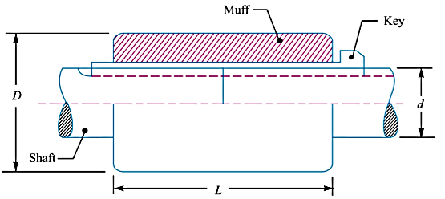
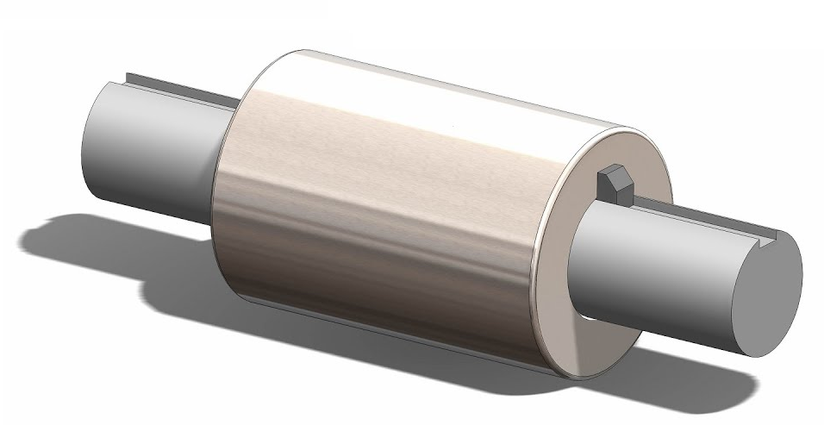
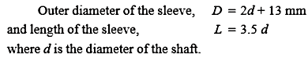
SLEEVE OR MUFF-COUPLING
It is the simplest type of rigid coupling, made of cast iron. It consists of a hollow cylinder whose inner diameter is the same as that of the shaft. It is fitted over the ends of the two shafts by means of a gib head key,

Slide 7
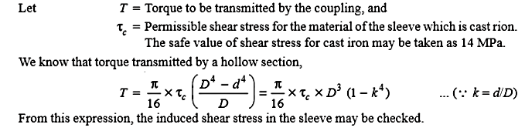
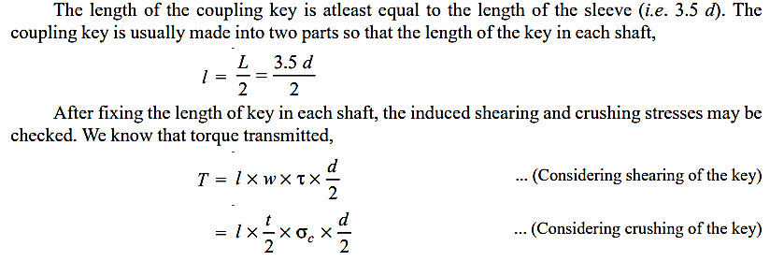

Slide 8
Design and make a neat dimensioned sketch of a muff coupling which is used to connect two steel shafts transmitting 40 kW at 350 r.p.m. The material for the shafts and key is plain carbon steel for which allowable shear and crushing stresses may be taken as 40 MPa and 80 MPa respectively. The material for the muff is cast iron for which the allowable shear stress may be assumed as 15 MPa.
Given :
P = 40 kW = 40 × 10³ W;
N = 350 r.p.m.;
τ_{s} = 40 MPa = 40 N/mm2;
σ_{cs} = 80 MPa = 80 N/mm2;
τ_{c} = 15 MPa = 15 N/mm2

Slide 9
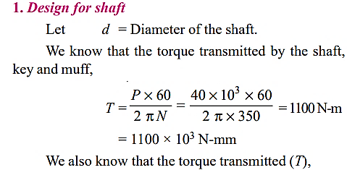
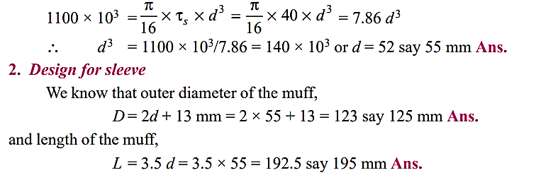

Slide 10
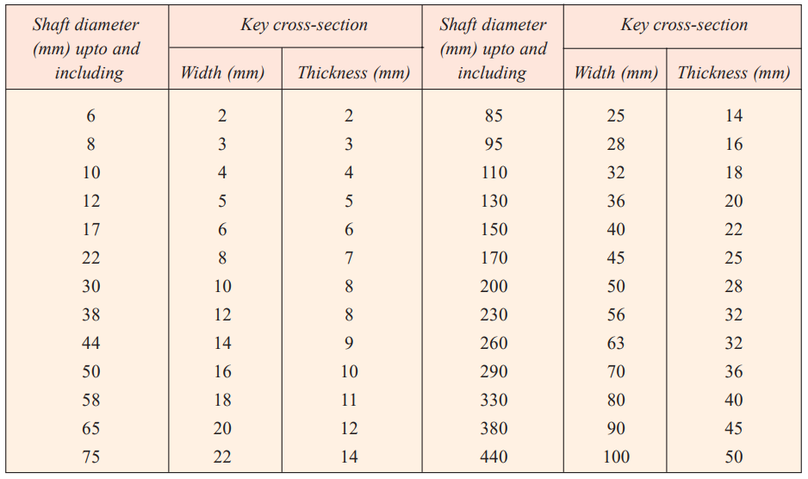
Table 13.1

Slide 11
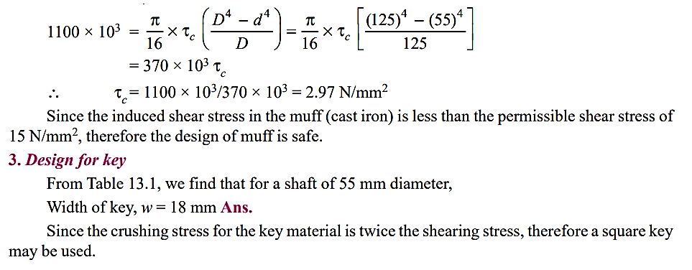
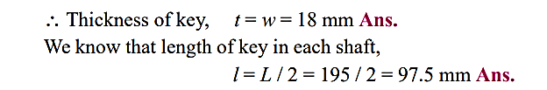

Slide 12
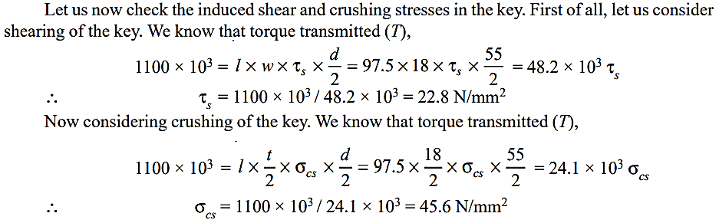


Slide 13
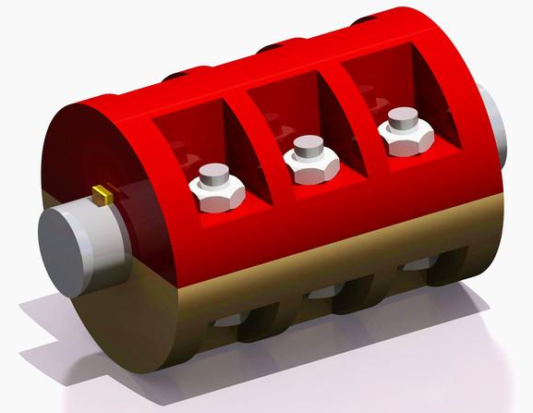
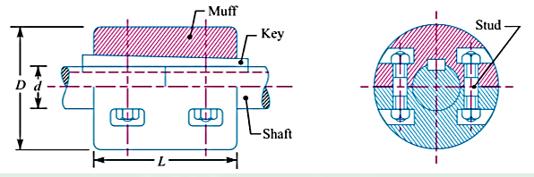
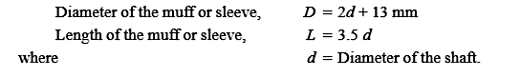
CLAMP OR COMPRESSION COUPLING
It is also known as split muff coupling. In this case, the muff or sleeve is made into two halves and are bolted together

Slide 14
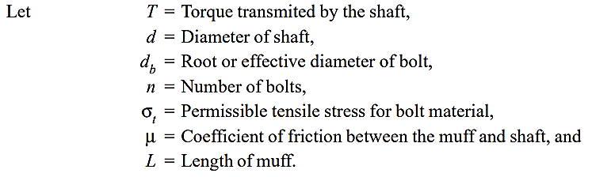
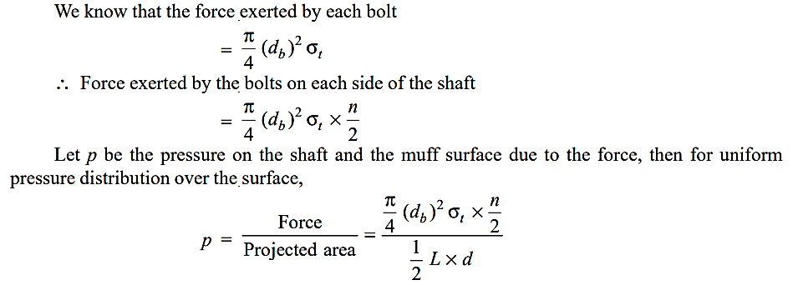
DESIGN OF CLAMP OR COMPRESSION COUPLING

Slide 15
