Slide 1
DESIGN OF MACHINE ELEMENTS-I
BME 2201
Lecture 3 Module 1
Dinesh Kumar
Assistant Professor
School of Engineering
DYPIU

Slide 2
USE OF STANDARDS IN DESIGN
Standardization is deﬁned as obligatory norms, to which various characteristics of a product should conform. The characteristics include materials, dimensions and shape of the component, method of testing and method of marking, packing and storing of the product.
Standards for Materials, their Chemical Compositions, Mechanical Properties and Heat Treatment
Standards for Shapes and Dimensions of Commonly used Machine Elements
Standards for Fits, Tolerances and Surface Finish of Component
Standards for Testing of Products
Standards for Engineering Drawing of Components

Slide 3
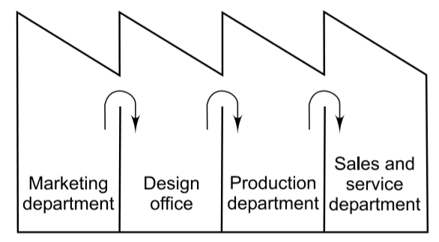
CONCURRENT ENGINEERING
Conventional design process is sequential, where the main activities are executed in a sequence as shown in Figure. In the sequential design process, the production department suggests a number of design modiﬁcations, after the design is ﬁnalised
Sequential Design Process

Slide 4
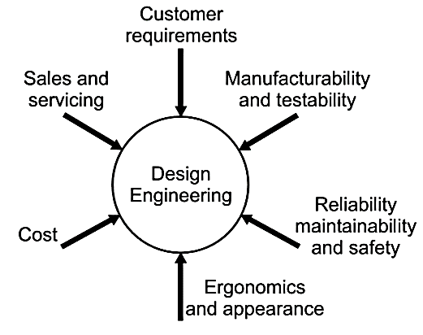
CONCURRENT ENGINEERING
Concurrent engineering is deﬁned as the design process that brings both design and manufacturing engineers together during the early phases of design process. In this process, a team of specialists examines the design from different angles as shown in Figure.
In concurrent engineering, where various activities are carried out in parallel, instead of in series. The trend is to bring the design and manufacturing activities together as a single engineering discipline.

Slide 5
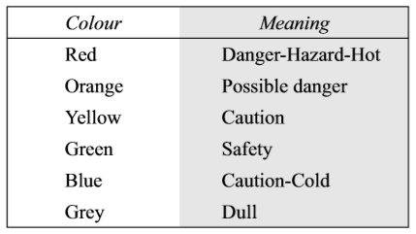
AESTHETIC CONSIDERATIONS IN DESIGN
There are a number of products in the market having the same qualities of efﬁciency, durability and cost, the customer is attracted towards the most appealing product.
The external appearance of the product does not depend upon only the two factors of form and colour. It is a cumulative effect of a number of factors such as rigidity and resilience, tolerances and surface ﬁnish, motion of individual components, materials, manufacturing methods and noise.

Slide 6
ERGONOMIC CONSIDERATIONS IN DESIGN
Ergonomics is deﬁned as the relationship between man and machine and the application of anatomical, physiological and psychological principles to solve the problems arising from man–machine relationship.
From design considerations, the topics of ergonomic studies are as follows:
Anatomical factors in the design of a driver’s seat
Layout of instrument dials and display panels for accurate perception by the operators
Design of hand levers and hand wheels
Energy expenditure in hand and foot operations

Slide 7
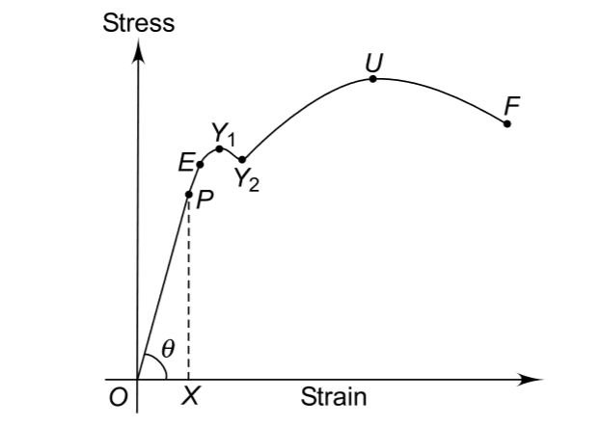
MECHANICAL PROPERTIES OF ENGINEERING MATERIALS
The mechanical properties of materials are the properties that describe the behaviour of the material under the action of external forces. They usually relate to elastic and plastic behaviour of the material. Mechanical properties are of signiﬁcant importance in the selection of material for structural machine components.
Stress–Strain Diagram of Ductile Materials

Slide 8
Strength
hardness
elasticity
brittleness
plasticity
Mechanical Properties
ductility
stiffness
malleability
resilience
toughness

Slide 9
MECHANICAL PROPERTIES OF ENGINEERING MATERIALS
Strength is deﬁned as the ability of the material to resist, without rupture, external forces causing various types of stresses.
Elasticity is deﬁned as the ability of the material to regain its original shape and size after the deformation, when the external forces are removed.
Plasticity is deﬁned as the ability of the material to retain the deformation produced under the load on a permanent basis.

Slide 10
MECHANICAL PROPERTIES OF ENGINEERING MATERIALS
Stiffness or rigidity is deﬁned as the ability of the material to resist deformation under the
action of an external load.
Resilience is deﬁned as the ability of the material to absorb energy when deformed elastically and to release this energy when unloaded.
Toughness is deﬁned as the ability of the material to absorb energy before fracture takes place.

Slide 11
MECHANICAL PROPERTIES OF ENGINEERING MATERIALS
Malleability is deﬁned as the ability of a material to deform to a greater extent before the sign of crack, when it is subjected to compressive force.
Ductility is deﬁned as the ability of a material to deform to a greater extent before the sign of crack, when it is subjected to tensile force.
Brittleness is the property of a material which shows negligible plastic deformation before fracture takes place.
Hardness is deﬁned as the resistance of the material to penetration or permanent deformation.

