Slide 1
DESIGN OF MACHINE ELEMENTS-I
BME 2201
Lecture 6 Module 2
Dinesh Kumar
Assistant Professor
School of Engineering
DYPIU

Slide 2
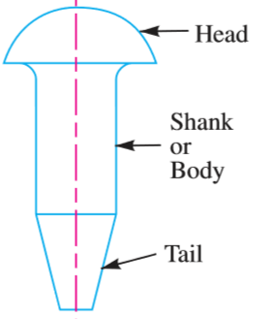
RIVET
A rivet is a short cylindrical bar with a head integral to it. The cylindrical portion of the rivet is called shank or body and lower portion of shank is known as tail
The rivets are used to make permanent fastening between the plates such as in structural work, ship building, bridges, tanks and boiler shells. The riveted joints are widely used for joining light metals.

Slide 3
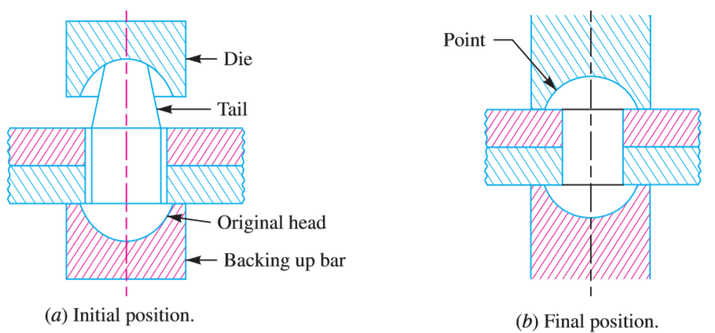
METHODS OF RIVETING

Slide 4
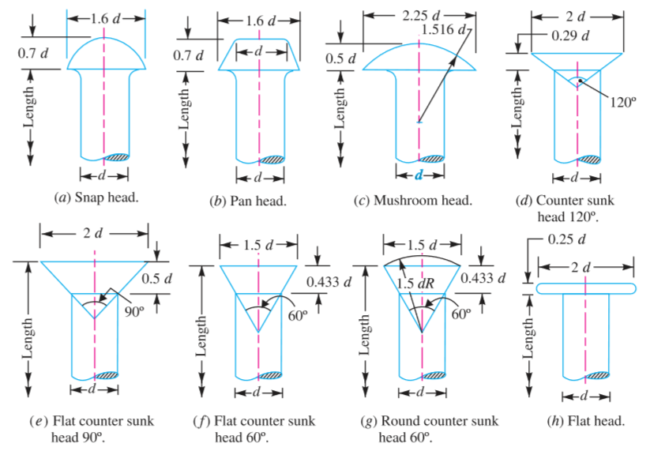
TYPES OF RIVET HEADS

Slide 5
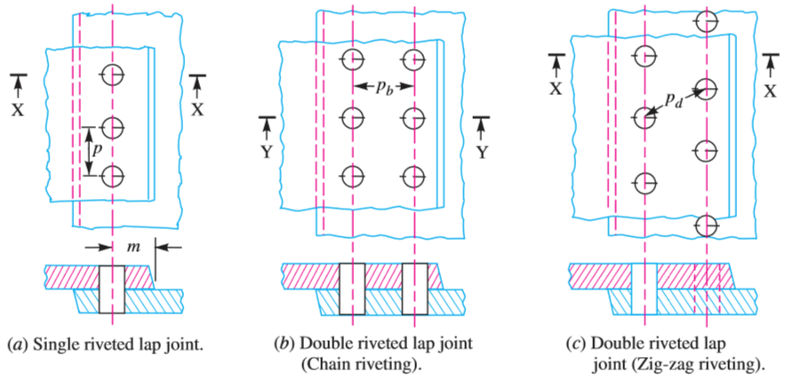
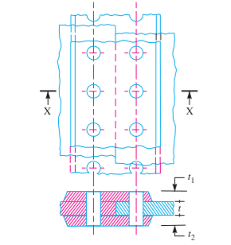
TYPES OF RIVETED JOINTS
Lap joint
A lap joint is that in which one plate overlaps the other and the two plates are then riveted together.
2. Butt joint.
A butt joint is that in which the main plates are kept in alignment butting (i.e. touching) each other and a cover plate (i.e. strap) is placed either on one side or on both sides of the main plates.

Slide 6
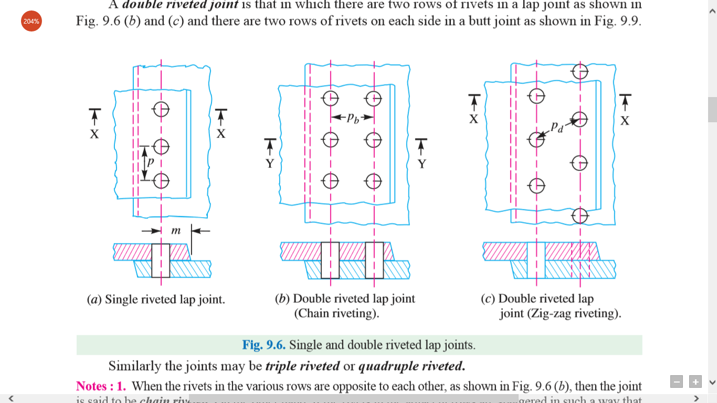
IMPORTANT TERMS USED IN RIVETED JOINTS
Pitch. It is the distance from the centre of one rivet to the centre of the next rivet measured parallel to the seam as shown in Fig. It is usually denoted by p.
Back pitch. It is the perpendicular distance between the centre lines of the successive rows as shown in Fig. It is usually denoted by pb.

Slide 7
IMPORTANT TERMS USED IN RIVETED JOINTS
3. Diagonal pitch. It is the distance between the centres of the rivets in adjacent rows of zig-zag riveted joint as shown in Fig. It is usually denoted by p_{d}
4. Margin or marginal pitch. It is the distance between the centre of rivet hole to the nearest edge of the plate as shown in Fig. It is usually denoted by m.

Slide 8
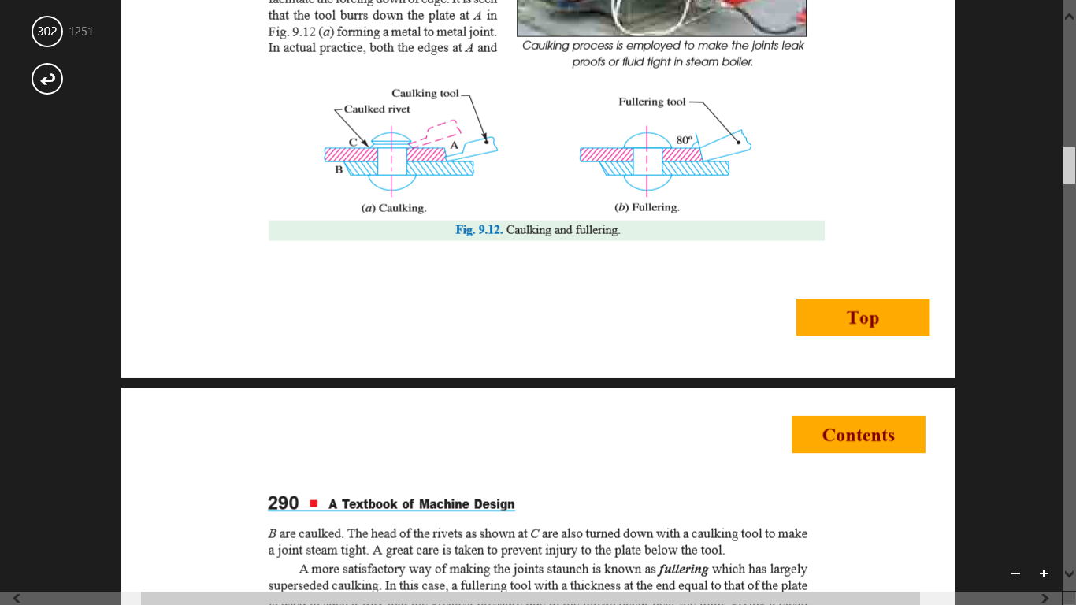
CAULKING AND FULLERING
In order to make the joints leak proof or fluid tight in pressure vessels like steam boilers, air receivers and tanks etc. a process known as caulking is employed. A more satisfactory way of making the joints staunch is known as fullering which has largely superseded caulking. In this case, a fullering tool with a thickness at the end equal to that of the plate is used in such a way that the greatest pressure due to the blows occur near the joint, giving a clean finish, with less risk of damaging the plate.

