Slide 1
DESIGN OF MACHINE ELEMENTS-I
BME 2201
Lecture 7 Module 2
Dinesh Kumar
Assistant Professor
School of Engineering
DYPIU

Slide 2
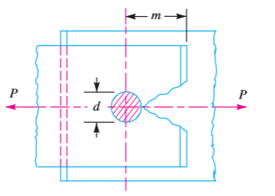
FAILURES OF A RIVETED JOINT
1. Tearing of the plate at an edge. A joint may fail due to tearing of the plate at an edge as shown in Fig. This can be avoided by keeping the margin, m = 1.5d, where d is the diameter of the rivet hole.

Slide 3
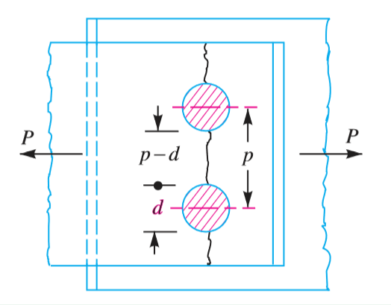
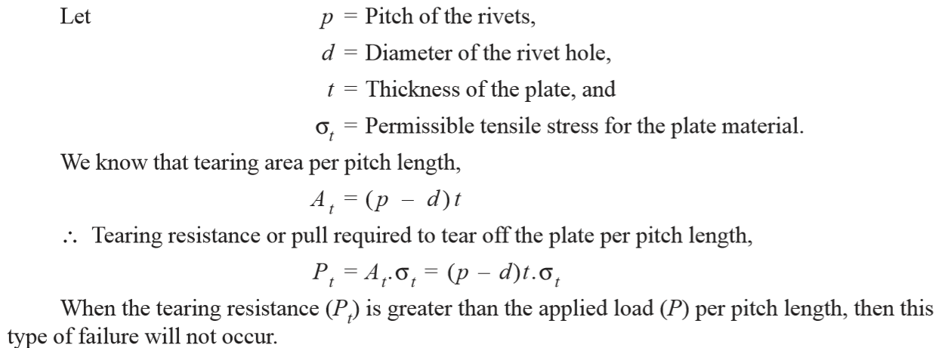
2. Tearing of the plate across a row of rivets. Due to the tensile stresses in the main plates, the main plate or cover plates may tear off across a row of rivets as shown in Fig.
The resistance offered by the plate against tearing is known as tearing resistance or tearing strength or tearing value of the plate.

Slide 5
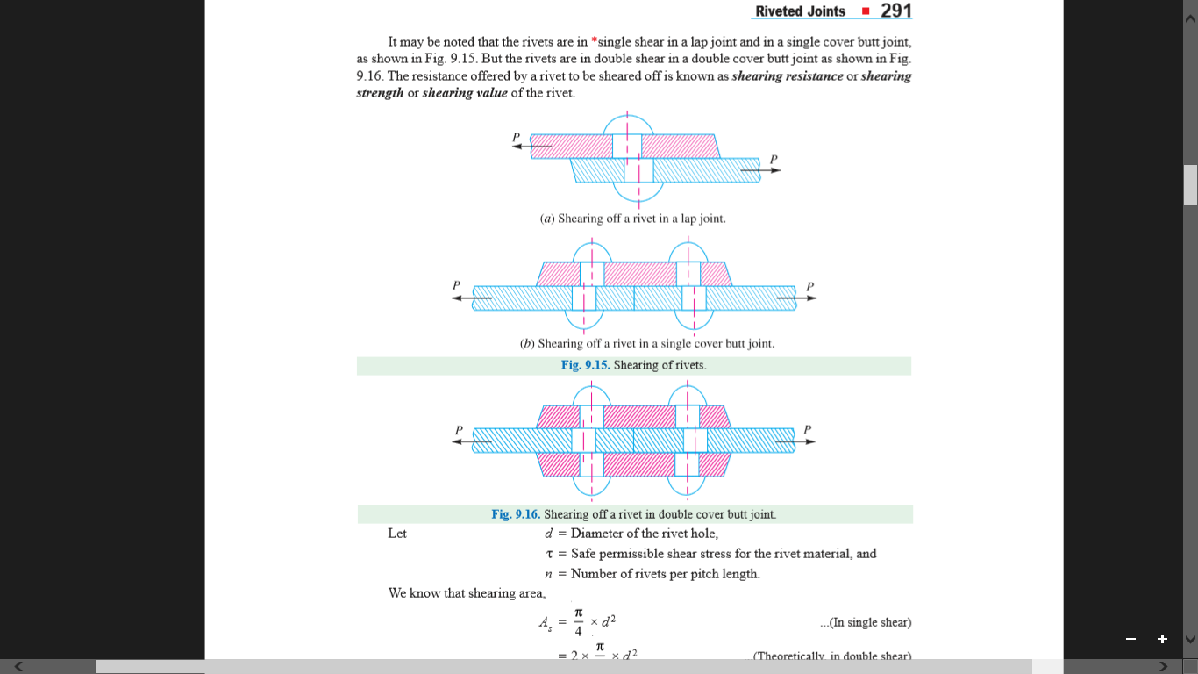
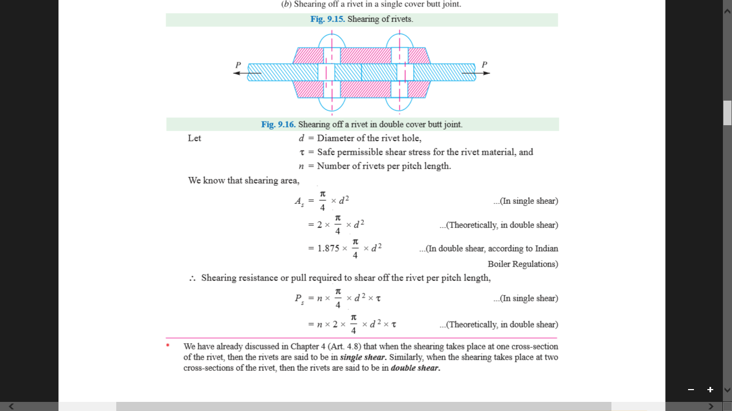
3. Shearing of the rivets. The plates which are connected by the rivets exert tensile stress on the rivets, and if the rivets are unable to resist the stress, they are sheared off as shown in Fig.

Slide 7
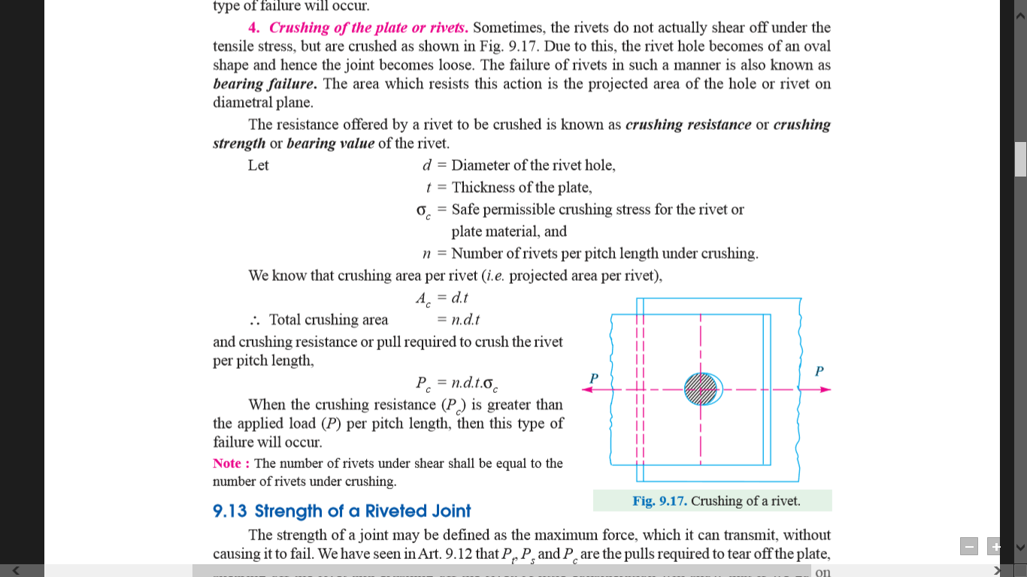
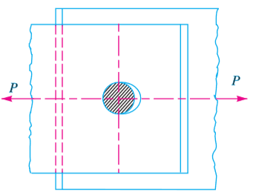
4. Crushing of the plate or rivets. Sometimes, the rivets do not actually shear off under the tensile stress, but are crushed as shown in Fig. Due to this, the rivet hole becomes of an oval shape and hence the joint becomes loose. The failure of rivets in such a manner is also known as bearing failure. The area which resists this action is the projected area of the hole or rivet on diametral plane.

Slide 9
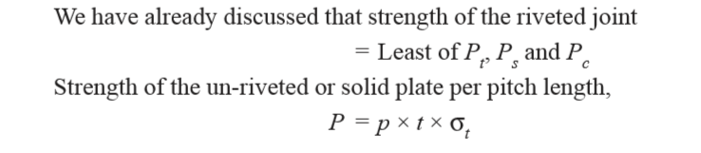
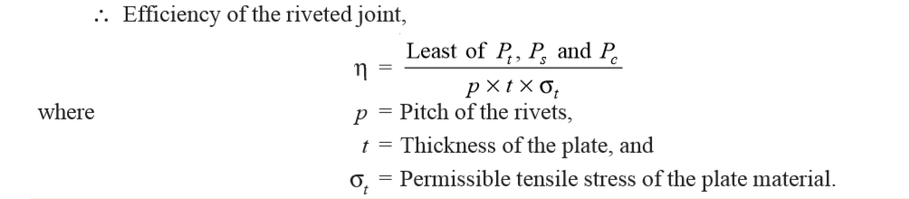
EFFICIENCY OF A RIVETED JOINT

