Slide 1
DESIGN OF MACHINE ELEMENTS-I
BME 2201
Lecture 8 Module 2
Dinesh Kumar
Assistant Professor
School of Engineering
DYPIU

Slide 2
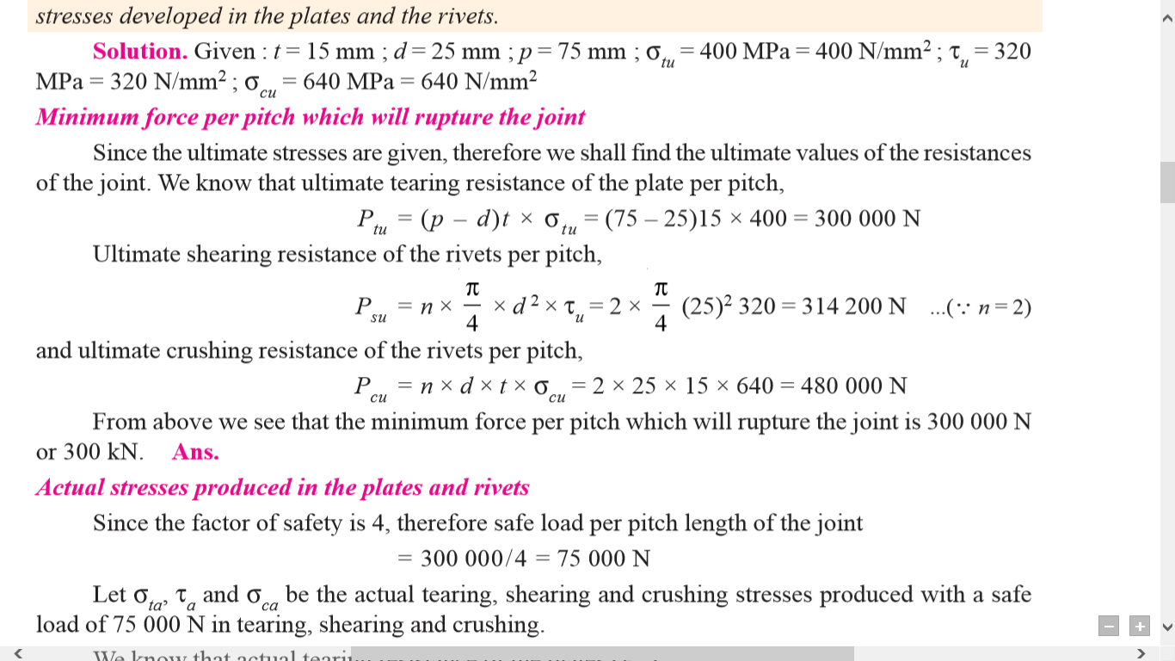
Q. A double riveted lap joint is made between 15 mm thick plates. The rivet diameter and pitch are 25 mm and 75 mm respectively. If the ultimate stresses are 400 MPa in tension, 320 MPa in shear and 640 MPa in crushing, find the minimum force per pitch which will rupture the joint. If the above joint is subjected to a load such that the factor of safety is 4, find out the actual stresses developed in the plates and the rivets.

Slide 5
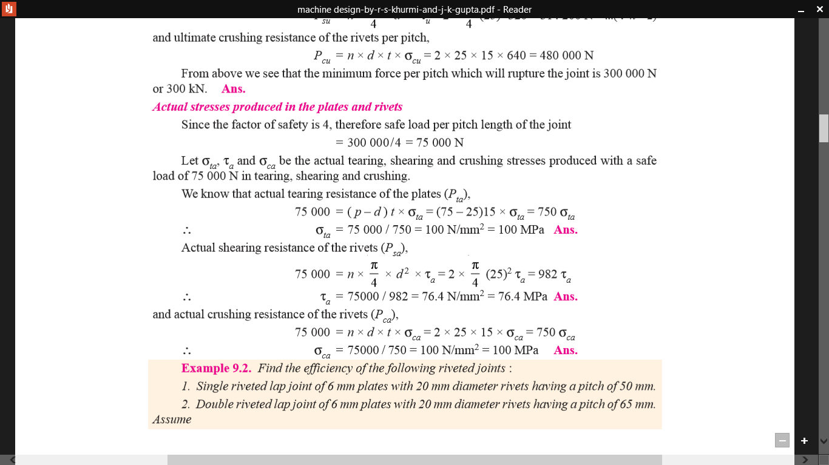

Slide 6
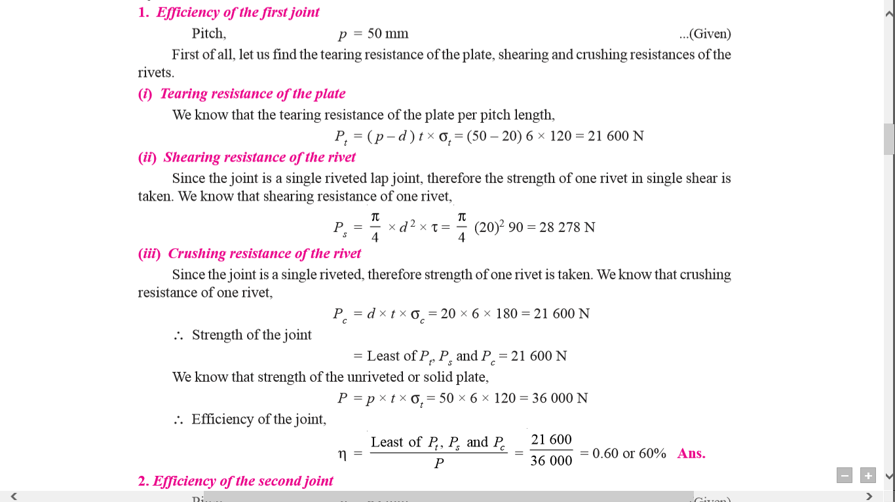
Find the efficiency of the following riveted joints : 1. Single riveted lap joint of 6 mm plates with 20 mm diameter rivets having a pitch of 50 mm. 2. Double riveted lap joint of 6 mm plates with 20 mm diameter rivets having a pitch of 65 mm. Assume Permissible tensile stress in plate = 120 MPa , Permissible shearing stress in rivets = 90 Mpa, Permissible crushing stress in rivets = 180 MPa

Slide 7
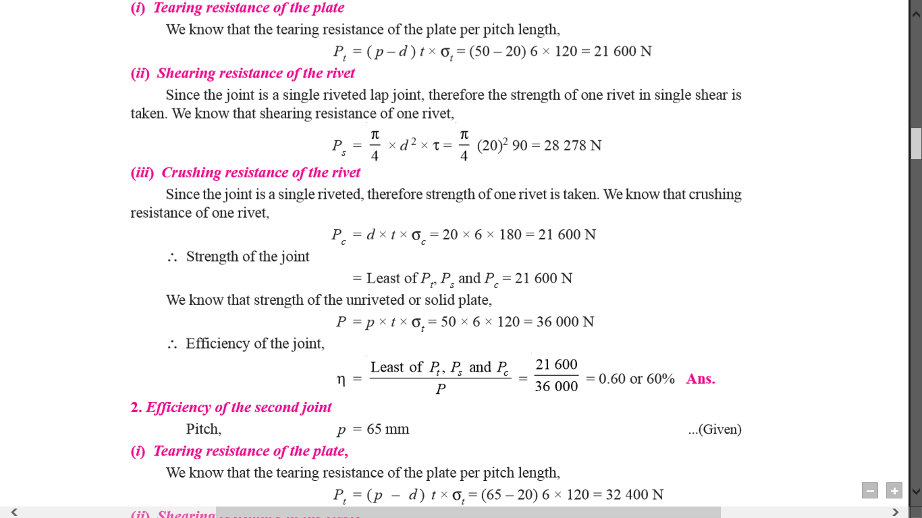
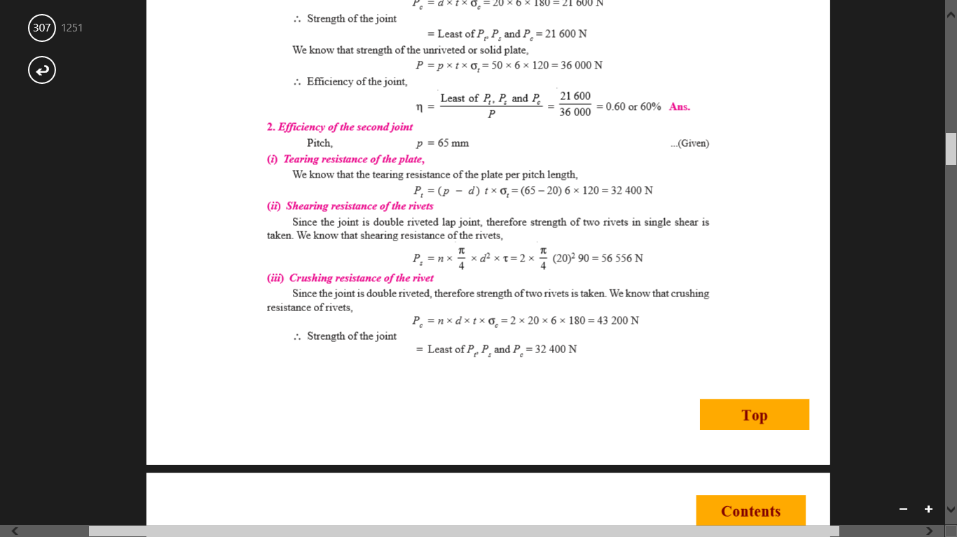

Slide 8
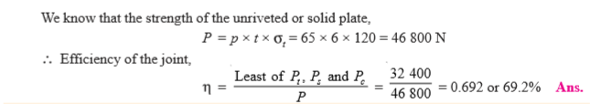
Q. A double riveted double cover butt joint in plates 20 mm thick is made with 25 mm diameter rivets at 100 mm pitch. The permissible stresses are : σt = 120 MPa; τ = 100 MPa; σc = 150 MPa Find the efficiency of joint, taking the strength of the rivet in double shear as twice than that of single shear.

