Slide 1
DESIGN OF MACHINE ELEMENTS-II
(BME3102)
Lecture 1 Module 1
By:-
Dinesh Kumar
School of Engineering

Slide 2
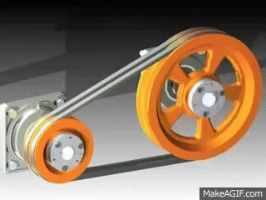
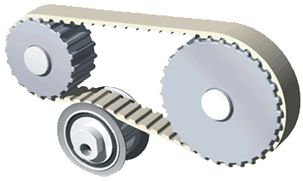
INTRODUCTION TO BELTS
INTRODUCTION
The belts are used to transmit power from one shaft to another by means of pulleys which rotate at the same speed or at different speeds.

Slide 3
There are two types of drives—rigid and flexible.
Belt, chain and rope drives are called ‘flexible’ drives.
Gear drives are called rigid or non-flexible drives
In flexible drives, there is an intermediate link such as belt, rope or chain between the driving and driven shafts.
In gear drives, there is direct contact between the driving and driven shafts through the gears.

Slide 4
The advantages of flexible drives over rigid drives are as follows:
Flexible drives transmit power over a comparatively long distance due to an intermediate link between driving and driven shafts.
Since the intermediate link is long and flexible, it absorbs shock loads and damps vibrations.
Flexible drives provide considerable flexibility in the location of the driving and driven shafts. The tolerances on the centre distance are not critical as compared with a gear drive.
Flexible drives are cheap compared to gear drives. Their initial and maintenance costs are low.

Slide 5
The disadvantages of flexible drives are as follows:
Belt drives have large dimensions and occupy more space.
The velocity ratio is not constant due to belt slip.
They impose heavy loads on shafts and bearings.
There is considerable loss of power resulting in low efficiency.
Belt drives have comparatively short service life.

Slide 6
THE AMOUNT OF POWER TRANSMITTED DEPENDS UPON THE FOLLOWING FACTORS
The velocity of the belt.
The tension under which the belt is placed on the pulleys.
The arc of contact between the belt and the smaller pulley.
The conditions under which the belt is used.

Slide 7
SELECTION OF A BELT DRIVE
Following are the various important factors upon which the selection of a belt drive depends:
Speed of the driving and driven shafts,
Speed reduction ratio,
Power to be transmitted,
Centre distance between the shafts,
Positive drive requirements,
6. Shafts layout,
Space available, and
Service conditions.

Slide 8
TYPES OF BELT DRIVES
The belt drives are usually classified into the following three groups:
Light drives. These are used to transmit small powers at belt speeds upto about 10 m/s as in agricultural machines and small machine tools.
Medium drives. These are used to transmit medium powers at belt speeds over 10 m/s but up to 22 m/s, as in machine tools.
Heavy drives. These are used to transmit large powers at belt speeds above 22 m/s as in compressors and generators.

Slide 9
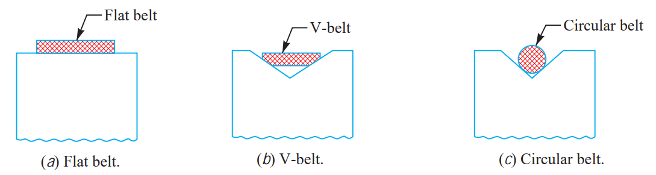
TYPES OF BELTS
1. FLAT BELT :- The flat belt as shown in Figure (a), is mostly used in the factories and workshops, where a moderate amount of power is to be transmitted, from one pulley to another when the two pulleys are not more than 8 metres apart.

