Slide 1
DESIGN OF MACHINE ELEMENTS-II
(BME3102)
Lecture 10 Module 1
By:-
Dinesh Kumar
School of Engineering

Slide 2
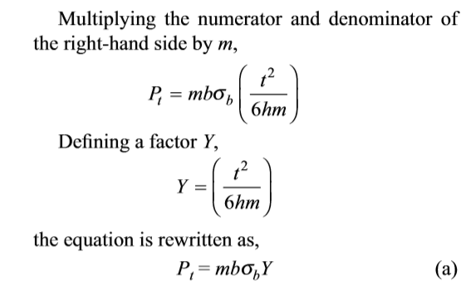
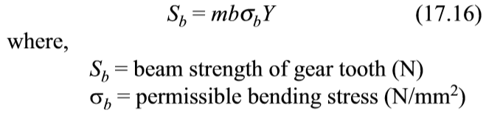
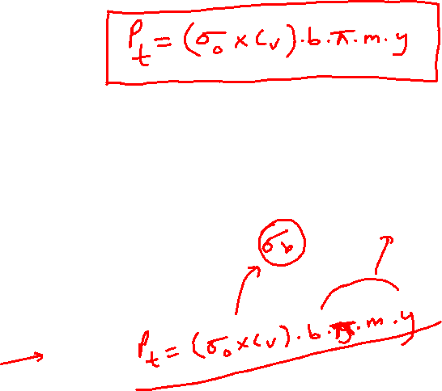
In the above equation, Y is called the Lewis form factor.

Slide 3
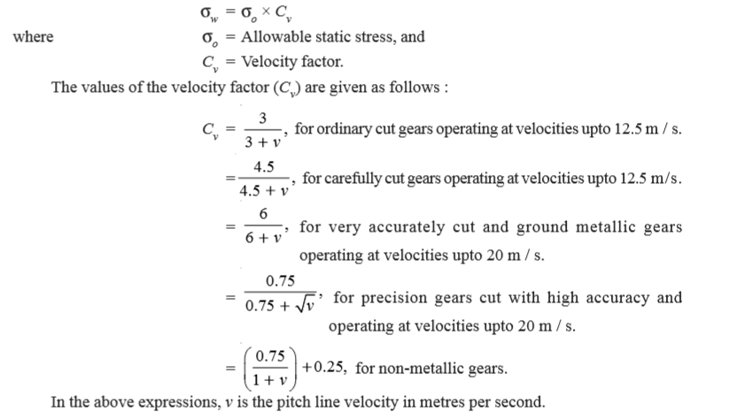
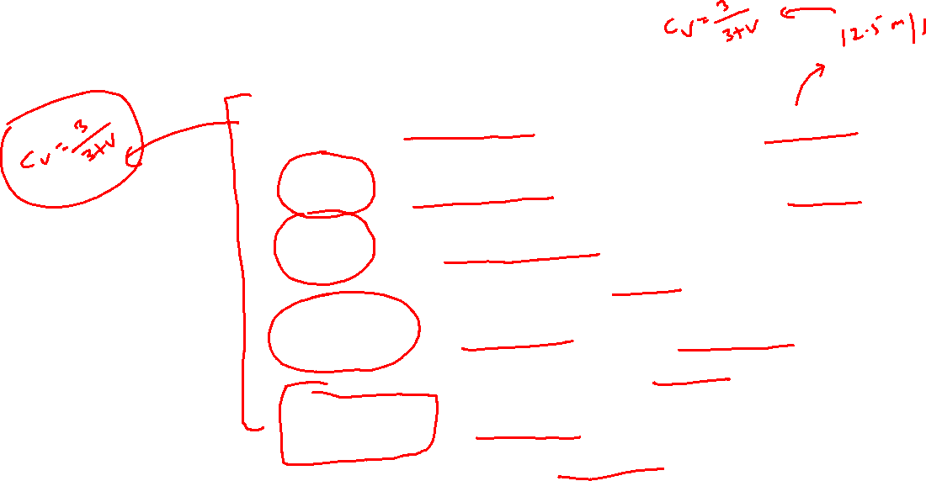

Slide 4
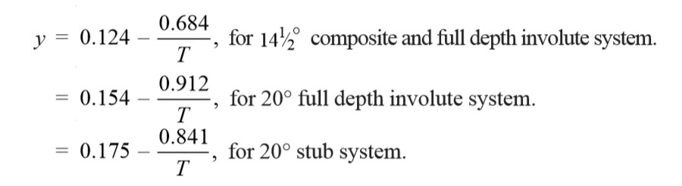
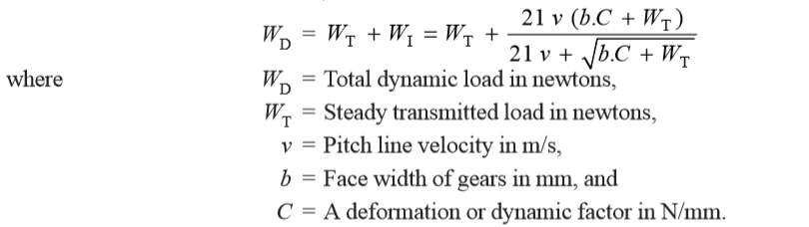
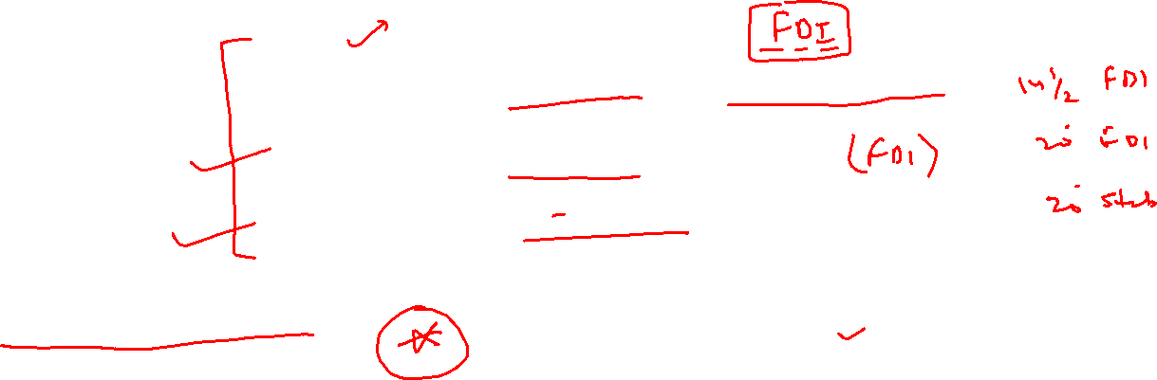
DYNAMIC TOOTH LOAD

Slide 5
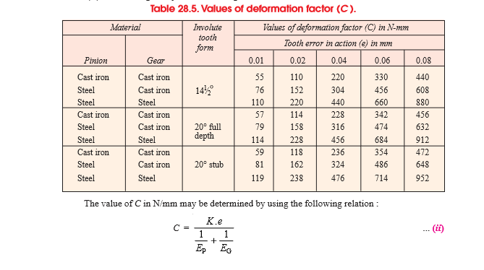

Slide 6
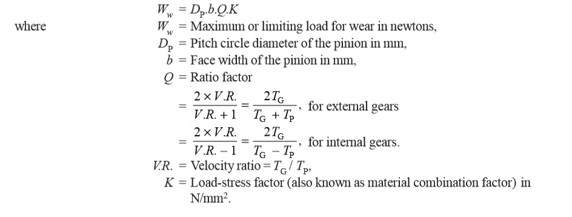
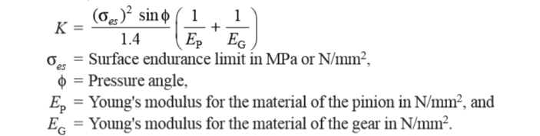

WEAR TOOTH LOAD

Slide 7
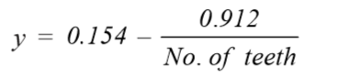
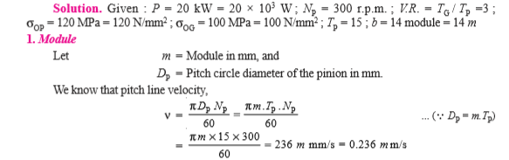
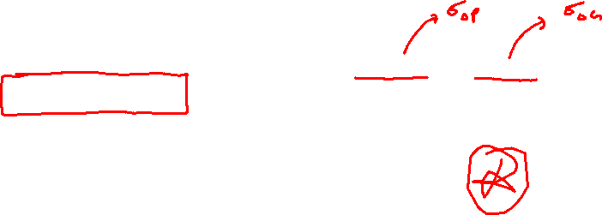
A pair of straight teeth spur gears is to transmit 20 kW when the pinion rotates at 300 r.p.m. The velocity ratio is 1 : 3. The allowable static stresses for the pinion and gear materials are 120 MPa and 100 MPa respectively. The pinion has 15 teeth and its face width is 14 times the module. Determine : 1. module; 2. face width; and 3. pitch circle diameters of both the pinion and the gear from the standpoint of strength only, taking into consideration the effect of the dynamic loading. The tooth form factor y can be taken as

Slide 8
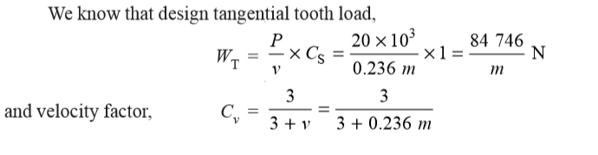
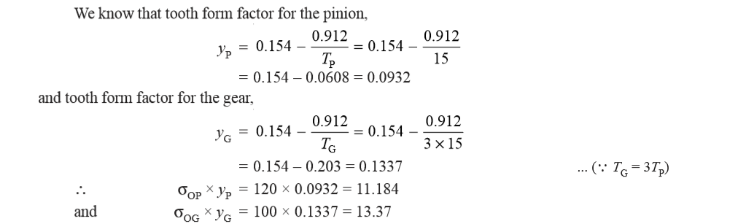
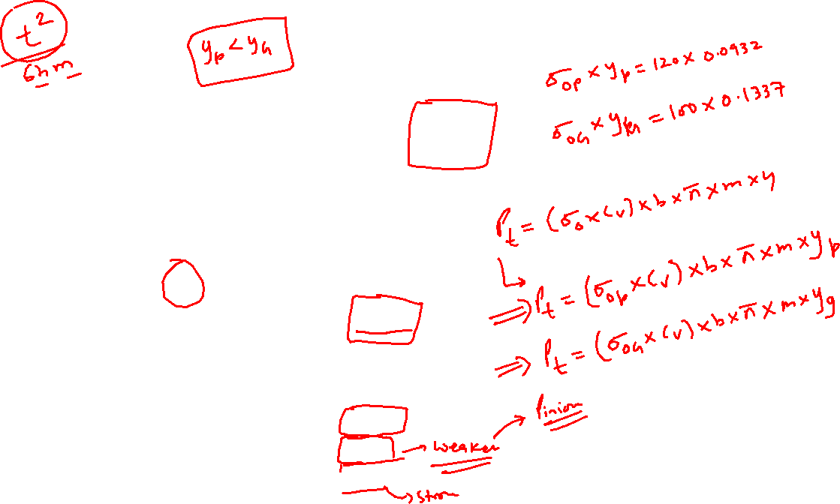

Slide 9
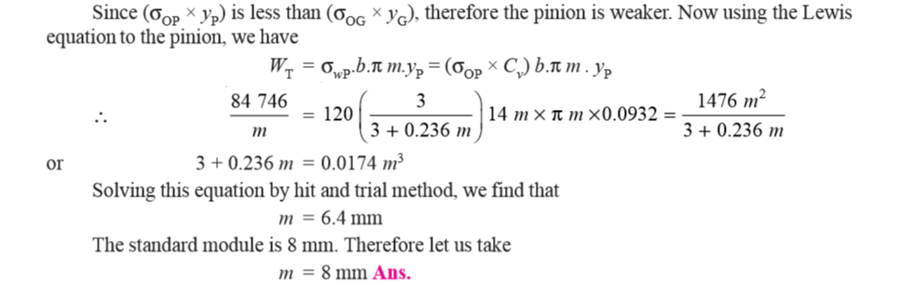
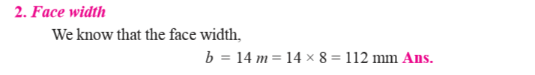

Slide 10
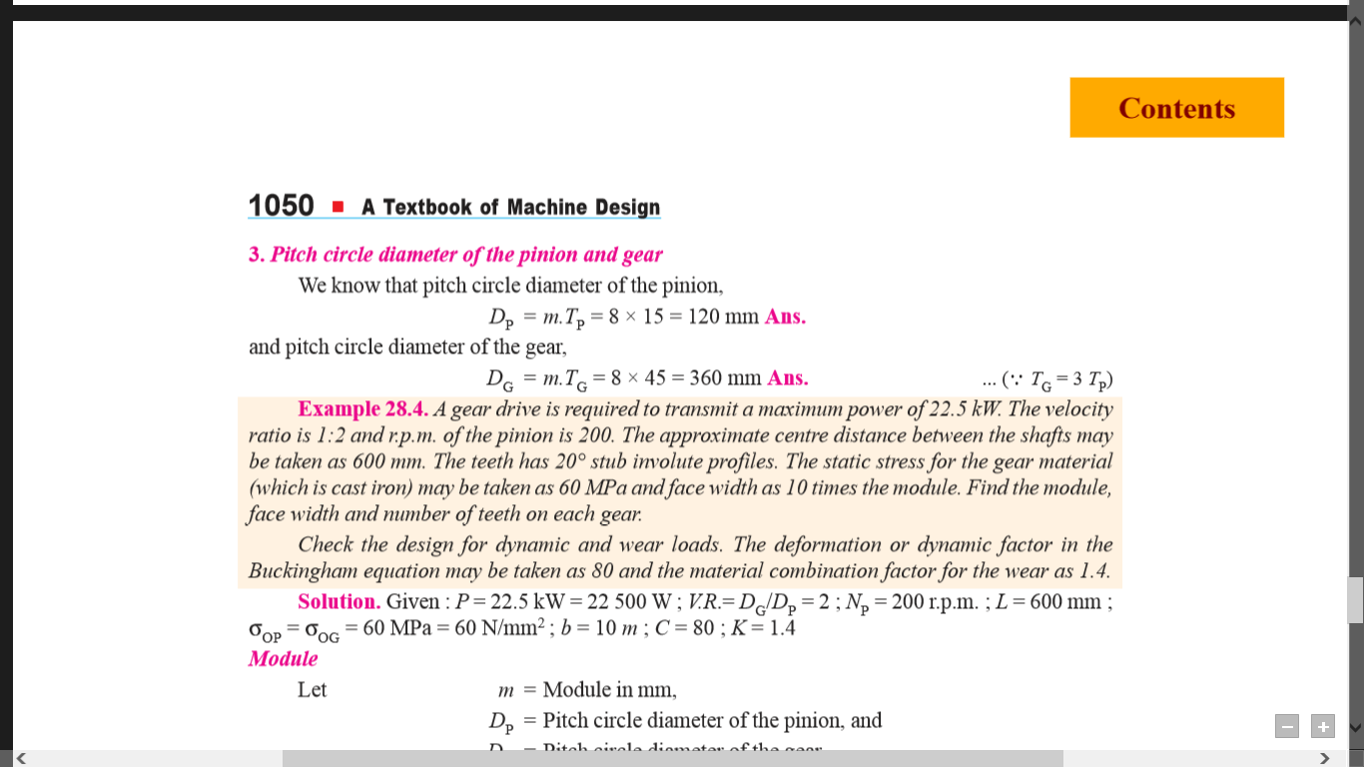
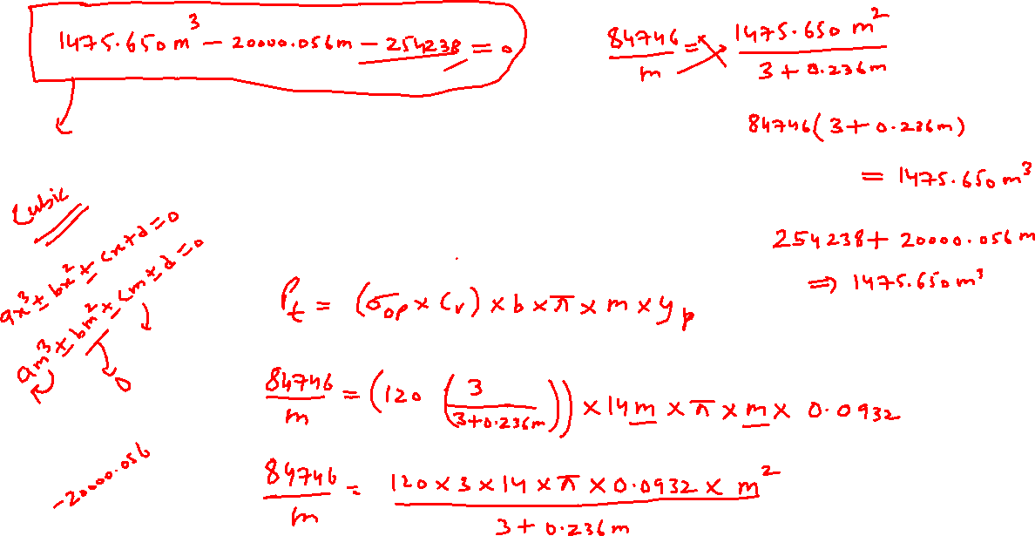

Slide 11
