Slide 1
DESIGN OF MACHINE ELEMENTS-II
(BME3102)
Lecture 11 Module 1
By:-
Dinesh Kumar
School of Engineering

Slide 2
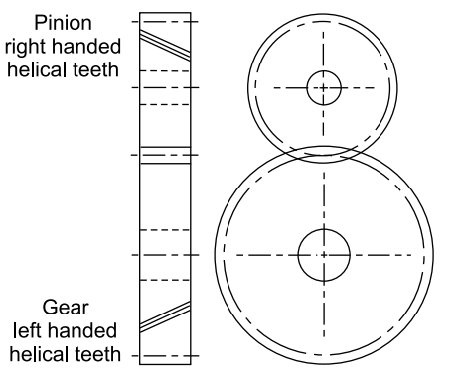
HELICAL GEARS
A helical gear is a type of cylindrical gear on which the teeth are helicoid, that has teeth that are cut at an angle to the axis of rotation.
There is a basic difference between spur and helical gears. While the teeth of spur gears are cut parallel to the axis of the shaft, the teeth of helical gears are cut in the form of a helix on the pitch cylinder.
In spur gears, the contact between meshing teeth occurs along the entire face width of the tooth, resulting in sudden application of the load, which in turn, results in impact conditions and generates noise in high speed applications.

Slide 3
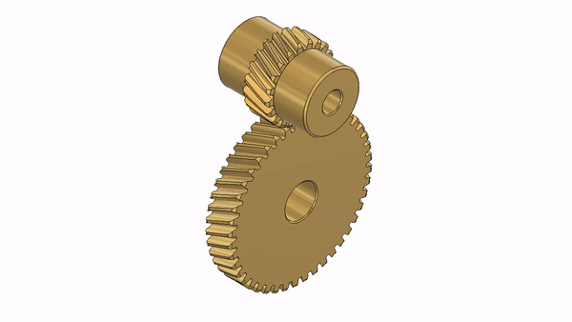
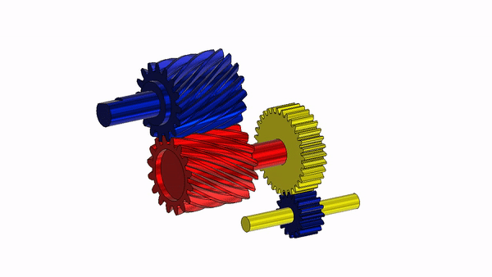
In helical gears, the contact between meshing teeth begins with a point on the leading edge of the tooth and gradually extends along the diagonal line across the tooth. There is a gradual pick-up of load by the tooth, resulting in smooth engagement and quiet operation even at high speeds.

Slide 4
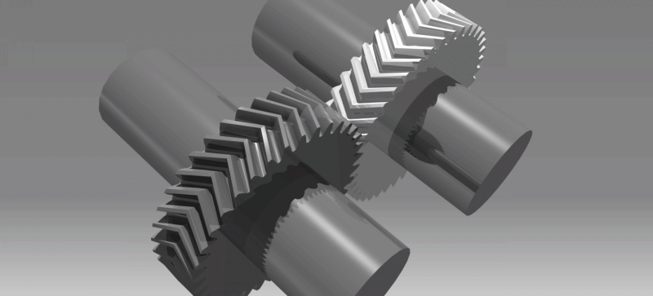
In case of single helical gears there is some axial thrust between the teeth, which is a disadvantage. In order to eliminate this axial thrust, double helical gears (i.e. herringbone gears) are used. It is equivalent to two single helical gears, in which equal and opposite thrusts are provided on each gear and the resulting axial thrust is zero.

Slide 5
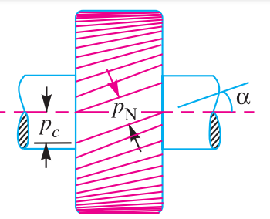

TERMS USED IN HELICAL GEARS
Helix angle(α). It is a constant angle made by the helices with the axis of rotation.
Axial pitch(p_{c}). It is the distance, parallel to the axis, between similar faces of adjacent teeth. It is the same as circular pitch and is therefore denoted by p_{c} . The axial pitch may also be defined as the circular pitch in the plane of rotation or the diametral plane.
Normal pitch(p_{N}). It is the distance between similar faces of adjacent teeth along a helix on the pitch cylinders normal to the teeth. It is denoted by p_{N}. The normal pitch may also be defined as the circular pitch in the normal plane which is a plane perpendicular to the teeth. Mathematically, normal pitch,

Slide 6
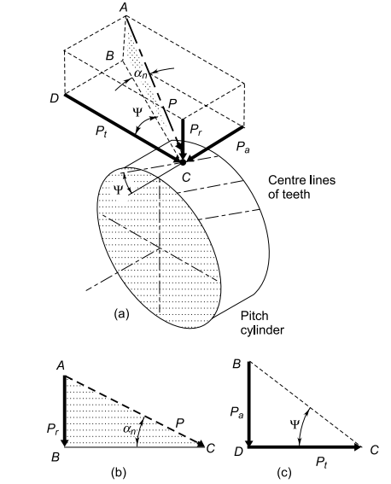

FORCE ANALYSIS
The resultant force P acting on the tooth of a helical gear is resolved into three components, P_{t} , P_{r} and P_{a} as shown in Figure (a)
The normal pressure angle (α_{n}) is in the plane ABC shaded by dots, while helix angle Ѱ is in the lower plane BCD.

Slide 7
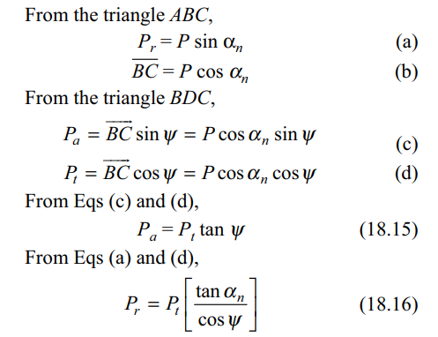

Slide 8
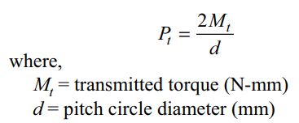
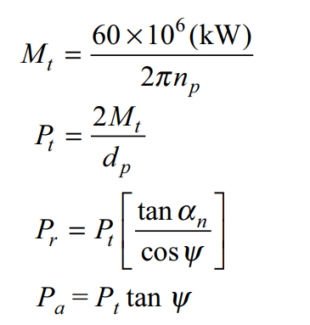
The tangential component is calculated from the relationship

Slide 9
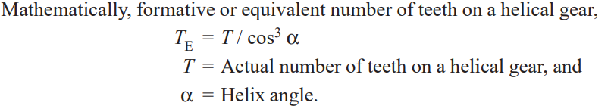
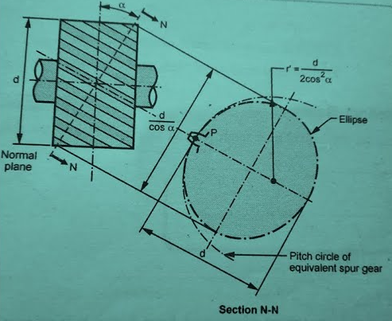
Formative or Equivalent Number of Teeth for Helical Gears

Slide 10
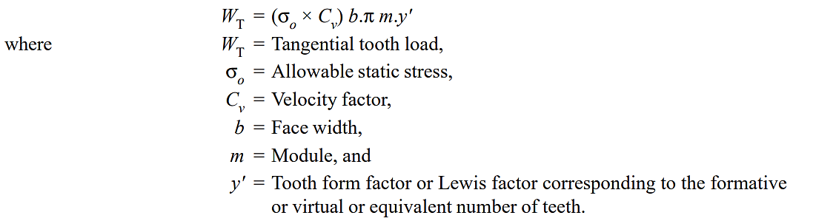
Strength of Helical Gears
Strength of Helical Gears In helical gears, the contact between mating teeth is gradual, starting at one end and moving along the teeth so that at any instant the line of contact runs diagonally across the teeth. Therefore in order to find the strength of helical gears, a modified Lewis equation is used. It is given by

Slide 11
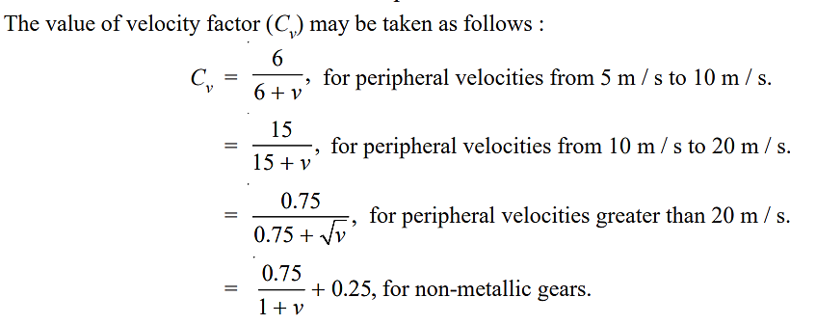

Slide 12
