Slide 1
DESIGN OF MACHINE ELEMENTS-II
(BME3102)
Lecture 12 Module 1
By:-
Dinesh Kumar
School of Engineering

Slide 2
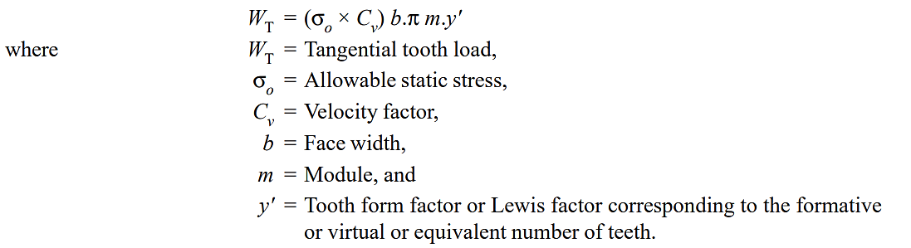
Strength of Helical Gears
Strength of Helical Gears In helical gears, the contact between mating teeth is gradual, starting at one end and moving along the teeth so that at any instant the line of contact runs diagonally across the teeth. Therefore in order to find the strength of helical gears, a modified Lewis equation is used. It is given by

Slide 3
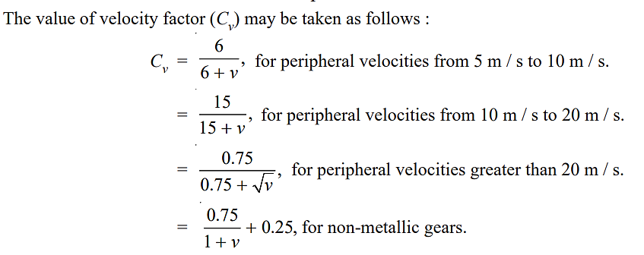

Slide 4
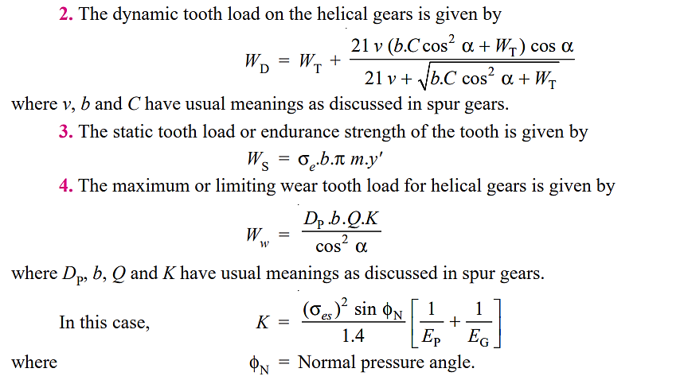

Slide 5
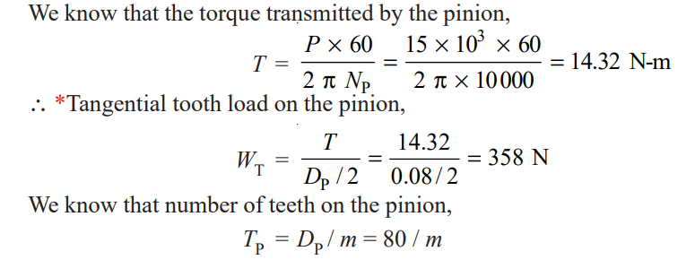
A pair of helical gears are to transmit 15 kW. The teeth are 20° stub in diametral plane and have a helix angle of 45°. The pinion runs at 10000 r.p.m. and has 80 mm pitch diameter. The gear has 320 mm pitch diameter. If the gears are made of cast steel having allowable static strength of 100 MPa; determine a suitable module and face width.

Slide 6
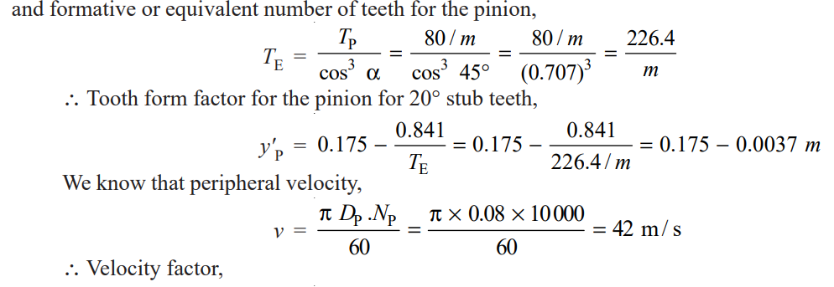
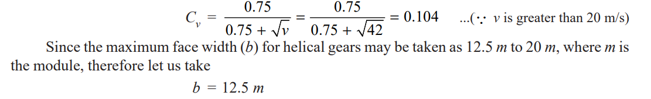

Slide 7
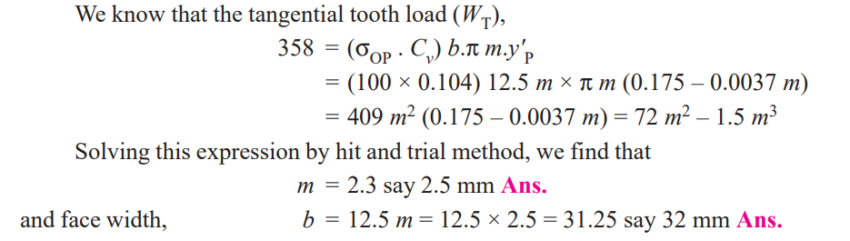

Slide 8
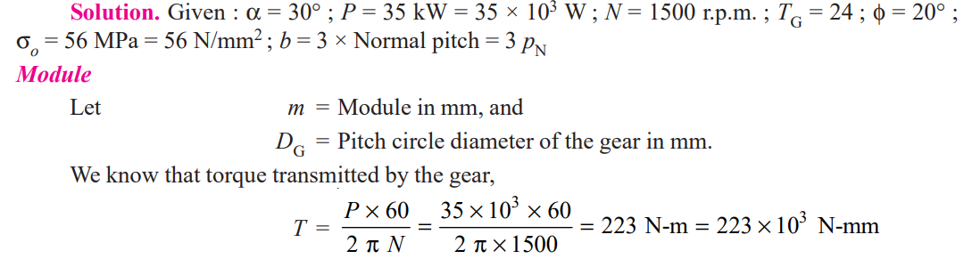
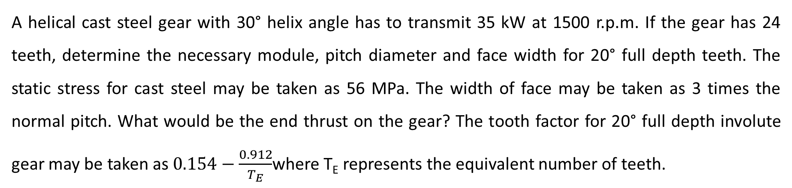
A helical cast steel gear with 30° helix angle has to transmit 35 kW at 1500 r.p.m. If the gear has 24 teeth, determine the necessary module, pitch diameter and face width for 20° full depth teeth. The static stress for cast steel may be taken as 56 MPa. The width of face may be taken as 3 times the normal pitch. What would be the end thrust on the gear? The tooth factor for 20° full depth involute gear may be taken as $0.154−\frac{0.912}{T_{E}}$where T_{E} represents the equivalent number of teeth.

Slide 9
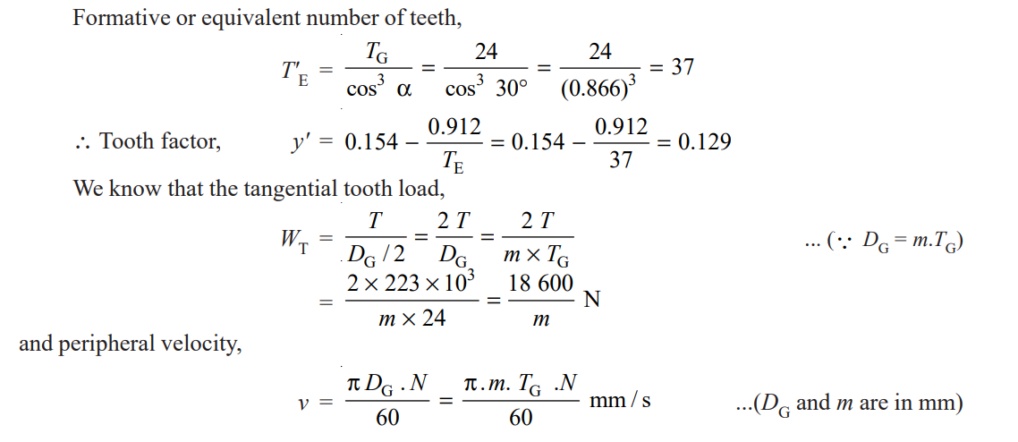

Slide 10
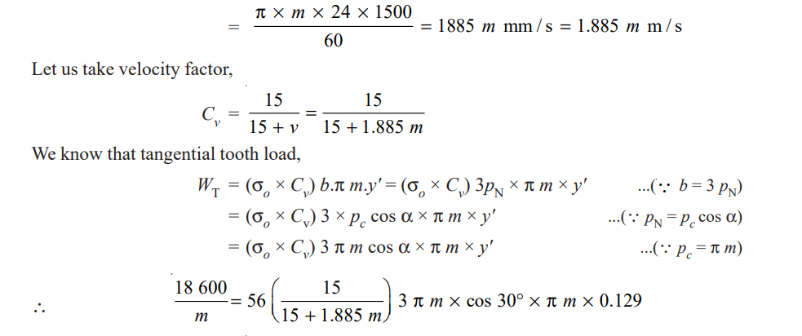

Slide 11
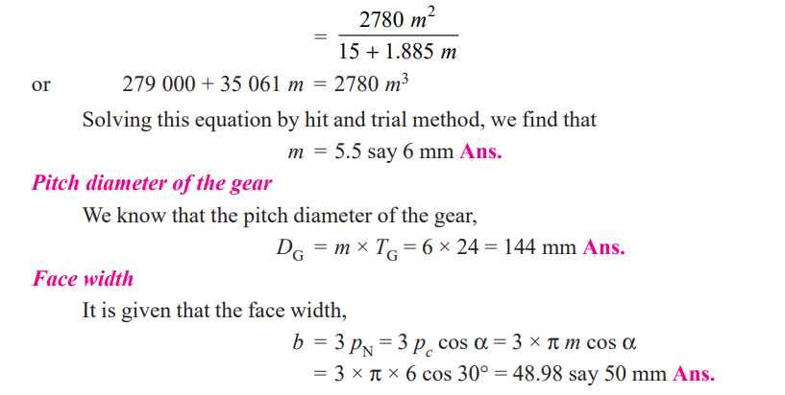

Slide 12
