Slide 1
DESIGN OF MACHINE ELEMENTS-II
(BME3102)
Lecture 13 Module 2
By:-
Dinesh Kumar
School of Engineering

Slide 2
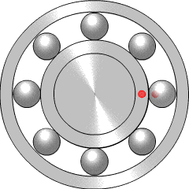
Rolling Contact Bearings
Bearing is a mechanical element that permits relative motion between two parts, such as the shaft and the housing, with minimum friction.
The functions of the bearing are as follows:
The bearing ensures free rotation of the shaft or the axle with minimum friction.
The bearing supports the shaft or the axle and holds it in the correct position.
The bearing takes up the forces that act on the shaft or the axle and transmits them to the frame or the foundation.

Slide 3
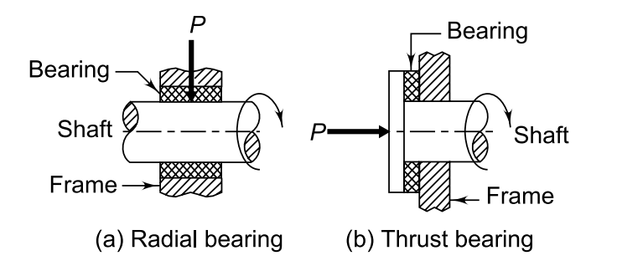
Bearings are classified in different ways. Depending upon the direction of force that acts on them, bearings are classified into two categories
Bearing
Radial Thrust Bearing
Axial Thrust Bearing

Slide 4
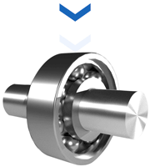
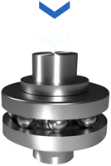
A radial bearing supports the load, which is perpendicular to the axis of the shaft.
A thrust bearing supports the load, which acts along the axis of the shaft.

Slide 5
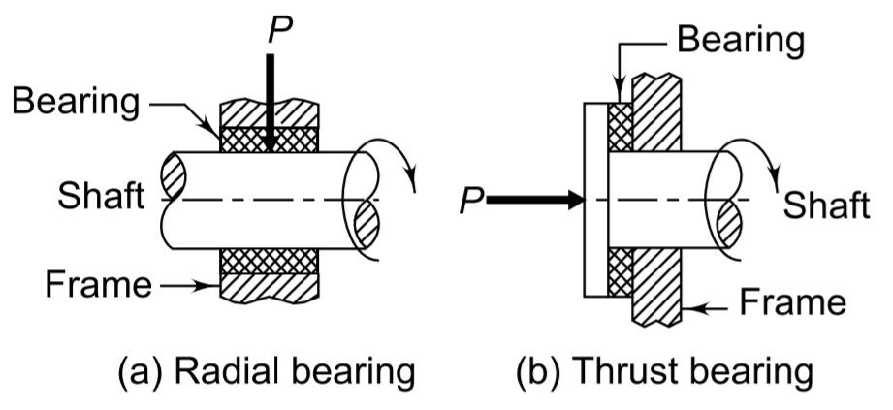
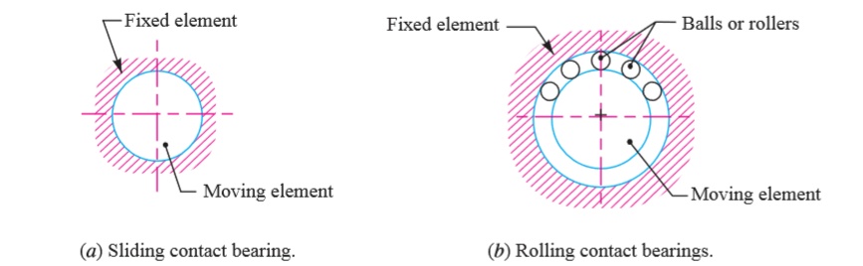
Classification of Bearing
1. Depending upon the direction of load to be supported.
2. Depending upon the nature of contact.

Slide 6
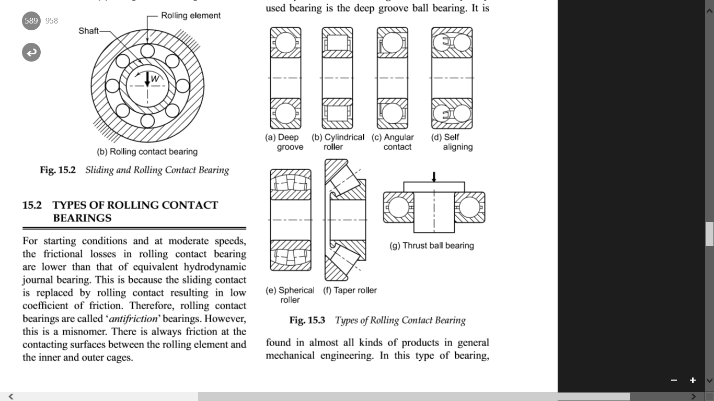
Types of Rolling Contact Bearing

Slide 7
STATIC LOAD CARRYING CAPACITY (C₀)
Static load is deﬁned as the load acting on the bearing when the shaft is stationary. It produces permanent deformation in balls and races, which increases with increasing load. The permissible static load, therefore, depends upon the permissible magnitude of permanent deformation.
The static load carrying capacity of a bearing is deﬁned as the static load which corresponds to a total permanent deformation of balls and races, at the most heavily stressed point of contact, equal to 0.0001 of the ball diameter.

Slide 8
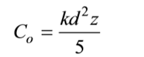
STRIBECK’S EQUATION
Stribeck’s equation gives the static load capacity of bearing. It is based on the following assumptions:
The races are rigid and retain their circular shape.
The balls are equally spaced.
The balls in the upper half do not support any load.
where d is the ball diameter and the factor k depends upon the radii of curvature at the point of contact, and on the modulus of elasticity of materials.
Z = No. of balls

Slide 9
DYNAMIC LOAD CARRYING CAPACITY (C)
The dynamic load carrying capacity of a bearing is deﬁned as the radial load in radial bearings (or thrust load in thrust bearings) that can be carried for a minimum life of one million revolutions.
The life of an individual ball bearing is deﬁned as the number of revolutions (or hours of service at some given constant speed), which the bearing runs before the ﬁrst evidence of fatigue crack in balls or races.

Slide 10
