Slide 1
DESIGN OF MACHINE ELEMENTS-II
(BME3102)
Lecture 14 Module 2
By:-
Dinesh Kumar
School of Engineering

Slide 2
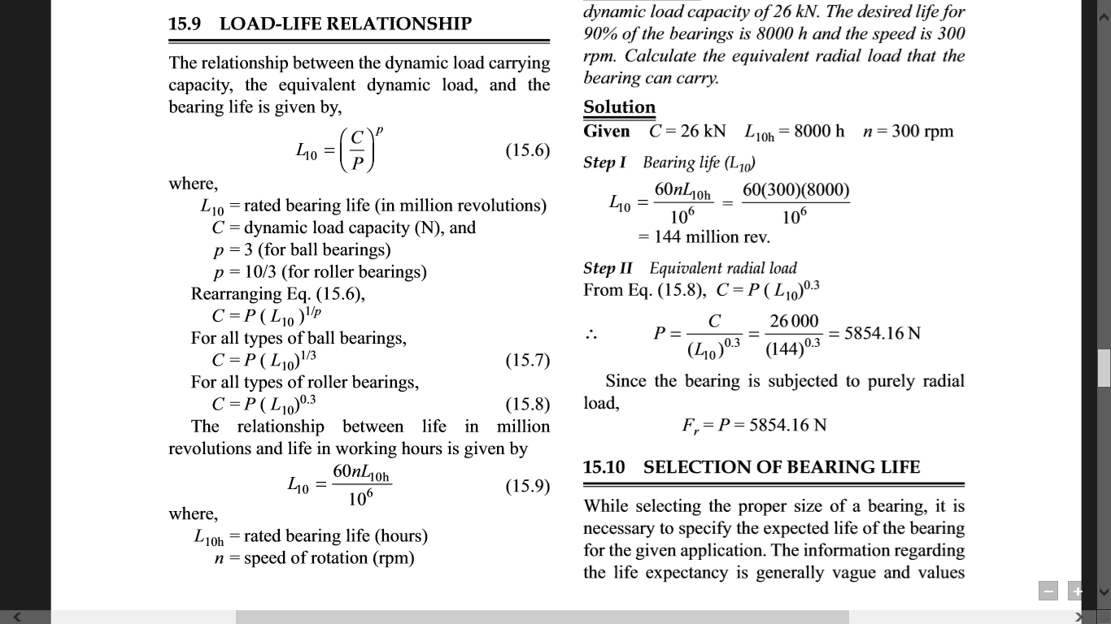

Slide 4
Q1. In a particular application, the radial load acting on a ball bearing is 5 kN and the expected life for 90% of the bearings is 8000 h. Calculate the dynamic load carrying capacity of the bearing, when the shaft rotates at 1450 rpm.

Slide 5
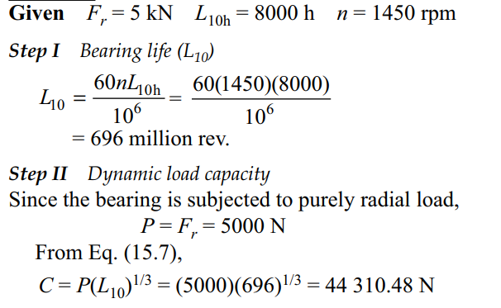

Slide 6
Q2. A taper roller bearing has a dynamic load capacity of 26 kN. The desired life for 90% of the bearings is 8000 h and the speed is 300 rpm. Calculate the equivalent radial load that the bearing can carry.

Slide 7
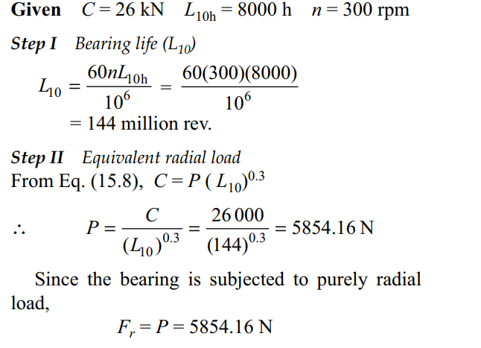

Slide 8
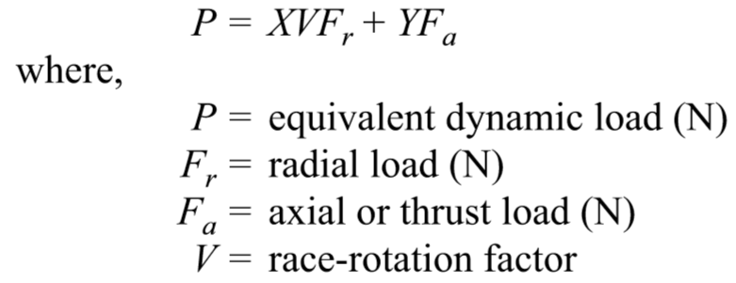
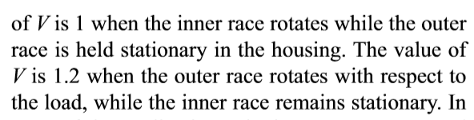
EQUIVALENT BEARING LOAD

Slide 9
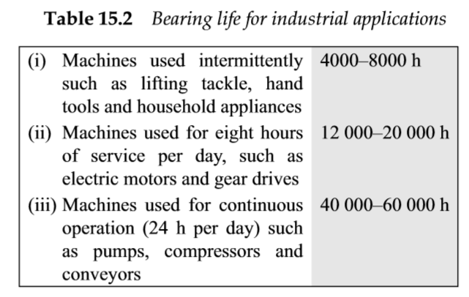
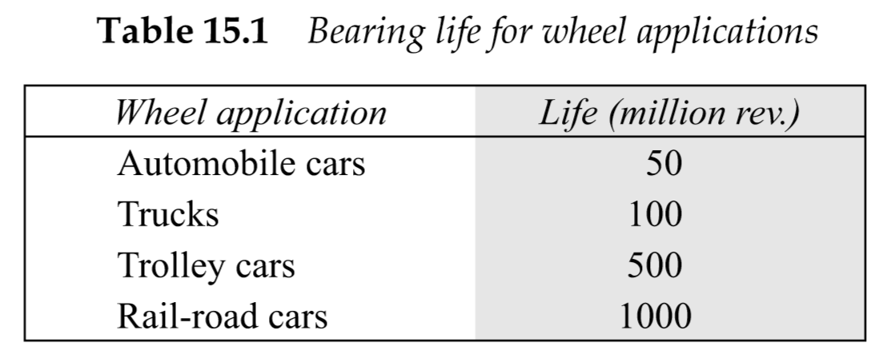
SELECTION OF BEARING LIFE

Slide 10
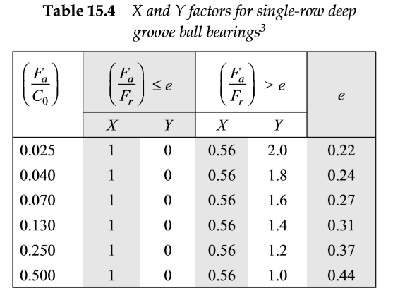

Slide 11
A single-row deep groove ball bearing is subjected to a radial force of 12 kN and a thrust force of 5 kN. The shaft rotates at 1100 rpm. The expected life L10h of the bearing is 25000 h. The minimum acceptable diameter of the shaft is 75 mm. Select a suitable ball bearing for this application.

