Slide 1
DESIGN OF MACHINE ELEMENTS-II
(BME3102)
Lecture 15 Module 2
By:-
Dinesh Kumar
School of Engineering

Slide 2
A single-row deep groove ball bearing is subjected to a pure radial force of 3 kN from a shaft that rotates at 600 rpm. The expected life L_{10h} of the bearing is 30000 h. The minimum acceptable diameter of the shaft is 40 mm. Select a suitable ball bearing for this application.

Slide 3
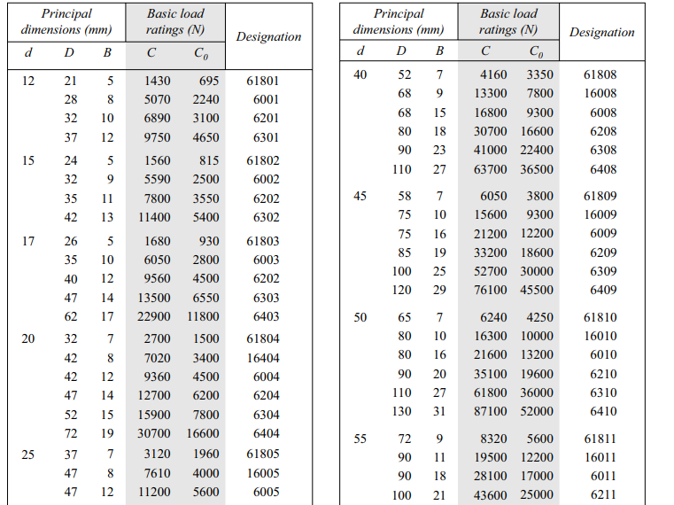


Slide 4
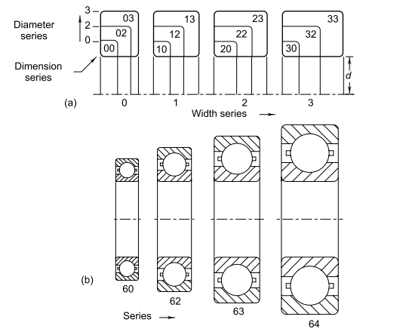

Slide 5
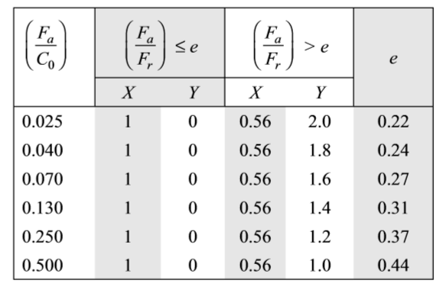

A single-row deep groove ball bearing is subjected to a radial force of 8 kN and a thrust force of 3 kN. The shaft rotates at 1200 rpm. The expected life L10h of the bearing is 20 000 h. The minimum acceptable diameter of the shaft is 75 mm. Select a suitable ball bearing for this application.

Slide 6
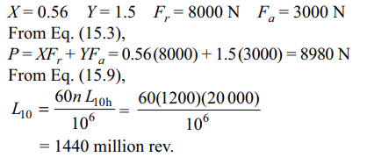

Slide 7
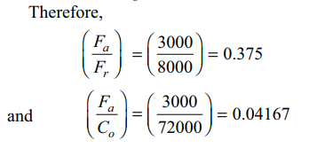


Slide 8
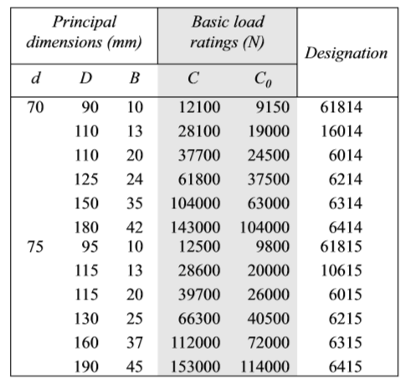
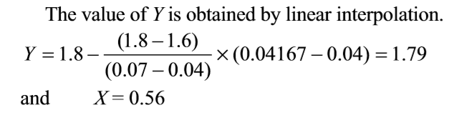

Slide 9

Bearing No. 6315 (C = 112 000) is suitable for the above application.

