Slide 1
DESIGN OF MACHINE ELEMENTS-II
(BME3102)
Lecture 16 Module 2
By:-
Dinesh Kumar
School of Engineering

Slide 2
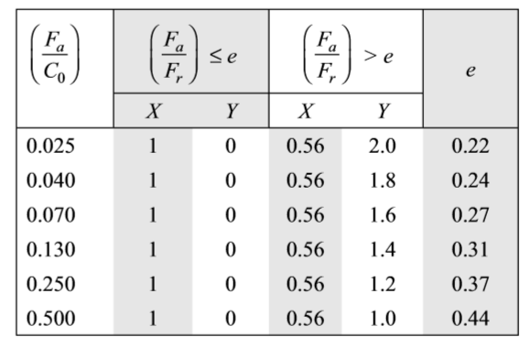
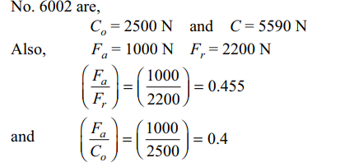
A single-row deep groove ball bearing No. 6002 is subjected to an axial thrust of 1000 N and a radial load of 2200 N. Find the expected life that 50% of the bearings will complete under this condition.
Given : F_{a} = 1000 N F_{r} = 2200 N Bearing = No. 6002

Slide 3





Slide 4
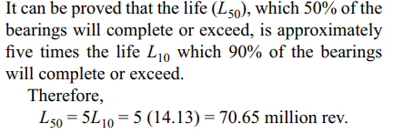

Slide 5
A single-row deep groove ball bearing is subjected to a radial force of 12 kN and a thrust force of 5 kN. The shaft rotates at 1100 rpm. The expected life L10h of the bearing is 25000 h. The minimum acceptable diameter of the shaft is 75 mm. Select a suitable ball bearing for this application.

Slide 6
DESIGN FOR CYCLIC LOADS AND SPEEDS
In certain applications, ball bearings are subjected to cyclic loads and speeds. As an example, consider a ball bearing operating under the following conditions:
radial load 2500 N at 700 rpm for 25% of the time,
radial load 5000 N at 900 rpm for 50% of the time, and
radial load 1000 N at 750 rpm for the remaining 25% of the time.
Under these circumstances, it is necessary to consider the complete work cycle while finding out the dynamic load capacity of the bearing.

Slide 7

Suppose that the work cycle is divided into x elements. Let P₁, P₂, … P_{x} be the loads and n₁, n₂, …, n_{x} be the speeds during these elements. During the first element, the life L₁ corresponding to load P₁, is given by

Slide 10
A single-row deep groove ball bearing has a dynamic load capacity of 40500 N and operates on the following work cycle:
radial load of 5000 N at 500 rpm for 25% of the time;
radial load of 10000 N at 700 rpm for 50% of the time; and
radial load of 7000 N at 400 rpm for the remaining 25% of the time.
Calculate the expected life of the bearing in hours.
Given C = 40500 N
Consider the work cycle of one minute duration. The values of load P and revolutions N are tabulated as follows:

Slide 11
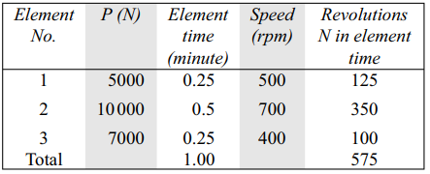
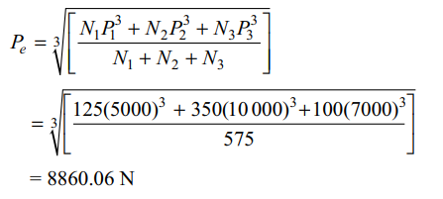

Slide 12
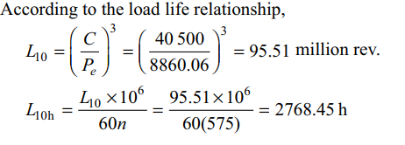

Slide 13
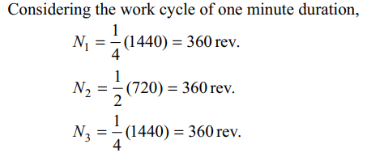

A ball bearing is operating on a work cycle consisting of three parts—a radial load of 3000 N at 1440 rpm for one quarter cycle, a radial load of 5000 N at 720 rpm for one half cycle, and radial load of 2500 N at 1440 rpm for the remaining cycle. The expected life of the bearing is 10000 h. Calculate the dynamic load carrying capacity of the bearing.
Given L_{10h} = 10 000 h

Slide 14
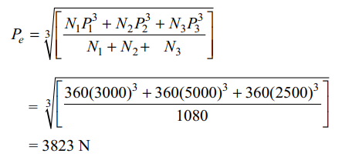
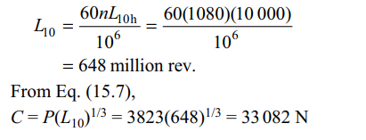

Slide 15
A ball bearing is operating on a work cycle consisting of three parts
Radial Load 2500 N at 1200 rpm for 15 percent
Radial load 4500 N at 600 rpm for 25 percent
Radial load 3300 N at 900 rpm 30 percent
Radial load 10000 N at 1500 rpm for the remanning.
The expected life of the bearing is 10000 h. Calculate the dynamic load carrying capacity of the bearing.

