Slide 1
DESIGN OF MACHINE ELEMENTS-II
(BME3102)
Lecture 17 Module 2
By:-
Dinesh Kumar
School of Engineering

Slide 2
DEFINITION
A ﬂywheel is a heavy rotating body that acts as a reservoir of energy. The energy is stored in the ﬂywheel in the form of kinetic energy. The ﬂywheel acts as an energy bank between the source of power and the driven machinery.
THE FUNCTIONS OF THE FLYWHEEL ARE AS FOLLOWS:
To store and release energy when needed during the work cycle.
To reduce the power capacity of the electric motor or engine.
To reduce the amplitude of speed ﬂuctuations

Slide 3
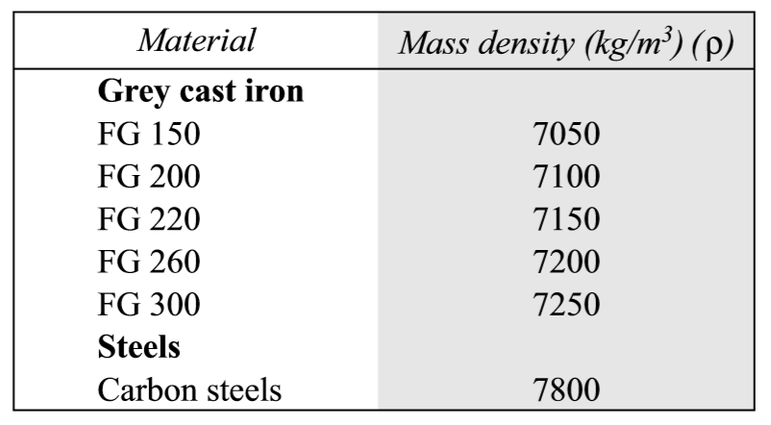
FLYWHEEL MATERIALS
Traditionally, ﬂywheels are made of cast iron. From design considerations, cast iron ﬂywheels offer the following advantages:
Cast iron ﬂywheels are the cheapest.
Cast iron ﬂywheel can be given any complex shape without involving machining operations.
Cast iron ﬂywheel has excellent ability to damp vibrations.
However, cast iron has poor tensile strength compared to steel. The failure of cast iron ﬂywheel is sudden and total. The machinability of cast iron ﬂywheel is poor compared to steel ﬂywheel.

Slide 4
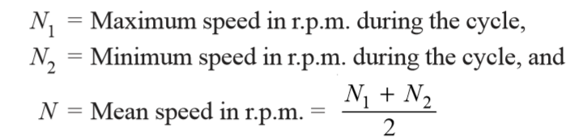
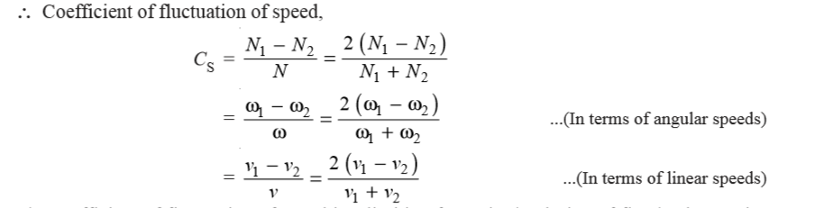
COEFFICIENT OF FLUCTUATION OF SPEED
The difference between the maximum and minimum speeds during a cycle is called the maximum fluctuation of speed. The ratio of the maximum fluctuation of speed to the mean speed is called coefficient of fluctuation of speed.

Slide 5
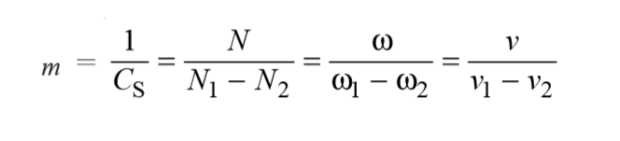
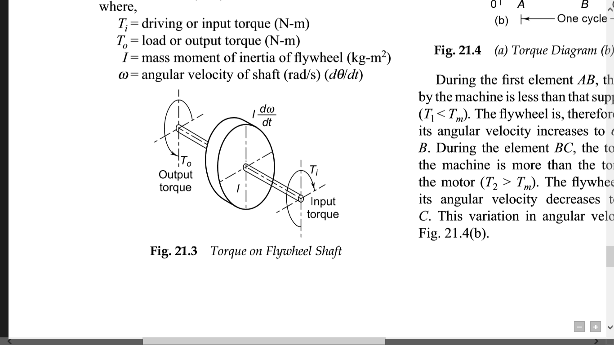
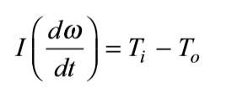
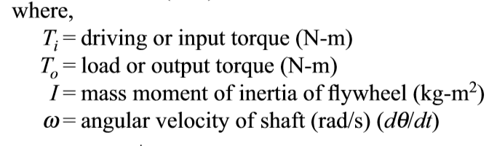
The reciprocal of coefficient of fluctuation of speed is known as coefficient of steadiness and it is denoted by m.
TORQUE ANALYSIS

Slide 6
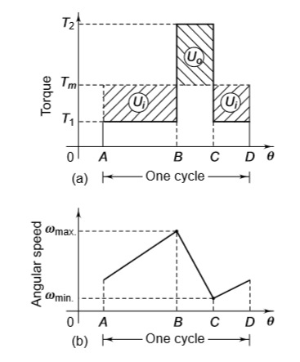
When the driving torque is more than the load torque, the term (T_{i} – T_{o}) is positive and the ﬂywheel is accelerated.
When the driving torque is less than the load torque, the term (T_{i} – T_{o}) is negative indicating retardation of ﬂywheel.
During the ﬁrst element AB, the torque required by the machine is less than that supplied by the motor (T₁ < T_{m}). The ﬂywheel is, therefore, accelerated and its angular velocity increases to ω_{max}. at the point B.
During the element BC, the torque required by the machine is more than the torque supplied by the motor (T₂ > T_{m}). The ﬂywheel is retarded and its angular velocity decreases to ω_{min}. at point C.

