Slide 1
DESIGN OF MACHINE ELEMENTS-II
(BME3102)
Lecture 18 Module 2
By:-
Dinesh Kumar
School of Engineering

Slide 2
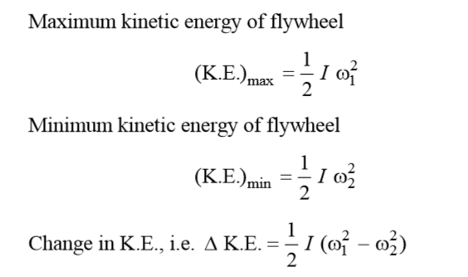
FLYWHEEL DESIGN
The function of the flywheel is to store excess energy during period of harvestation and it supplies energy during period of starvation. Thereby, it reduces fluctuation in the speed within the cycle. Let ω1 be the maximum angular speed and ω2 be the minimum angular speed.
Let I be the mass moment of inertia of the flywheel.

Slide 3
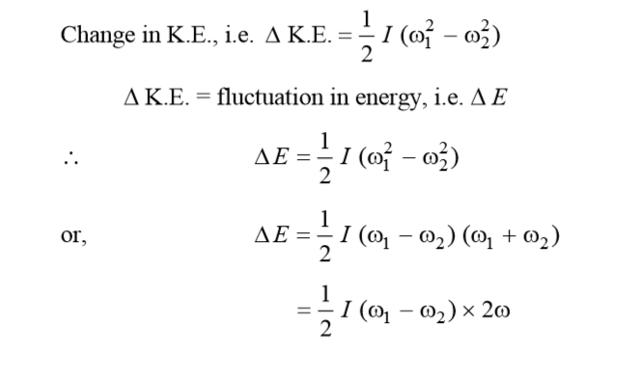
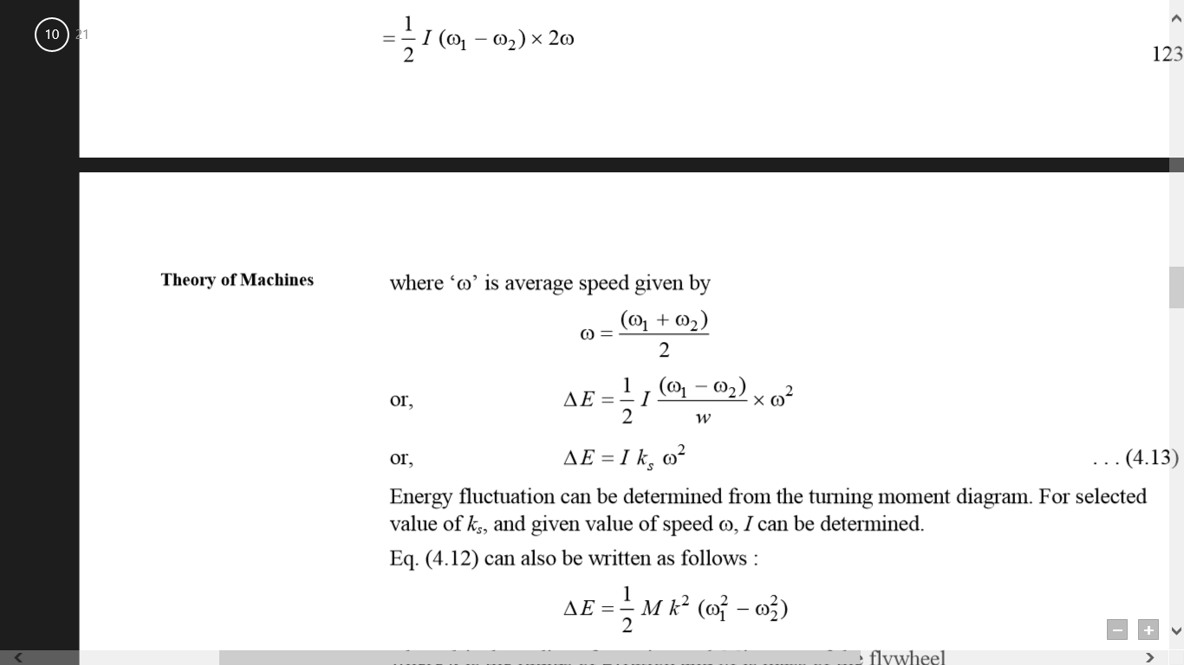

Slide 4
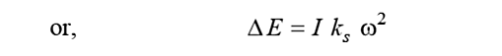
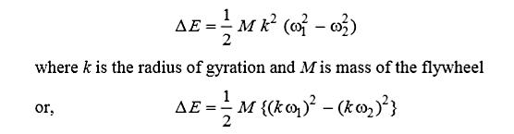
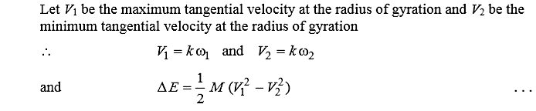
Energy fluctuation can be determined from the turning moment diagram. For selected value of Cs, and given value of speed ω, I can be determined.

Slide 5
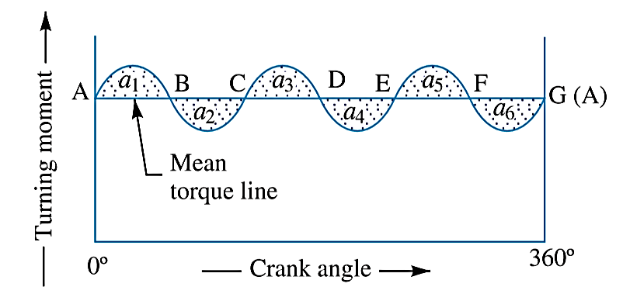
Maximum Fluctuation of Energy
A turning moment diagram for a multi-cylinder engine is shown by a wavy curve in Figure. The horizontal line AG represents the mean torque line. Let a₁, a₃, a₅ be the areas above the mean torque line and a₂, a₄ and a₆ be the areas below the mean torque line. These areas represent some quantity of energy which is either added or subtracted from the energy of the moving parts of the engine.

Slide 6
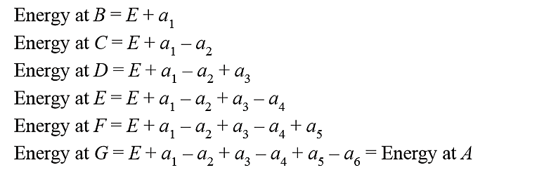
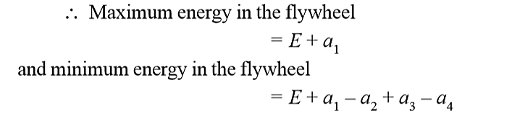
Let the energy in the flywheel at A = E, then from Figure, we have
Let us now suppose that the maximum of these energies is at B and minimum at E.

Slide 7
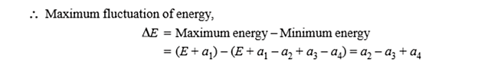

Slide 8
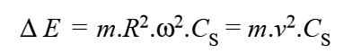
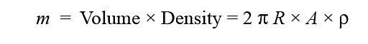
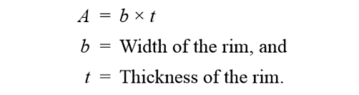
Knowing the ratio of b/t which is usually taken as 2, we may find the width and thickness of rim.

