Slide 1
DESIGN OF MACHINE ELEMENTS-II
(BME3102)
Lecture 19 Module 2
By:-
Dinesh Kumar
School of Engineering

Slide 2
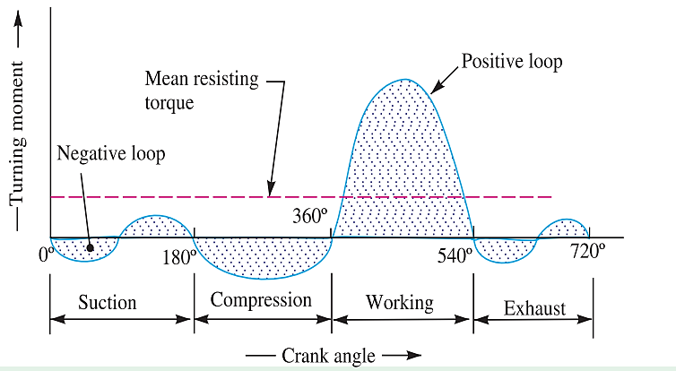
TUNRING MOMENT DIAGRAM FOR A FOUR STROKE INTERNAL COMBUSTION ENGINE.

Slide 3
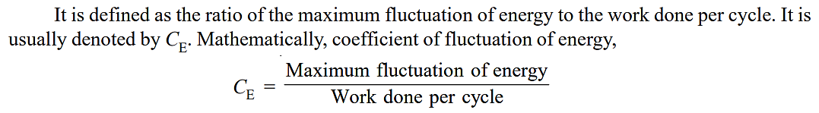
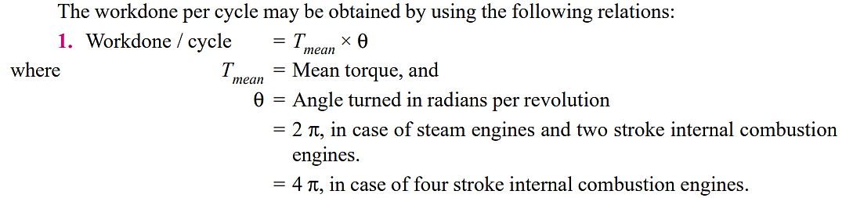
COEFFICIENT OF FLUCTUATION OF ENERGY

Slide 4
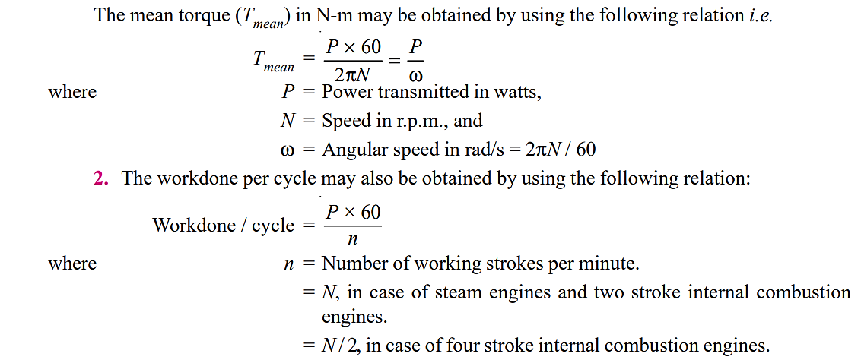

Slide 5
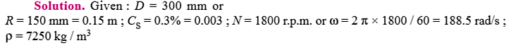
The turning moment diagram for a petrol engine is drawn to the following scales: Turning moment, 1 mm = 5 N-m; Crank angle, 1 mm = 1º. The turning moment diagram repeats itself at every half revolution of the engine and the areas above and below the mean turning moment line, taken in order are 295, 685, 40, 340, 960, 270 mm². Determine the mass of 300 mm diameter flywheel rim when the coefficient of fluctuation of speed is 0.3% and the engine runs at 1800 r.p.m. Also determine the cross-section of the rim when the width of the rim is twice of thickness. Assume density of rim material as 7250 kg / m³.

Slide 6
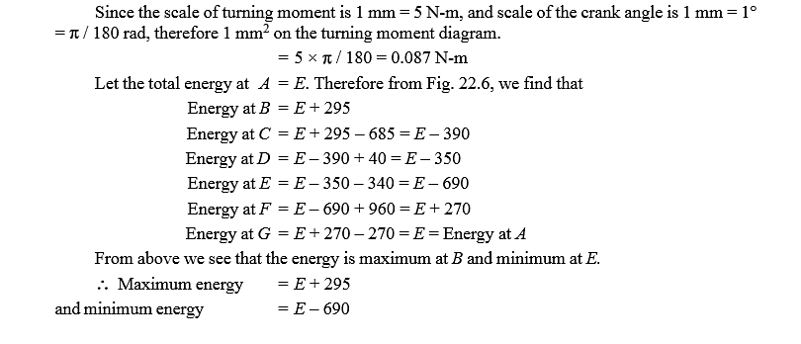

Slide 7
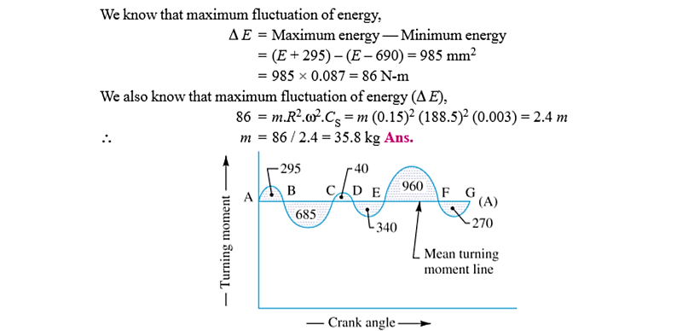

Slide 8
