Slide 1
DESIGN OF MACHINE ELEMENTS-II
(BME3102)
Lecture 2 Module 1
By:-
Dinesh Kumar
School of Engineering

Slide 2
MATERIAL USED FOR BELTS
LEATHER BELTS
Material: Top-grade steer hides
Properties: Hair side: Smoother, harder
  Flesh side: Stronger, interwoven fibers
Treatment: Oak-tanned or chrome-tanned
Configuration: Single, double, or triple ply
Maintenance: Requires periodic cleaning and oil treatment
Applications:
  Industrial machinery
  High-tensile strength applications
  Precision equipment

Slide 3
COTTON OR FABRIC BELTS
Material: Canvas or cotton duck, multiple layers stitched
Properties: Impregnated with linseed oil for water-proofing
Advantages: Cheaper, suitable for warm climates, low maintenance
Applications:
  Farm machinery
  Belt conveyors
  Warm and damp environments
  Exposed outdoor equipment

Slide 4
RUBBER BELTS
Material: Fabric layers impregnated with rubber composition
Properties: Flexible, but susceptible to damage from heat, oil, and grease
Advantages: Easily made endless
Applications:
  Saw mills
  Paper mills
  Moisture-exposed environments
  Light to medium industrial applications

Slide 5
BALATA BELTS
Material: Fabric layers impregnated with balata gum
Properties: Acid-proof, water-proof, resistant to animal oils and alkalies
Temperature Limit: Not suitable above 40°C
Strength: 25% higher than rubber belts
Applications:
  Chemical industries
  Food processing industries
  Applications requiring resistance to acids, oils, and moisture
  Heavy-duty industrial machinery

Slide 6
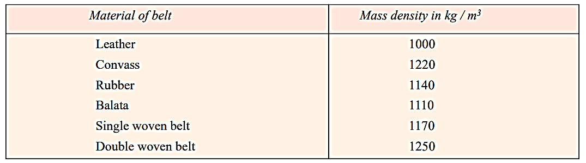
DENSITY OF BELT MATERIALS

Slide 7
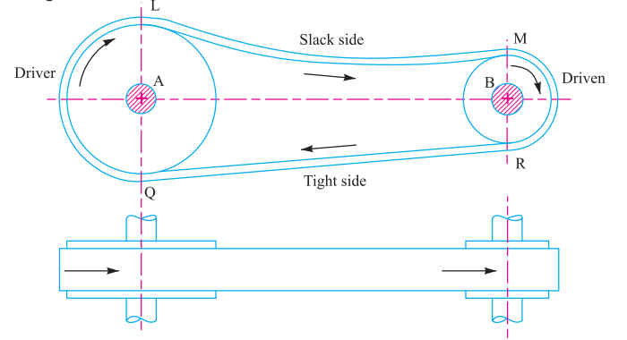
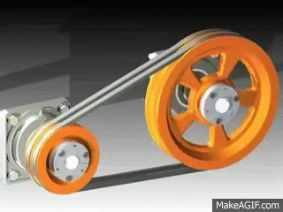
TYPES OF FLAT BELT DRIVES
1. OPEN BELT DRIVE
An open belt drive is used with parallel shafts that rotate in the same direction. In this configuration, the driver (A) pulls the belt from one side (lower side RQ) and delivers it to the other side (upper side LM). As a result, the tension in the lower side belt is greater than that in the upper side belt. The lower side belt, due to its higher tension, is known as the tight side, while the upper side belt, due to its lower tension, is known as the slack side.

Slide 8
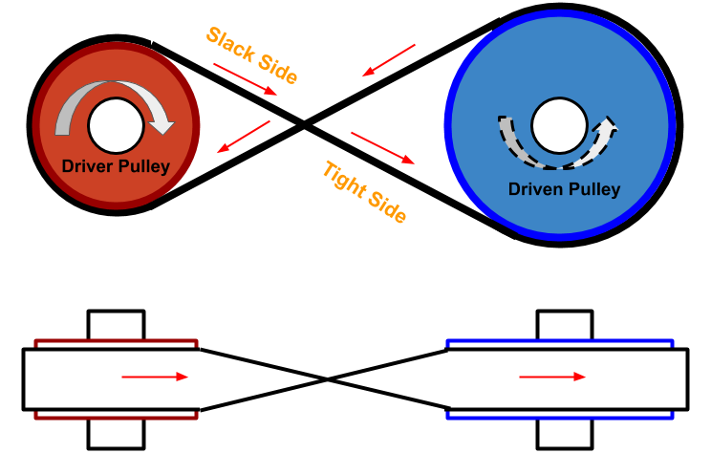
2. CROSSED OR TWIST BELT DRIVE
A crossed or twist belt drive is used with parallel shafts that rotate in opposite directions. In this setup, the driver pulls the belt from one side (RQ) and delivers it to the other side (LM). As a result, the tension in the belt RQ is greater than in the belt LM. The belt RQ, due to its higher tension, is known as the tight side, while the belt LM, due to its lower tension, is known as the slack side.
At the point where the belt crosses, the belts rub against each other, causing excessive wear and tear. To minimize this issue, the shafts should be placed at a maximum distance of 20 times the belt width (20b), and the belt speed should be kept below 15 m/s.

Slide 9
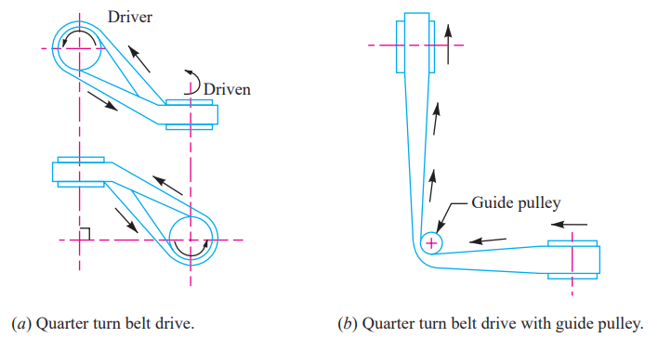
3. QUARTER TURN BELT DRIVE
The quarter turn belt drive, also known as a right angle belt drive, is used with shafts arranged at right angles and rotating in one direction. To prevent the belt from leaving the pulley, the face width of the pulley should be at least 1.4 times the belt width. If the pulleys cannot be arranged accordingly or if reversible motion is needed, a quarter turn belt drive with a guide pulley can be used.

Slide 10
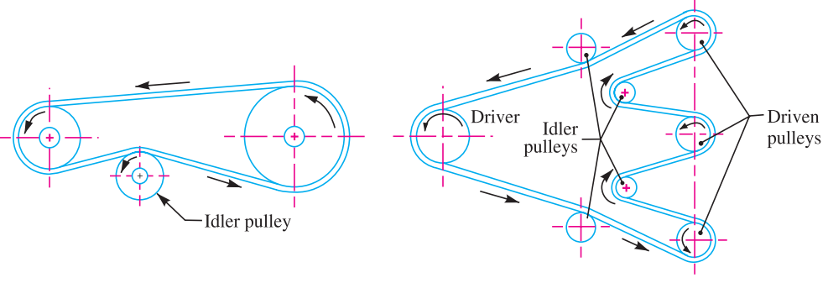
4. BELT DRIVE WITH IDLER PULLEY
A belt drive with an idler pulley, also known as a jockey pulley drive, is used with parallel shafts when an open belt drive cannot be used due to a small angle of contact on the smaller pulley. This type of drive is implemented to achieve a high velocity ratio and to maintain the required belt tension when other methods are inadequate. When motion needs to be transmitted from one shaft to several parallel shafts, multiple idler pulleys can be employed, AS SHOWN IN FIGURE

Slide 11
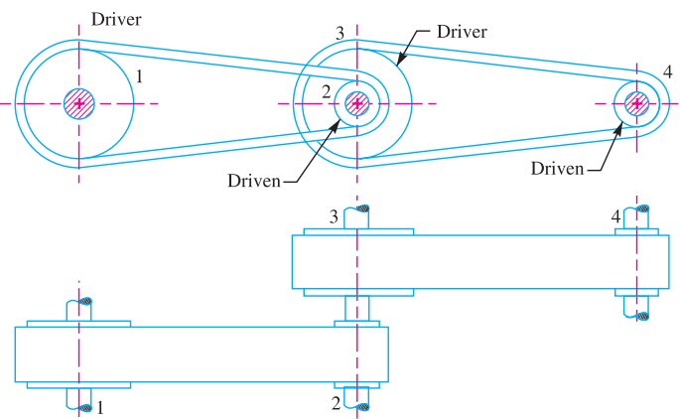
5. COMPOUND BELT DRIVE
A compound belt drive is used to transmit power from one shaft to another through multiple pulleys. This setup allows for power transfer across various points in a complex mechanical system

