Slide 1
DESIGN OF MACHINE ELEMENTS-II
(BME3102)
Lecture 20 Module 2
By:-
Dinesh Kumar
School of Engineering

Slide 2
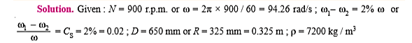
The intercepted areas between the output torque curve and the mean resistance line of a turning moment diagram for a multi cylinder engine, taken in order from one end are as follows: – 35, + 410, – 285, + 325, – 335, + 260, – 365, + 285, – 260 mm2. The diagram has been drawn to a scale of 1 mm = 70 N-m and 1 mm = 4.5°. The engine speed is 900 r.p.m. and the fluctuation in speed is not to exceed 2% of the mean speed. Find the mass and cross-section of the flywheel rim having 650 mm mean diameter. The density of the material of the flywheel may be taken as 7200 kg / m³. The rim is rectangular with the width 2 times the thickness. Neglect effect of arms, etc.

Slide 3
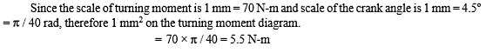
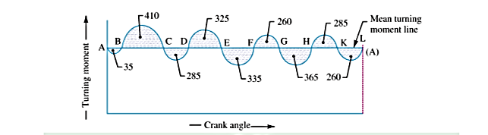
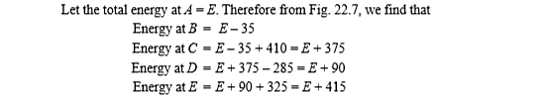

Slide 4
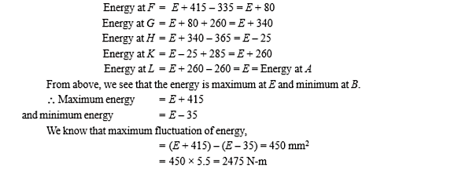
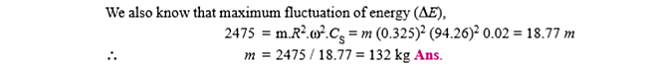

Slide 5
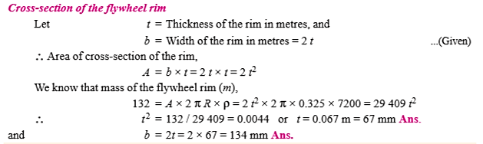

Slide 6
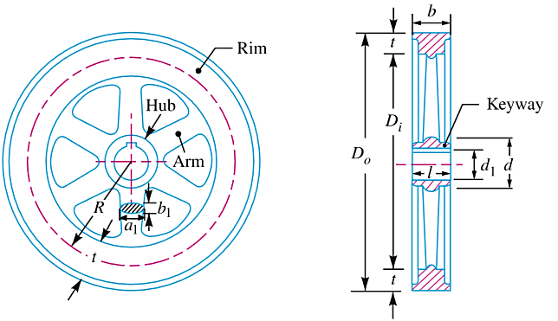
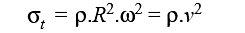
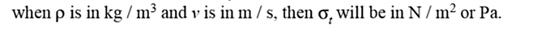
TENSILE STRESS DUE TO THE CENTRIFUGAL FORCE

