Slide 1
DESIGN OF MACHINE ELEMENTS-II
(BME3102)
Lecture 22 Module 3
By:-
Dinesh Kumar
School of Engineering

Slide 2
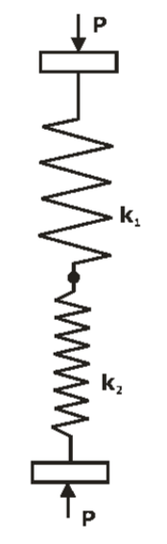
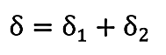

SERIES AND PARALLEL CONNECTIONS OF SPRINGS
FOR SERIES CONNECTION
The force acting on each spring is same and equal to the external force, i.e. P₁ = P₂ = P
The total deflection of the spring combination is equal to the sum of the deflections of individual springs

Slide 3
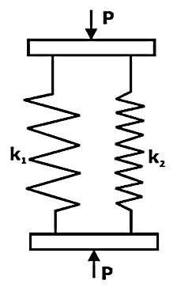
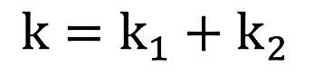
FOR PARALLEL CONNECTION
The force acting on the spring combination is equal to the sum of forces acting on individual springs, i.e. P = P₁ + P₂
The deflection of individual springs is same and equal to the deflection of the combination i.e. δ₁ = δ₂ = δ

Slide 4
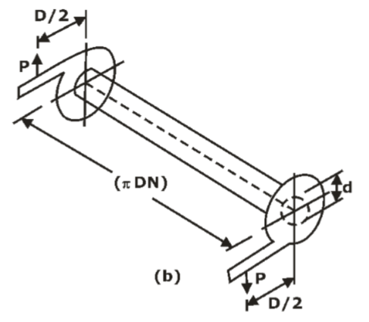
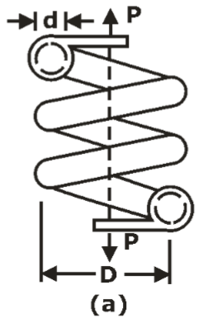
STRESS AND DEFLECTION EQUATIONS
There are two basic equations for the design of helical springs, load – stress equation and load – deflection equation A helical spring made from the wire of circular cross-section is shown in figure (a)

Slide 5
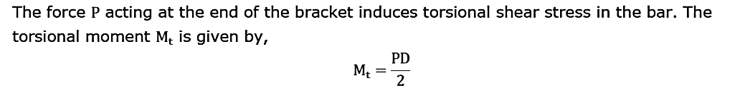
Let, a helical spring is subjected to an axial force P When the wire of the helical spring is uncoiled and straightened, it takes the shape of a bar as shown in figure (b)
The diameter of the bar is equal to the wire diameter of the spring (d)
The length of one coil in the spring is (πD). There are N such active coils. Therefore, the length of equivalent bar is (πDN)
The bar is fitted with a bracket at each end. The length of this bracket is equal to mean coil radius of the spring (D/2)

Slide 6
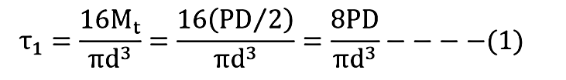
The torsional shear stress in the bar is given by,
When the equivalent bar is bent in the form of helical coil, there are additional stresses on account of following two factors:
There is direct or transverse shear stress in the spring wire
When the wire is bent in the form of coil, the length of the inside fiber is less than the length of the outside fiber. This results in stress concentration at the inside fiber of the coil The resultant stress consists of superimposition of torsional shear stress, direct shear stress and additional stresses due to the curvature of the coil

Slide 7
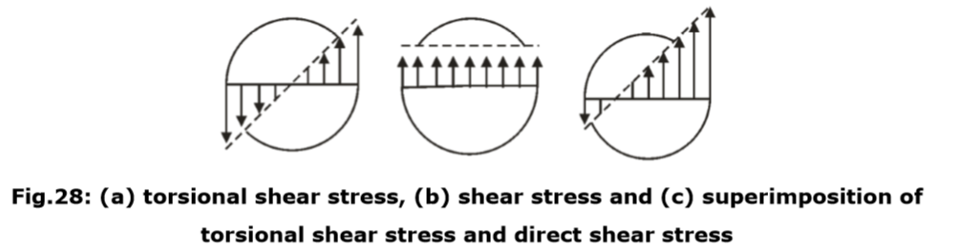

Slide 8
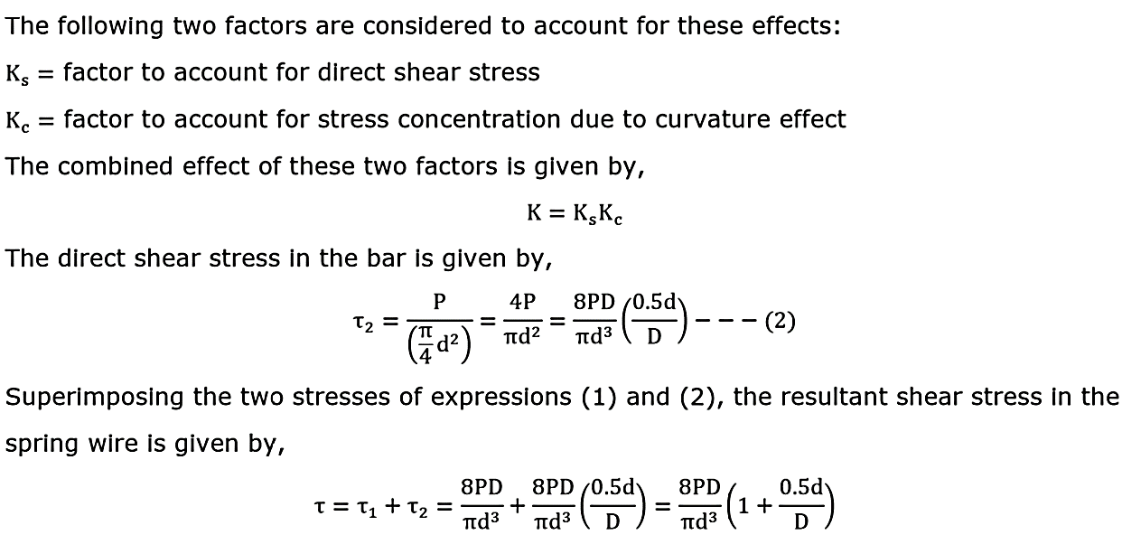

Slide 9
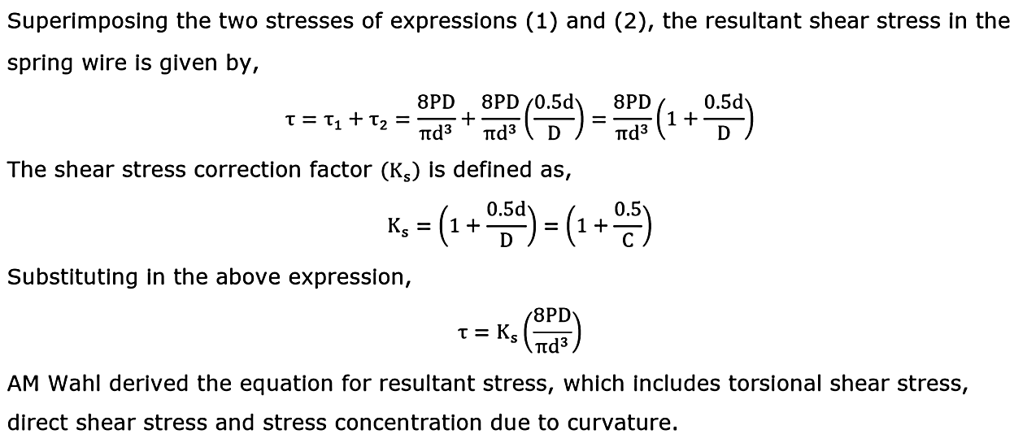

Slide 10
