Slide 1
DESIGN OF MACHINE ELEMENTS-II
(BME3102)
Lecture 3 Module 1
By:-
Dinesh Kumar
School of Engineering

Slide 2
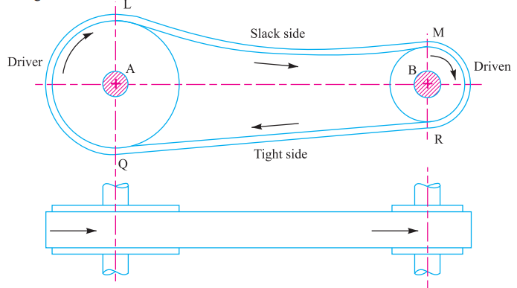
VELOCITY RATIO OF A BELT DRIVE
It is the ratio between the velocities of the driver and the follower or driven. It may be expressed
d₁ = Diameter of the driver,
d₂ = Diameter of the follower,
N₁ = Speed of the driver in r.p.m.,
N₂ = Speed of the follower in r.p.m.,

Slide 3
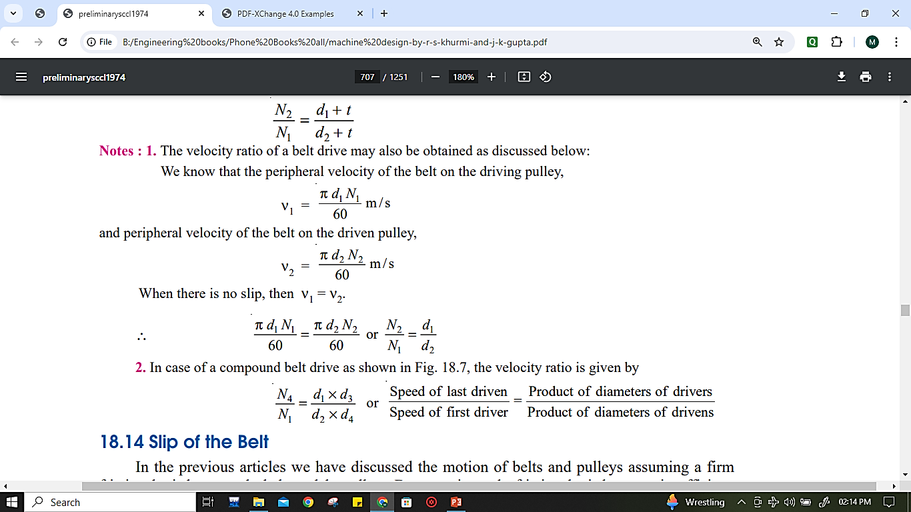
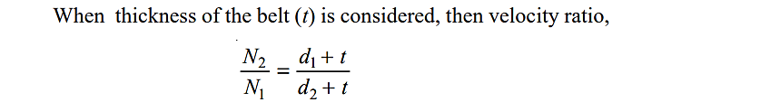

Slide 4
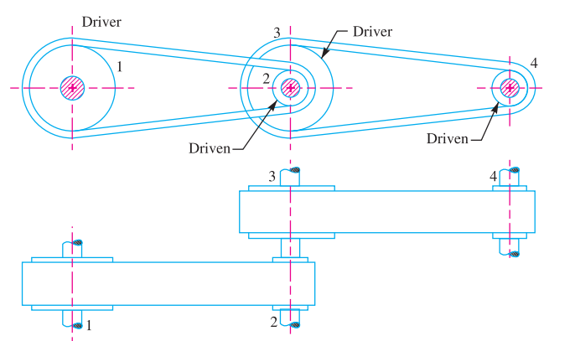
COMPOUND BELT DRIVE
d₁ = Diameter of the driver,
d₂ = Diameter of the follower,
d₃ = Diameter of the driver,
d₄ = Diameter of the follower,
N₁ = Speed of the driver in r.p.m.,
N₂ = Speed of the follower in r.p.m.,
N₃ = Speed of the driver in r.p.m.,
N₄ = Speed of the follower in r.p.m.,

Slide 5
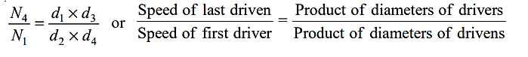
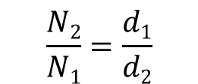
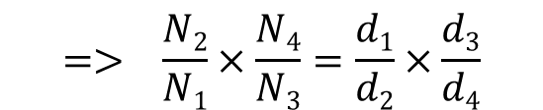

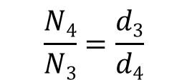
Speed ratio between 1st and 2nd pulley
Speed ratio between 3rd and 4th pulley
$$\frac{N2}{N1}=\frac{d1}{d2}$$
$$\frac{N4}{N3}=\frac{d3}{d4}$$
Taking Speed ratios on left side and diameters on the right hand side of the equation
$$\frac{N2}{N1}×\frac{N4}{N3}=\frac{d1}{d2}×\frac{d3}{d4}$$
N₂=N3 (Pulley 2 and Pulley 3 on the same shaft, Therefore will have the same speeds)
$$=> \frac{N2}{N1}×\frac{N4}{N3}=\frac{d1}{d2}×\frac{d3}{d4}$$

Slide 6
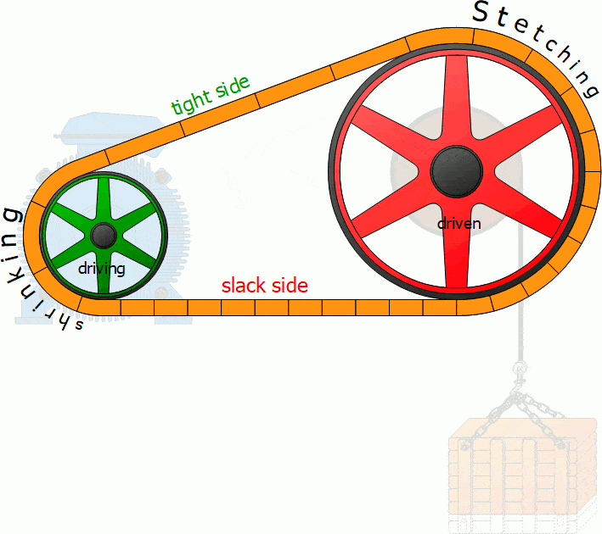
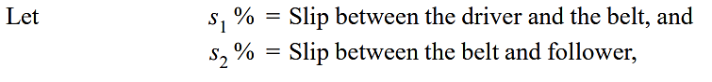
SLIP OF THE BELT
In the previous slides we have discussed the motion of belts and pulleys assuming a firm frictional grip between the belts and the pulleys. But sometimes, the frictional grip becomes insufficient. This may cause some forward motion of the driver without carrying the belt with it. This is called slip of the belt and is generally expressed as a percentage.

Slide 7
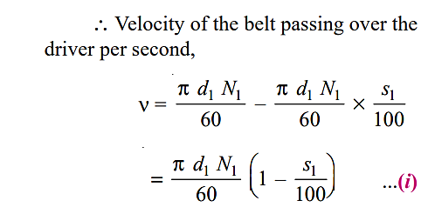
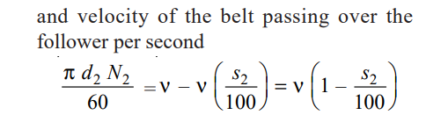
Substituting the value of ν from equation (i), we have

Slide 8
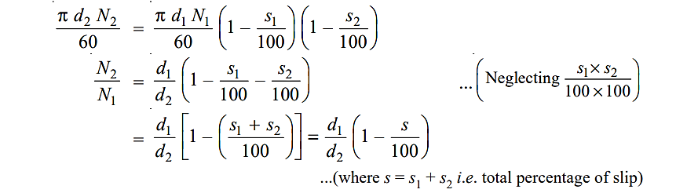
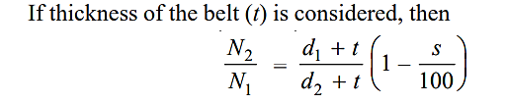

Slide 9
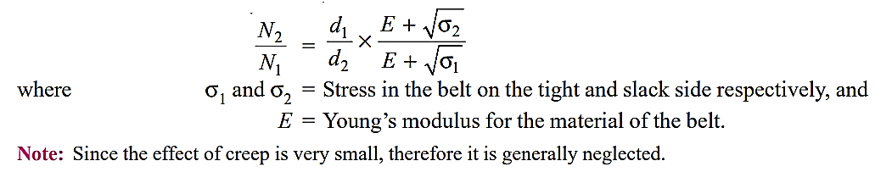
CREEP OF BELT
When the belt passes from the slack side to the tight side, a certain portion of the belt extends and it contracts again when the belt passes from the tight side to the slack side. Due to these changes of length, there is a relative motion between the belt and the pulley surfaces. This relative motion is termed as creep.

Slide 10
