Slide 1
DESIGN OF MACHINE ELEMENTS-II
(BME3102)
Lecture 32 Module 5
By:-
Dinesh Kumar
School of Engineering

Slide 2

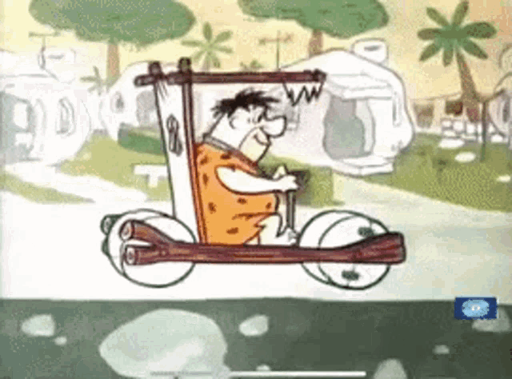
BRAKES
A brake is deﬁned as a mechanical device, which is used to absorb the energy possessed by a moving system or mechanism by means of friction.
The primary purpose of the brake is to slow down or completely stop the motion of a moving system, such as a rotating drum, machine or vehicle.
The energy absorbed by the brake can be either kinetic or potential or both.
The energy absorbed by the brake is converted into heat energy and dissipated to the surroundings.

Slide 3
TYPES OF BRAKES
Mechanical brakes, which are operated by mechanical means such as levers, springs and pedals.
Hydraulic and pneumatic brakes, which are operated by ﬂuid pressure such as oil pressure or air pressure.
Electrical brakes, which are operated by magnetic forces and which include magnetic particle brakes, hysteresis brakes and eddy-current brakes.

Slide 4
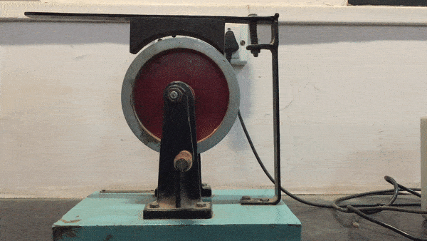
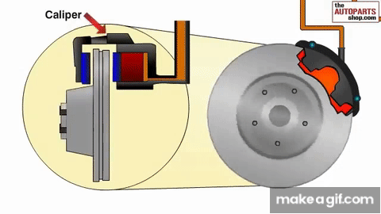
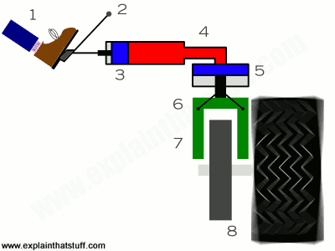
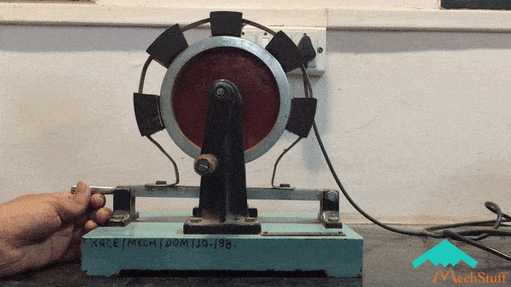

Slide 5
Brake capacity depends upon the following factors:
The unit pressure between braking surfaces
The contacting area of braking surface
The radius of the brake drum
The coefﬁcient of friction
The ability of the brake to dissipate heat that is equivalent to the energy being absorbed.

Slide 6
MATERIALS FOR BRAKE LINING
The material used for the brake lining should have the following characteristics :
It should have high coefficient of friction with minimum fading. In other words, the coefficient of friction should remain constant over the entire surface with change in temperature.
It should have low wear rate.
It should have high heat resistance.
It should have high heat dissipation capacity.
It should have low coefficient of thermal expansion.
It should have adequate mechanical strength.
It should not be affected by moisture and oil.

Slide 7
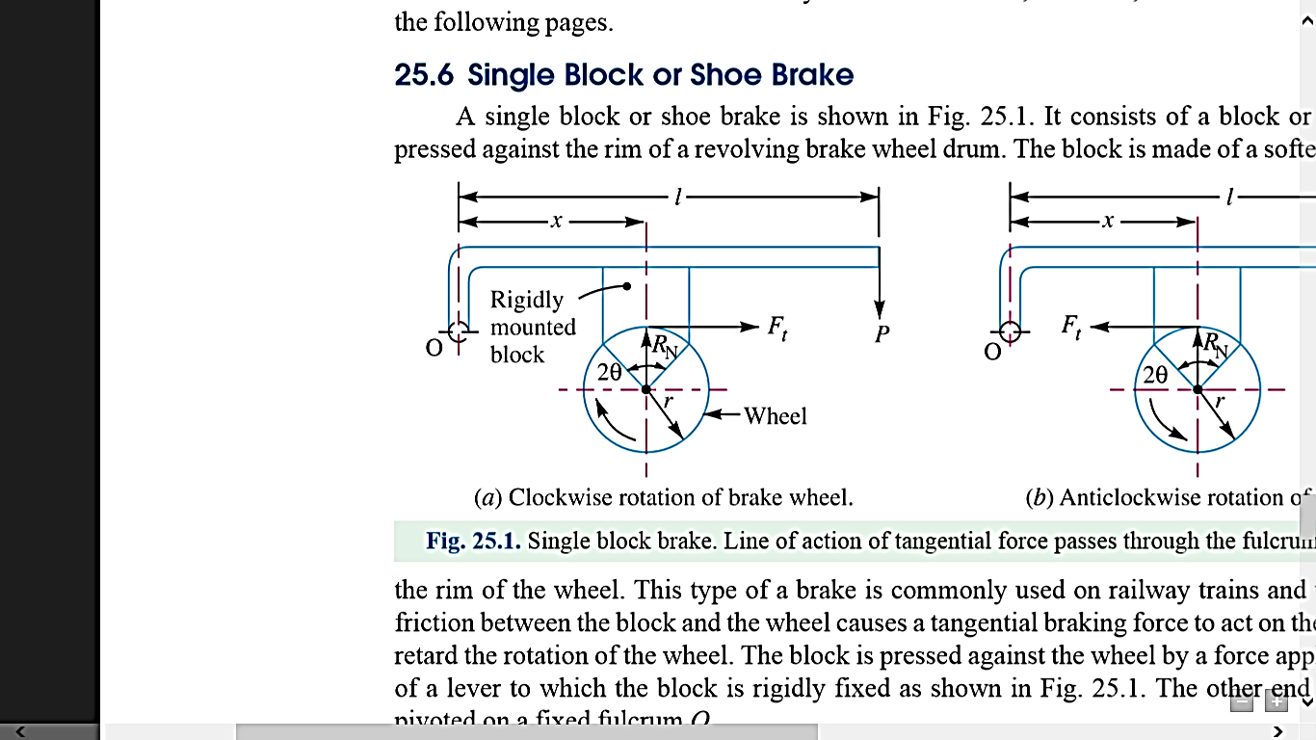
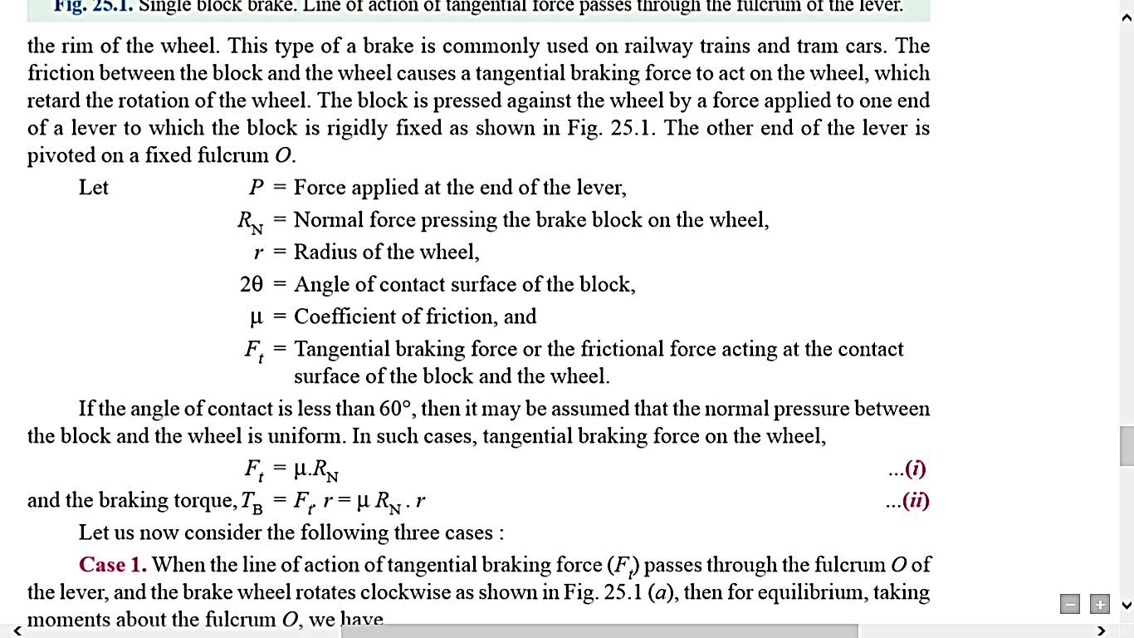
SINGLE BLOCK OR SHORT SHOE BRAKE

Slide 8
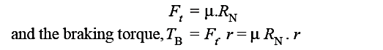
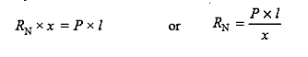
If the angle of contact is less than 60°, then it may be assumed that the normal pressure between the block and the wheel is uniform. In such cases, tangential braking force on the wheel,
Case 1. When the line of action of tangential braking force (F_{t}) passes through the fulcrum O of the lever, and the brake wheel rotates clockwise as shown in Figure, then for equilibrium, taking moments about the fulcrum O, we have

Slide 9
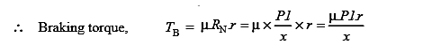
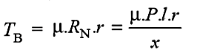
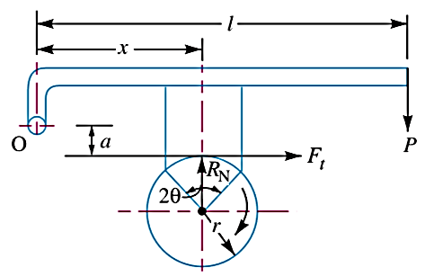
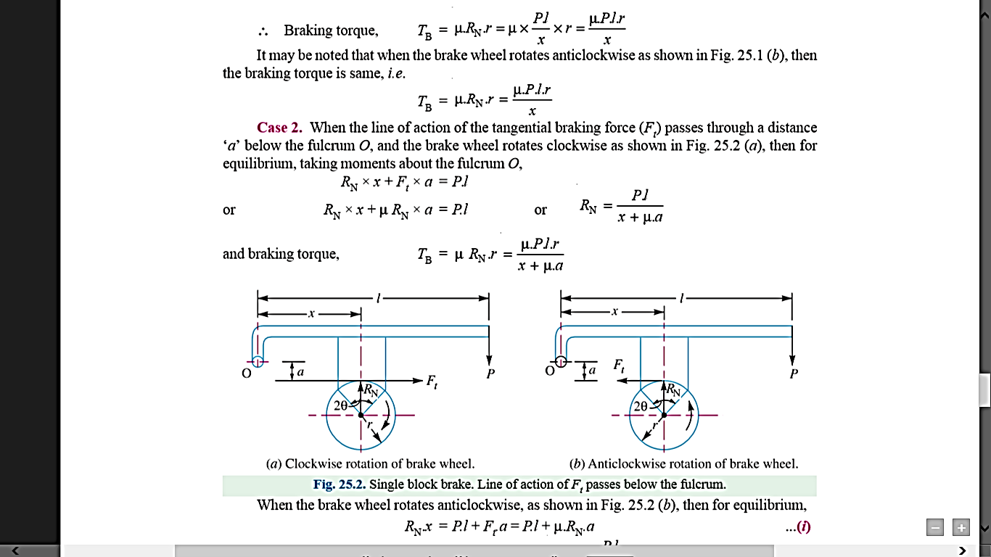
It may be noted that when the brake wheel rotates anticlockwise as shown in Figure, then the braking torque is same, i.e.
Case 2. When the line of action of the tangential braking force (Ft) passes through a distance ‘a’ below the fulcrum O, and the brake wheel rotates clockwise as shown in Figure, then for equilibrium, taking moments about the fulcrum O,

Slide 10
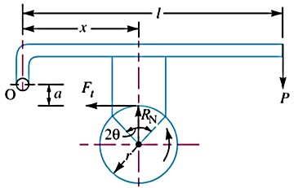
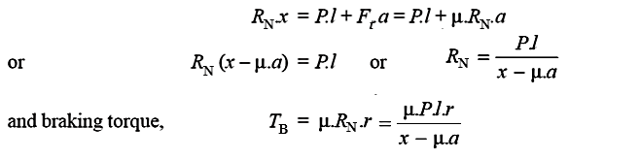
When the brake wheel rotates anticlockwise, as shown in Figure, then for equilibrium,

