Slide 1
DESIGN OF MACHINE ELEMENTS-II
(BME3102)
Lecture 33 Module 5
By:-
Dinesh Kumar
School of Engineering

Slide 2
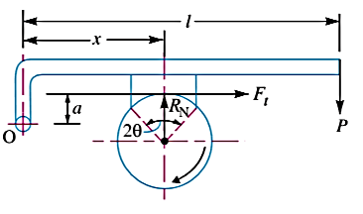
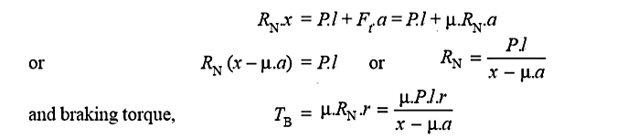
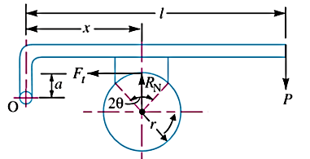
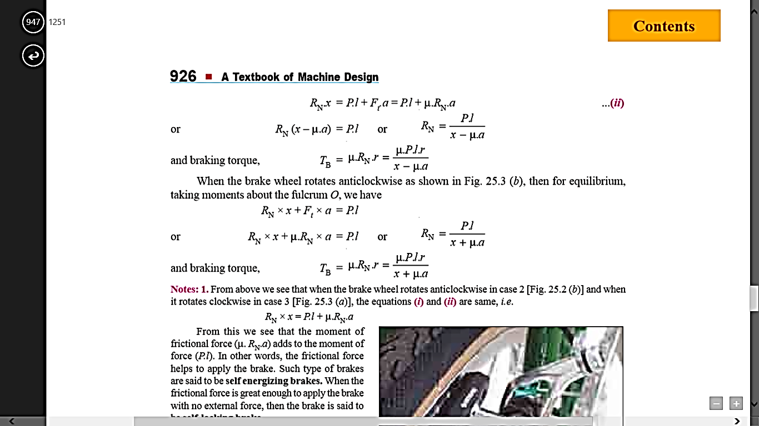
Case 3. When the line of action of the tangential braking force passes through a distance ‘a’ above the fulcrum, and the brake wheel rotates clockwise as shown in Figure, then for equilibrium, taking moments about the fulcrum O, we have
When the brake wheel rotates anticlockwise as shown in Figure, then for equilibrium, taking moments about the fulcrum O, we have

Slide 3
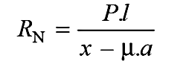
Case: I x>μa
Case: II x=μa
Case: III x<μa
This is a dangerous operating condition, resulting in uncontrolled braking and grabbing.
‘self-energizing’
‘self-locking’

Slide 4
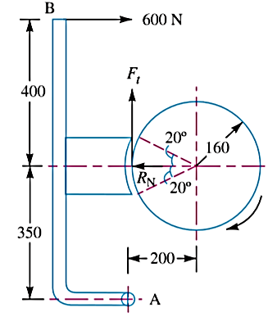
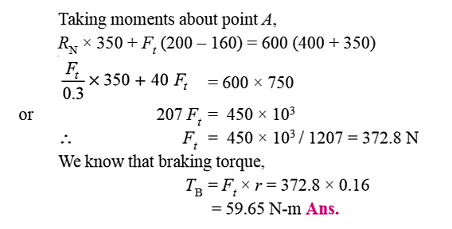
Figure shows a brake shoe applied to a drum by a lever AB which is pivoted at a fixed point A and rigidly fixed to the shoe. The radius of the drum is 160 mm. The coefficient of friction of the brake lining is 0.3. If the drum rotates clockwise, find the braking torque due to the horizontal force of 600 N applied at B.

Slide 5
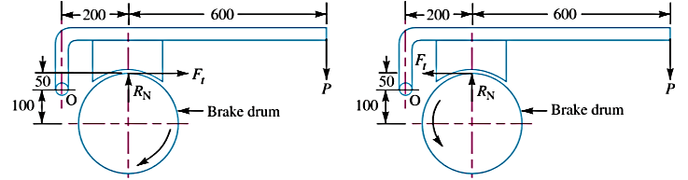
The block brake, as shown in Figure, provides a braking torque of 360 N-m. The diameter of the brake drum is 300 mm. The coefficient of friction is 0.3.
Find :
The force (P) to be applied at the end of the lever for the clockwise and counter clockwise rotation of the brake drum; and
The location of the pivot or fulcrum to make the brake self locking for the clockwise rotation of the brake drum.

Slide 6
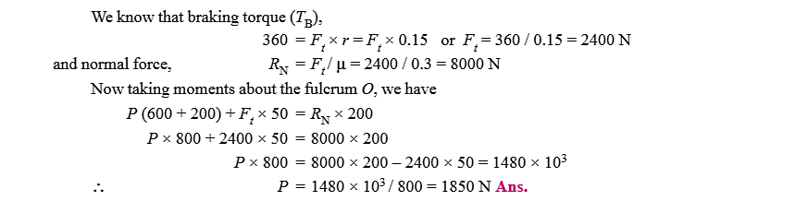
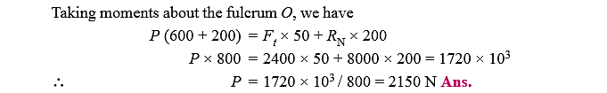
For the counter clockwise rotation of the drum, the frictional force or the tangential force (Ft) acting at the contact surfaces

Slide 7
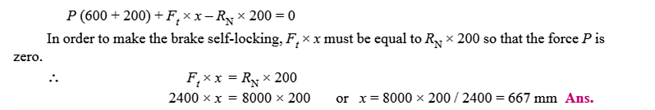
The clockwise rotation of the brake drum is shown in Figure Let x be the distance of the pivot or fulcrum O from the line of action of the tangential force (Ft). Taking moments about the fulcrum O, we have

Slide 8
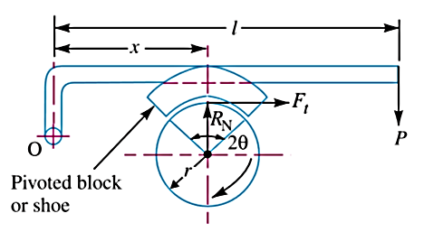
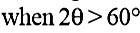
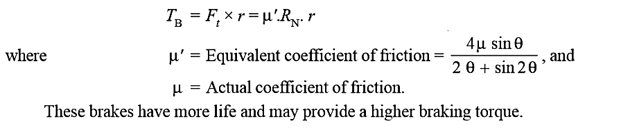
PIVOTED BLOCK OR LONG SHOE BRAKE
when the angle of contact is greater than 60°, then the unit pressure normal to the surface of contact is less at the ends than at the centre

Slide 9
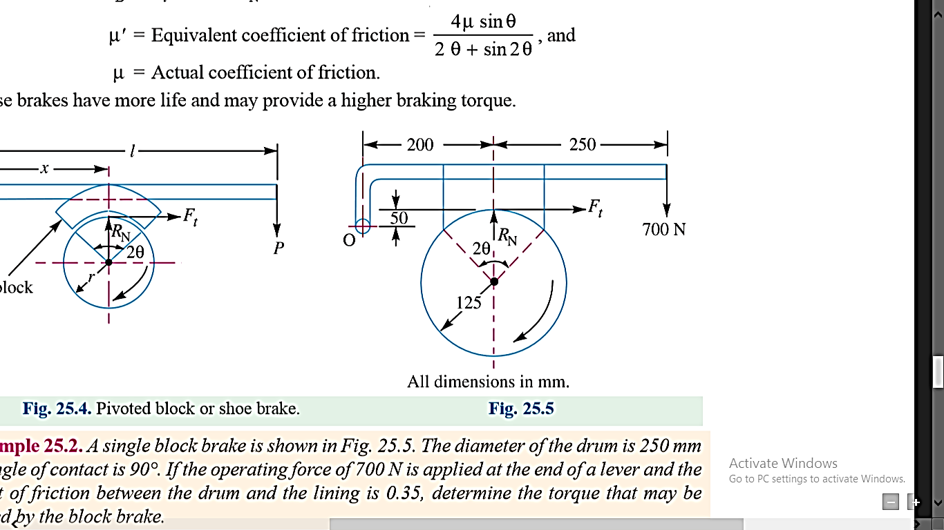
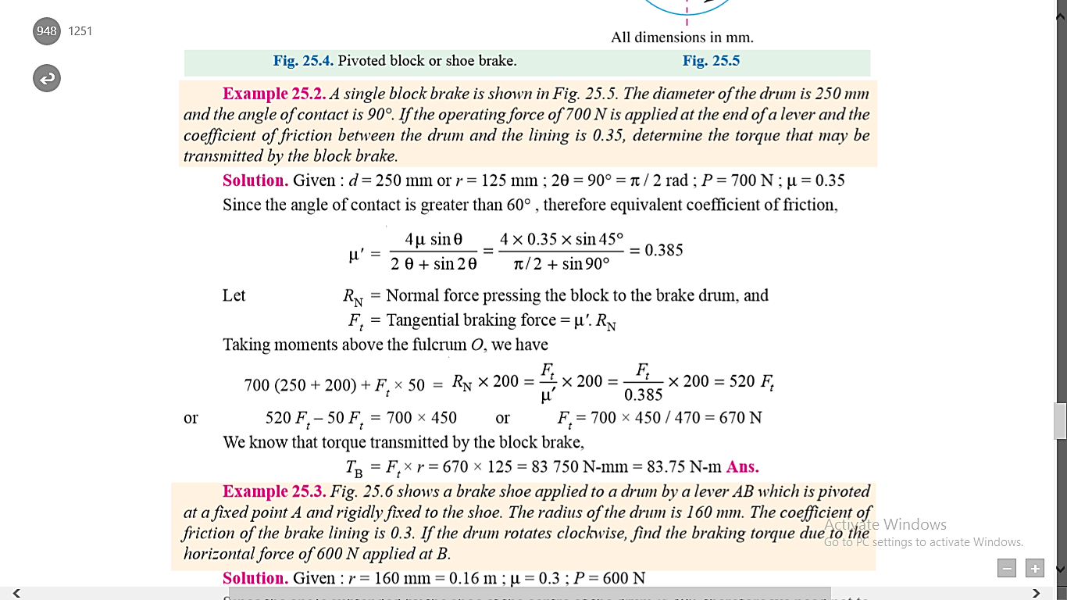
A single block brake is shown in Figure the diameter of the drum is 250 mm and the angle of contact is 90°. If the operating force of 700 N is applied at the end of a lever and the coefficient of friction between the drum and the lining is 0.35, determine the torque that may be transmitted by the block brake.
Given : d = 250 mm or r = 125 mm ; 2θ = 90° = π/ 2 rad ; P = 700 N μ = 0.35

Slide 10
