Slide 1
DESIGN OF MACHINE ELEMENTS-II
(BME3102)
Lecture 34 Module 5
By:-
Dinesh Kumar
School of Engineering

Slide 2
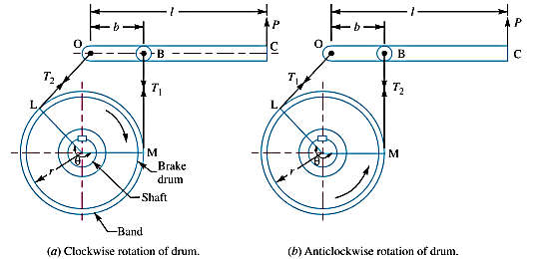
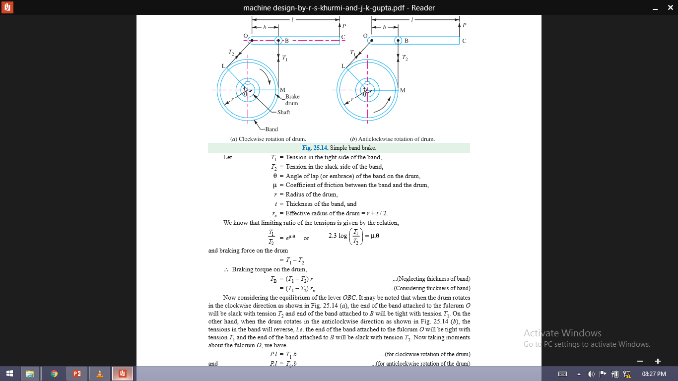
SIMPLE BAND BRAKE
A band brake consists of a flexible band of leather, one or more ropes, or a steel lined with friction material, which embraces a part of the circumference of the drum.

Slide 3
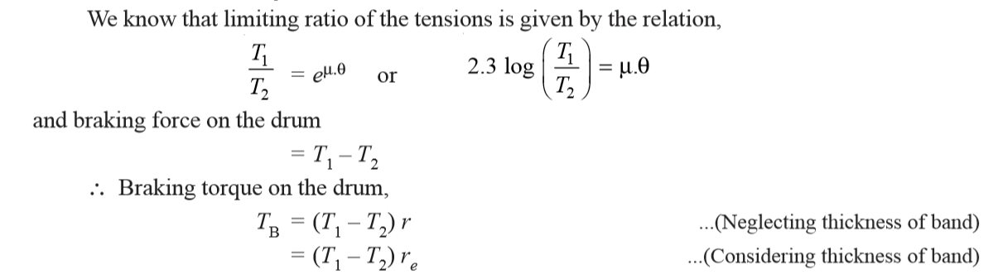
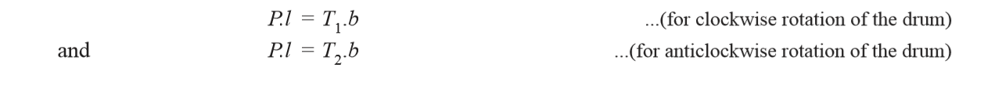
Taking Moment About pivoted point O

Slide 4
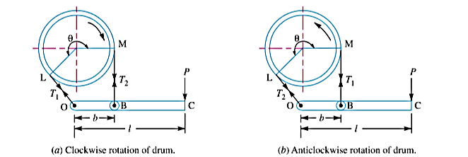
Sometimes the brake band is attached to the lever as shown in Figure (a) and (b), then the force (P) must act in the downward direction in order to tighten the band.

Slide 5
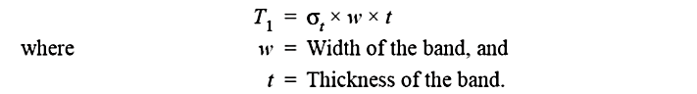
If the permissible tensile stress (σt) for the material of the band is known, then maximum tension in the band is given by

Slide 6
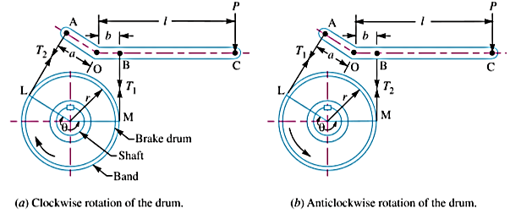
DIFFERENTIAL BAND BRAKE
In this case, neither end of the band passes through the fulcrum of the actuating lever. Such brakes can be designed for the condition of self-locking.

Slide 7
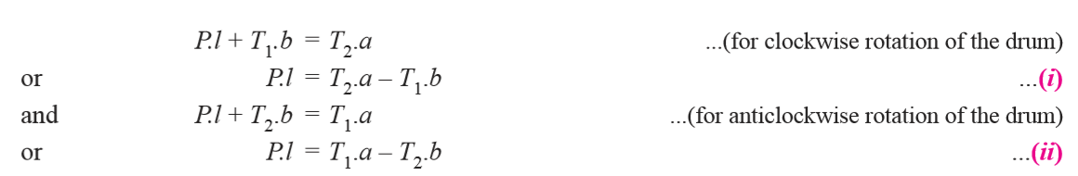
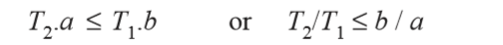
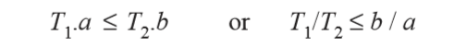
Now taking moments about the fulcrum O, we have
when the force P is negative or zero, then brake is self locking. Thus for differential band brake and for clockwise rotation of the drum, the condition for self- locking is
and for anticlockwise rotation of the drum, the condition for self-locking is

Slide 8
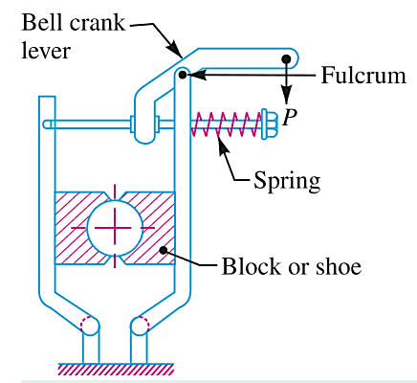
DOUBLE BLOCK OR SHOE BRAKE
When a single block brake is applied to a rolling wheel, and additional load is thrown on the shaft bearings due to the normal force (RN). This produces bending of the shaft. In order to overcome this drawback, a double block or shoe brake as shown in Figure, is used. It consists of two brake blocks applied at the opposite ends of a diameter of the wheel which eliminate or reduces the unbalanced force on the shaft.

