Slide 1
DESIGN OF MACHINE ELEMENTS-II
(BME3102)
Lecture 33 Module 4
By:-
Dinesh Kumar
School of Engineering

Slide 2
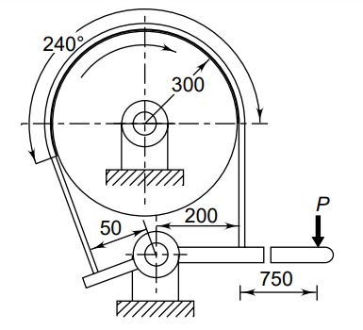
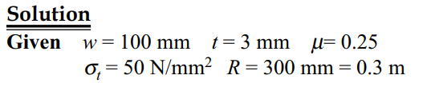
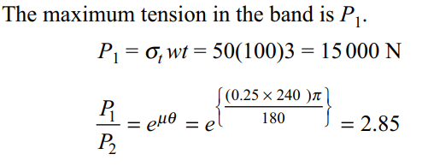
A differential band brake is shown in Figure. The width and the thickness of the steel band are 100 mm and 3 mm respectively and the maximum tensile stress in the band is 50 N/mm2. The coefficient of friction between the friction lining and the brake drum is 0.25. Calculate: (i) the tensions in the band; (ii) the actuating force; and (iii) the torque capacity of the brake. Find out whether the brake is self-locking.

Slide 3
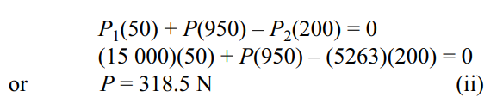
Torque capacity of brake
M_{t} = (P₁– P₂)R = (15000 – 5263)(0.3)
= 2921.1 N-m

Slide 4
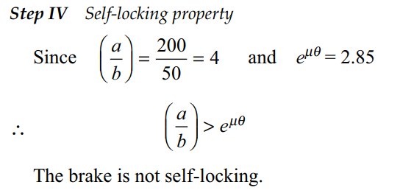

Slide 5
THERMAL CONSIDERATIONS
Brakes convert absorbed energy into heat, raising the temperature of rubbing surfaces and reducing the coefficient of friction, which lowers torque capacity.
Excessive heat causes rapid wear of the friction lining, shortening its lifespan.
Maintaining the temperature within permissible limits is crucial, as specified for various friction materials.

Slide 6
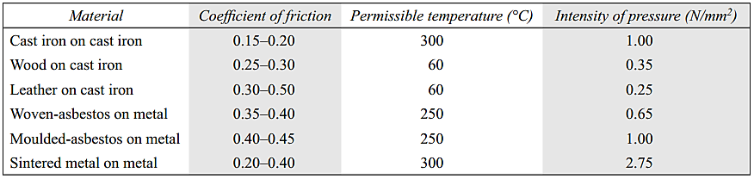
Properties of friction materials for brakes
Precise calculation of temperature rise is difficult, so the product (pv) is commonly used in preliminary design analysis. The rate of heat generation is proportional to (pv), where p represents normal pressure intensity and v is the rubbing speed. Recommended (pv) values are provided in the table.

Slide 7
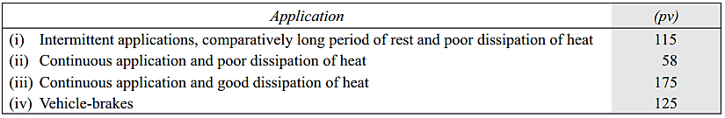
Recommended values of product (pv)
***where p represents normal pressure intensity and v is the rubbing speed

Slide 8
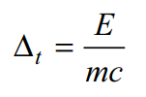
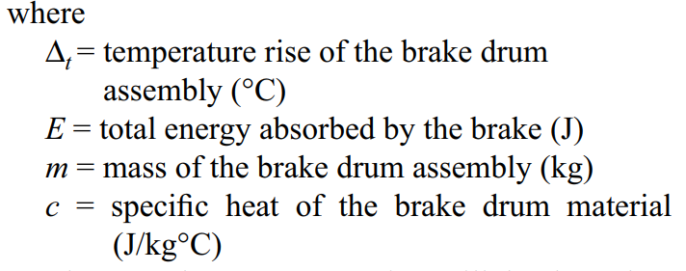
The temperature rise depends upon the mass of the brake drum assembly, the ratio of the braking period to the rest period and the specific heat of the material. For peak short-time requirements, it is assumed that all the heat generated during the braking period is absorbed by the brake drum assembly. In that case, the temperature rise is given by

Slide 9
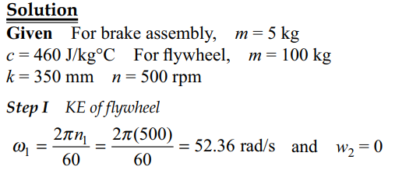
A flywheel of 100 kg mass and 350 mm radius of gyration is rotating at 500 rpm. It is brought to rest by means of a brake. The mass of the brake drum assembly is 5 kg. The brake drum is made of cast-iron FG260(c = 460 J/kg°C ). Assuming that the total heat generated is absorbed by the brake drum only, calculate the temperature rise.

Slide 10
