Slide 1
DESIGN OF MACHINE ELEMENTS-II
(BME3102)
Lecture 4 Module 1
By:-
Dinesh Kumar
School of Engineering

Slide 2
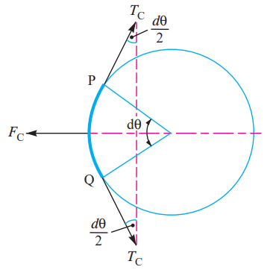
CENTRIFUGAL TENSION
Since the belt continuously runs over the pulleys, therefore, some centrifugal force is caused, whose effect is to increase the tension on both the tight as well as the slack sides. The tension caused by centrifugal force is called centrifugal tension.
Let m = Mass of belt per unit length in kg,
v = Linear velocity of belt in m/s,
r = Radius of pulley over which the belt runs in metres, and
T_{C} = Centrifugal tension acting tangentially at P and Q in newtons.

Slide 3
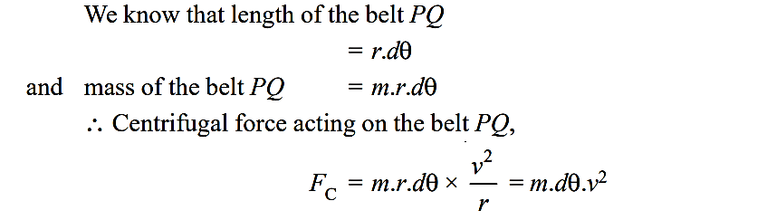
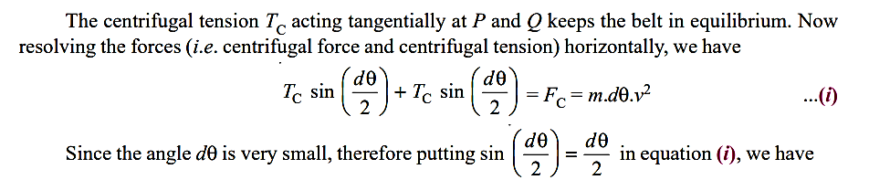

Slide 4
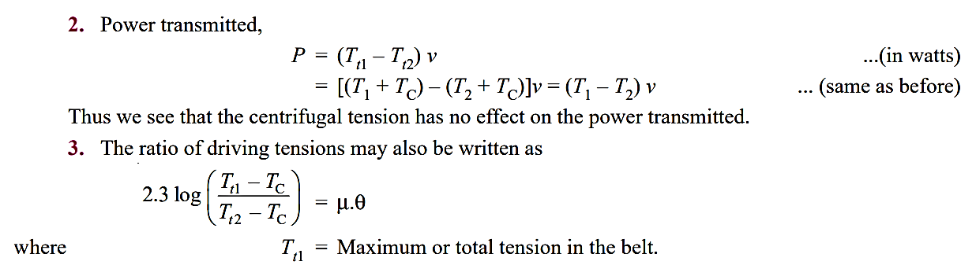

Slide 5
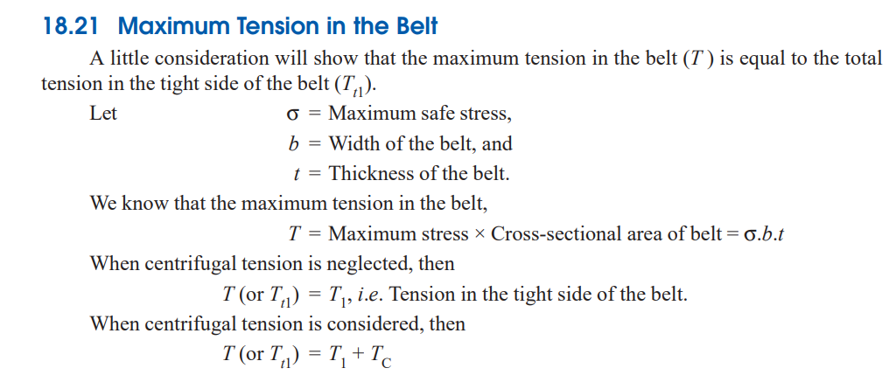

Slide 6
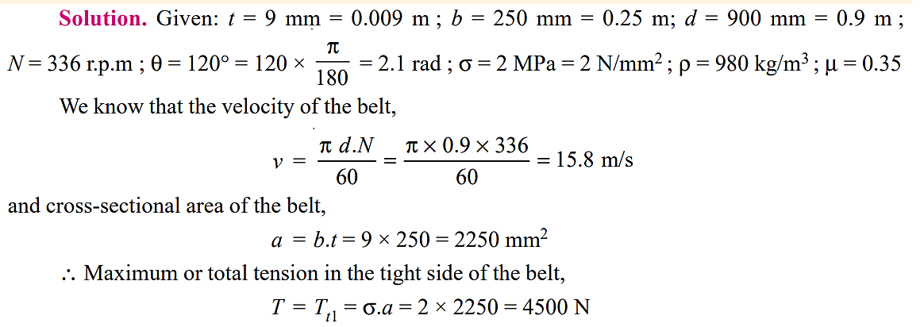
A leather belt 9 mm × 250 mm is used to drive a cast iron pulley 900 mm in diameter at 336 r.p.m. If the active arc on the smaller pulley is 120° and the stress in tight side is 2 MPa, find the power capacity of the belt. The density of leather may be taken as 980 kg/m3, and the coefficient of friction of leather on cast iron is 0.35.

Slide 7
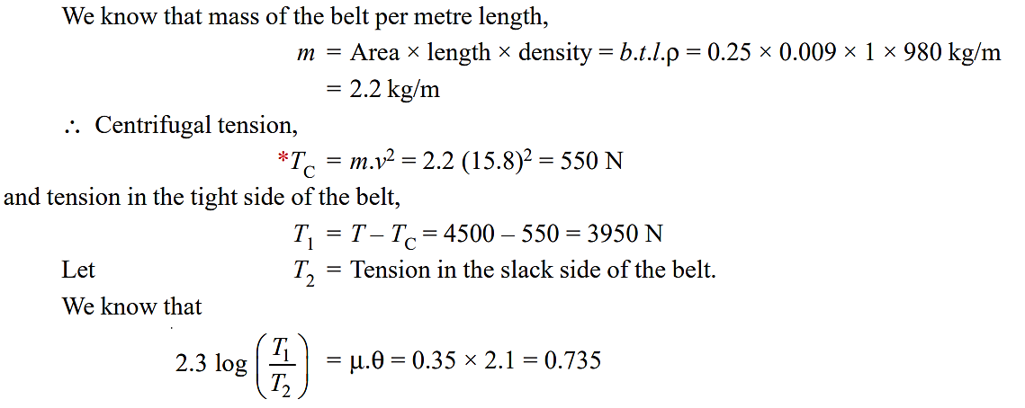

Slide 8
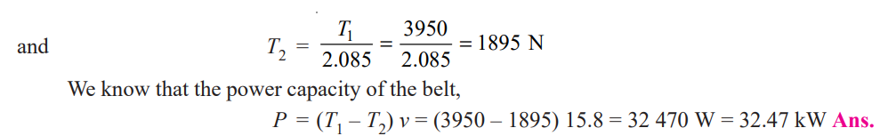

Slide 9
A wind turbine uses a belt drive to transmit power from the turbine blades to an electric generator. The turbine blades rotate at 30 RPM, and the generator needs to operate at 1500 RPM to produce electricity efficiently. The diameter of the turbine's pulley is 2 meters.

Slide 11
An automotive engine uses a belt drive to power the alternator. The engine crankshaft pulley has a diameter of 150 mm and rotates at 3000 RPM. The alternator pulley needs to rotate at 6000 RPM for optimal performance.

