Slide 1
DESIGN OF MACHINE ELEMENTS-II
(BME3102)
Lecture 5 Module 1
By:-
Dinesh Kumar
School of Engineering

Slide 2
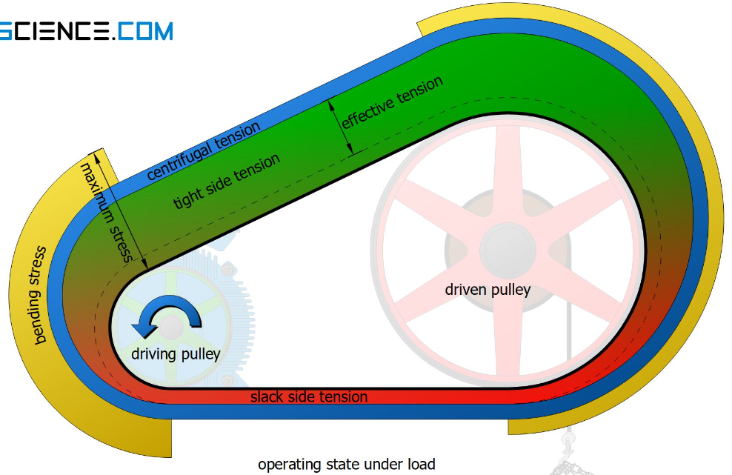
MAXIMUM TENSION IN THE BELT

Slide 4
CONDITION FOR THE TRANSMISSION MAXIMUM POWER

