Slide 1
DESIGN OF MACHINE ELEMENTS-II
(BME3102)
Lecture 6 Module 1
By:-
Dinesh Kumar
School of Engineering

Slide 2
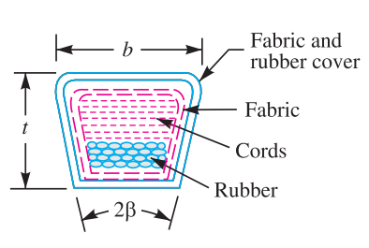
V-BELT
The V-belts are made of fabric and cords moulded in rubber and covered with fabric and rubber as shown in Figure
These belts are moulded to a trapezoidal shape and are made endless. These are particularly suitable for short drives. The included angle for the V-belt is usually from 30° to 40°.
In order to increase the power output, several V-belts may be operated side by side. It may be noted that in multiple V-belt drive, all the belts should stretch at the same rate so that the load is equally divided between them.

Slide 3
ADVANTAGES OF V-BELT DRIVE OVER FLAT BELT DRIVE
The V-belt drive gives compactness due to the small distance between centres of pulleys.
The drive is positive, because the slip between the belt and the pulley groove is negligible.
Since the V-belts are made endless and there is no joint trouble, therefore the drive is smooth.
It provides longer life, 3 to 5 years.
It can be easily installed and removed.
The operation of the belt and pulley is quie7. The belts have the ability to cushion the shock when machines are started. 8. The high velocity ratio (maximum 10) may be obtained.

Slide 4
DISADVANTAGES OF V-BELT DRIVE OVER FLAT BELT DRIVE
The V-belt drive can not be used with large centre distances, because of larger weight per unit length.
The V-belts are not so durable as flat belts.
The construction of pulleys for V-belts is more complicated than pulleys of flat belts.
Since the V-belts are subjected to certain amount of creep, therefore these are not suitable for constant speed applications such as synchronous machines and timing devices.
The belt life is greatly influenced with temperature changes, improper belt tension and mismatching of belt lengths.
The centrifugal tension prevents the use of V-belts at speeds below 5 m / s and above 50 m / s.

Slide 5
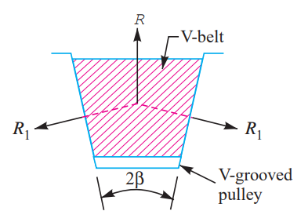
RATIO OF DRIVING TENSIONS FOR V-BELT
Let, R₁ = Normal reactions between belts and sides of the groove.
R = Total reaction in the plane of the groove.
μ = Coefficient of friction between the belt and sides of the groove.
Resolving the reactions vertically to the groove, we have R = R₁ sin β + R₁ sin β = 2R₁ sin β

Slide 6
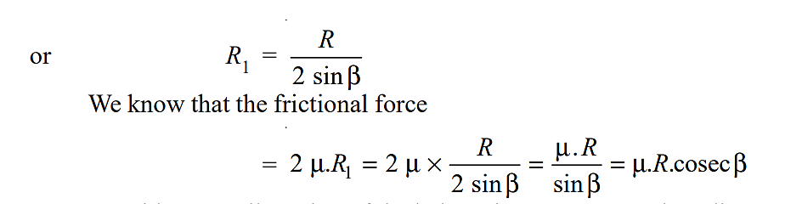
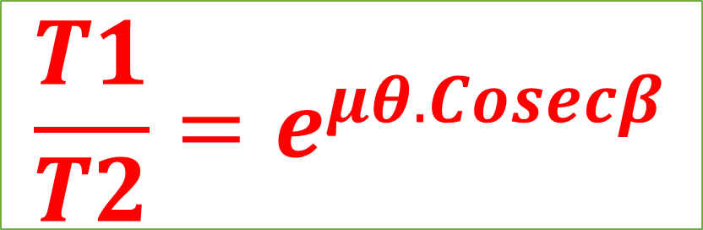
$$\frac{T1}{T2}=e^{μθ.Cosecβ}$$

Slide 7
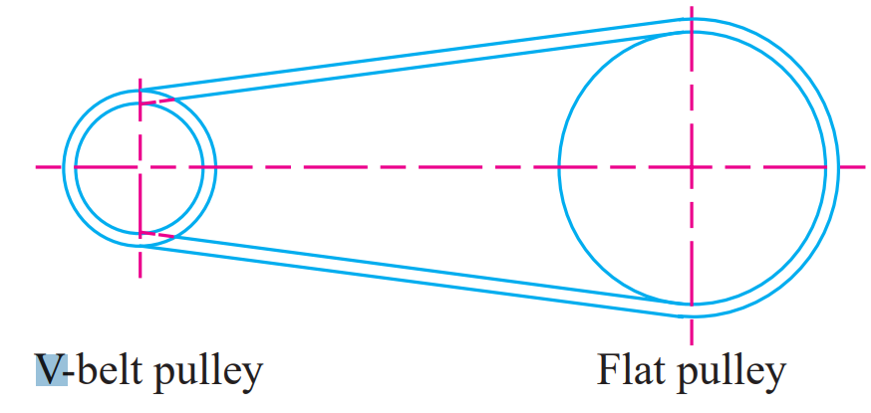
V-FLAT DRIVES
In many cases, particularly, when a flat belt is replaced by V-belt, it is economical to use flat-faced pulley, instead of large grooved pulley, as shown in Fig. 20.3. The cost of cutting the grooves is thereby eliminated. Such a drive is known as V-flat drive.

Slide 8
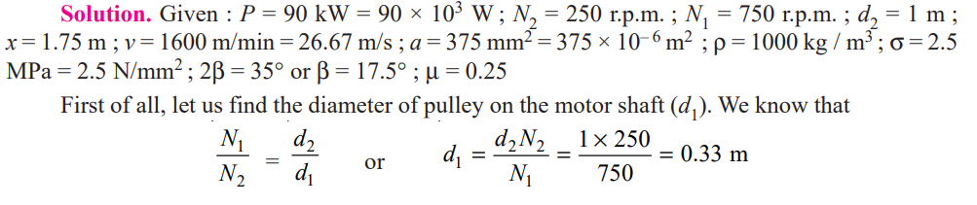
A compressor, requiring 90 kW, is to run at about 250 r.p.m. The drive is by V-belts from an electric motor running at 750 r.p.m. The diameter of the pulley on the compressor shaft must not be greater than 1 metre while the centre distance between the pulleys is limited to 1.75 metre. The belt speed should not exceed 1600 m / min. Determine the number of V-belts required to transmit the power if each belt has a cross-sectional area of 375 mm², density 1000 kg / m³ and an allowable tensile stress of 2.5 MPa. The groove angle of the pulleys is 35°. The coefficient of friction between the belt and the pulley is 0.25. Calculate also the length required of each belt.

Slide 10
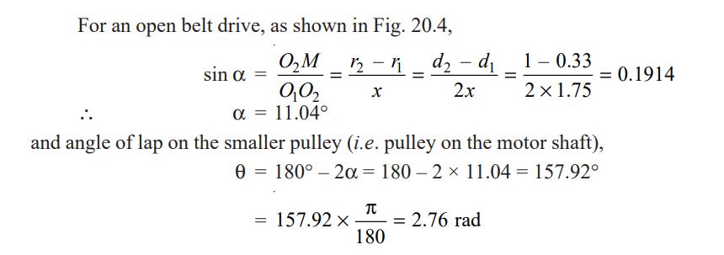
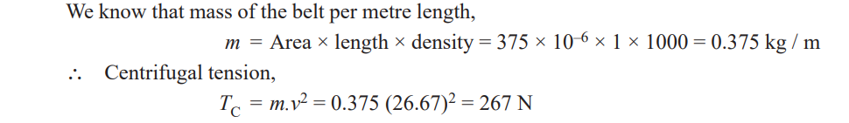

Slide 12
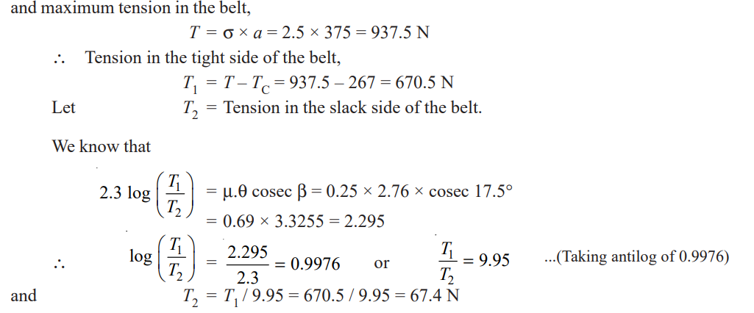

Slide 13
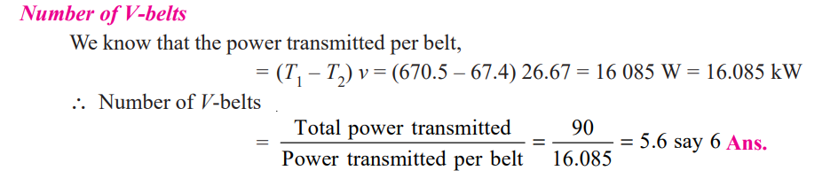
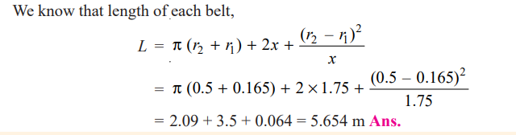

Slide 14
PRACTICE QUESTION
A belt drive consists of two V-belts in parallel, on grooved pulleys of the same size. The angle of the groove is 30°. The cross-sectional area of each belt is 750 mm² and μ = 0.12. The density of the belt material is 1200 kg / m³ and the maximum safe stress in the material is 7 MPa. Calculate the power that can be transmitted between pulleys of 300 mm diameter rotating at 1500 r.p.m. Find also the shaft speed in r.p.m. at which the power transmitted would be a maximum.

