Slide 1
DESIGN OF MACHINE ELEMENTS-II
(BME3102)
Lecture 7 Module 1
By:-
Dinesh Kumar
School of Engineering

Slide 2
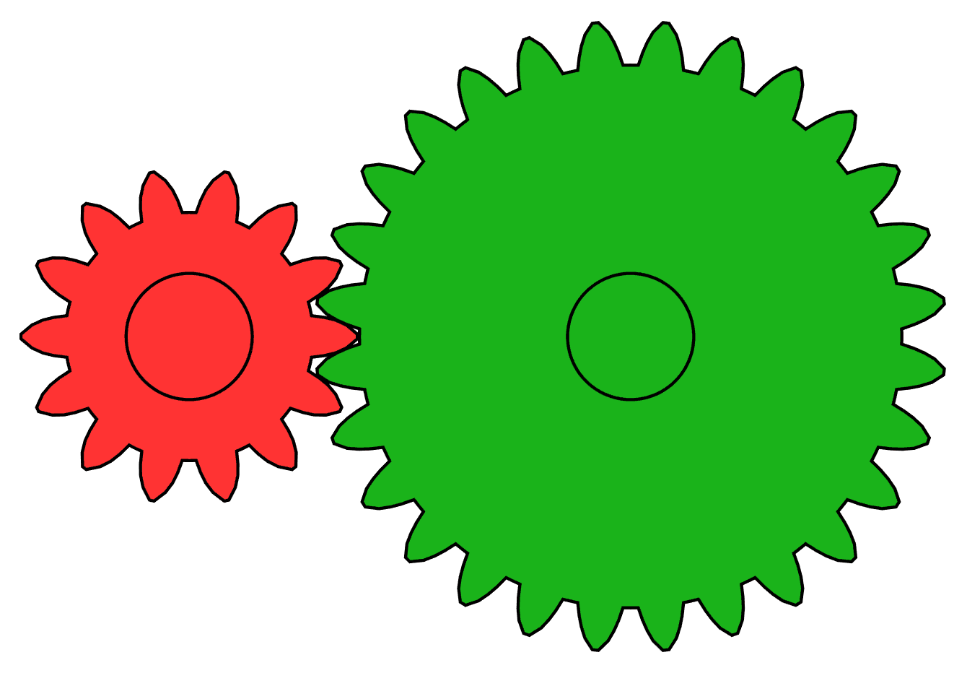
GEARS
Power transmission is the movement of energy from its place of generation to a location where it is applied to performing useful work
A gear is a component within a transmission device that transmits rotational force to another gear or device, Gears are used in various machines to change the speed, direction, and force of mechanical power.

Slide 3
1. BASED ON AXIS ORIENTATION
Parallel Axis Gears:
  Spur Gears: Have straight teeth parallel to the axis. They are the simplest and most common type of gear, used to transmit motion between parallel shafts.
  Helical Gears: Have teeth cut at an angle to the axis, allowing for smoother and quieter operation compared to spur gears. They also transmit motion between parallel shafts.
Intersecting Axis Gears:
  Bevel Gears: Have conical-shaped teeth and are used to transmit motion between intersecting shafts, typically at a right angle.

Slide 4
  Miter Gears: A special type of bevel gear where the gear ratio is 1:1, used for changing the direction of the shaft's rotation.
Non-Parallel and Non-Intersecting Axis Gears:
  Worm Gears: Consist of a worm (screw) and a worm wheel. They are used for large gear reductions and can transmit motion between non-parallel and non-intersecting shafts.
  Crossed Helical Gears: Similar to helical gears but used for transmitting motion between non-parallel, non-intersecting shafts.

Slide 5
2. Based on Tooth Design
Straight Teeth:
  Spur Gears: Have straight teeth that are parallel to the axis of rotation.
  Bevel Gears: Have straight, conical teeth, used in intersecting shafts.
Angled Teeth:
  Helical Gears: Have angled teeth, which engage gradually, resulting in smoother operation.
  Spiral Bevel Gears: Have curved teeth, offering smoother operation compared to straight bevel gears.
Curved Teeth:
  Hypoid Gears: Similar to bevel gears but with hyperbolic teeth, allowing for non-intersecting shafts.
  Crown Gears: Have teeth that project at right angles to the plane of the gear, resembling a crown.

Slide 6
3. Based on Gear Shape
Cylindrical Gears:
  Spur Gears
  Helical Gears
Conical Gears:
  Bevel Gears
  Miter Gears
Screw Gears:
  Worm Gears
Internal Gears:
  Ring Gears: Have teeth on the inner circumference, often used in planetary gear systems.

Slide 7
4. Based on Application
Planetary Gears: Used in applications requiring compact size and high torque, such as automatic transmissions in vehicles.
Rack and Pinion Gears: Convert rotational motion into linear motion, commonly used in steering systems of cars.
Differential Gears: Used in the differential of a vehicle to allow different wheels to rotate at different speeds while turning.

Slide 8
