Slide 1
DESIGN OF MACHINE ELEMENTS-II
(BME3102)
Lecture 8 Module 1
By:-
Dinesh Kumar
School of Engineering

Slide 2
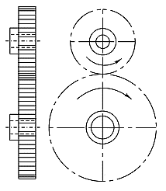
TERMS USED IN GEARS
Pinion A pinion is the smaller of the two mating gears.
Gear A gear is the larger of the two mating gears.
Velocity Ratio (i)
Velocity ratio is the ratio of angular velocity of the driving gear to the angular velocity of the driven gear. It is also called the speed ratio.
(iv) Transmission Ratio (i’)
The transmission ratio (i’) is the ratio of the angular speed of the first driving gear to the angular speed of the last driven gear in a gear train.

Slide 3
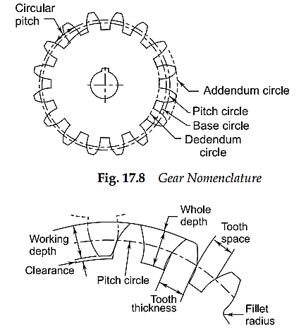
TERMS USED IN GEARS
(v) Pitch Surface The pitch surfaces of the gears are imaginary planes, cylinders or cones that roll together without slipping.
(vi) Pitch Circle The pitch circle is the curve of intersection of the pitch surface of revolution and the plane of rotation. It is an imaginary circle that rolls without slipping with the pitch circle of a mating gear. The pitch circles of a pair of mating gears are tangent to each other

Slide 4
TERMS USED IN GEARS
(vii) Pitch Circle Diameter The pitch circle diameter is the diameter of the pitch circle. The size of the gear is usually specified by the pitch circle diameter. It is also called pitch diameter. The pitch circle diameter is denoted by d ‘.
(viii) Pitch Point The pitch point is a point on the line of centres of two gears at which two pitch circles of mating gears are tangent to each other.
(ix) Top Land The top land is the surface of the top of the gear tooth.
(x) Bottom Land The bottom land is the surface of the gear between the flanks of adjacent teeth.
(xi) Involute An involute is a curve traced by a point on a line as the line rolls without slipping on a circle.

Slide 5
TERMS USED IN GEARS
(xii) Base Circle The base circle is an imaginary circle from which the involute curve of the tooth profile is generated. The base circles of two mating gears are tangent to the pressure line.
(xiii) Addendum Circle The addendum circle is an imaginary circle that borders the tops of gear teeth in the cross section.
(xiv) Addendum (h_{a}) The addendum (h_{a}) is the radial distance between the pitch and the addendum circles. Addendum indicates the height of the tooth above the pitch circle.
(xv) Dedendum Circle The Dedendum circle is an imaginary circle that borders the bottom of spaces between teeth in the cross section. It is also called root circle.
(xvi) Dedendum (h_{f}) The Dedendum (h_{f}) is the radial distance between pitch and the Dedendum circles. The Dedendum indicates the depth of the tooth below the pitch circle.

Slide 6
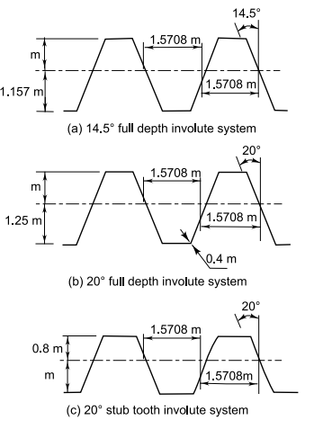
STANDARD SYSTEMS OF GEAR TOOTH
There are three standard systems for the shape of gear teeth.
They are as follows:
14.5° full depth involute system
20° full depth involute systems
20° stub involute system

Slide 7

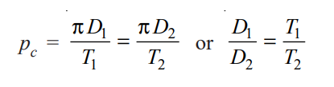
Circular pitch. It is the distance measured on the circumference of the pitch circle from a point of one tooth to the corresponding point on the next tooth. It is usually denoted by p_{c} . Mathematically,
NOTE: If D1 and D2 are the diameters of the two meshing gears having the teeth T1 and T2 respectively; then for them to mesh correctly,

Slide 8
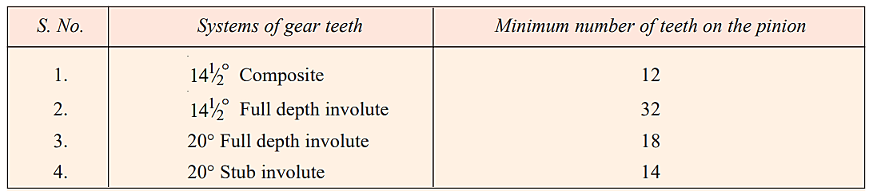
MINIMUM NUMBER OF TEETH ON THE PINION IN ORDER TO AVOID INTERFERENCE

Slide 9
Design Considerations for a Gear Drive In the design of a gear drive, the following data is usually given :
The power to be transmitted.
The speed of the driving gear,
The speed of the driven gear or the velocity ratio, and
The centre distance.
The following requirements must be met in the design of a gear drive :
(a) The gear teeth should have sufficient strength so that they will not fail under static loading or dynamic loading during normal running conditions.

Slide 10
(b) The gear teeth should have wear characteristics so that their life is satisfactory.
(c) The use of space and material should be economical.
(d) The alignment of the gears and deflections of the shafts must be considered because they effect on the performance of the gears.
(e) The lubrication of the gears must be satisfactory

