Slide 1
DESIGN OF MACHINE ELEMENTS-II
(BME3102)
Lecture 9 Module 1
By:-
Dinesh Kumar
School of Engineering

Slide 2
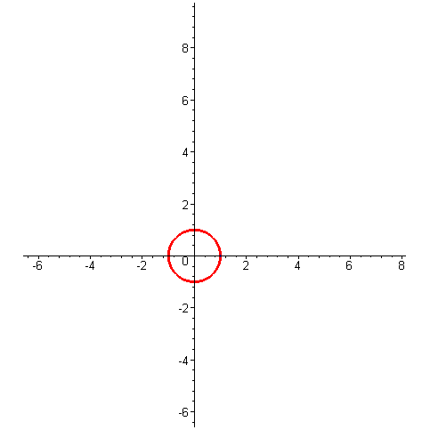
GEAR PROFILES
Involute Profile:
An involute profile is a curve that is generated by unwinding a taut string from a base circle. Imagine a string wrapped tightly around a cylinder or circle; if you unwind the string while keeping it taut, the path traced by the end of the string is called an involute curve.
This profile is commonly used in gear tooth design because it ensures smooth meshing of the gears, maintaining a constant velocity ratio.
The involute shape helps in reducing friction and wear, leading to more efficient power transmission.

Slide 3
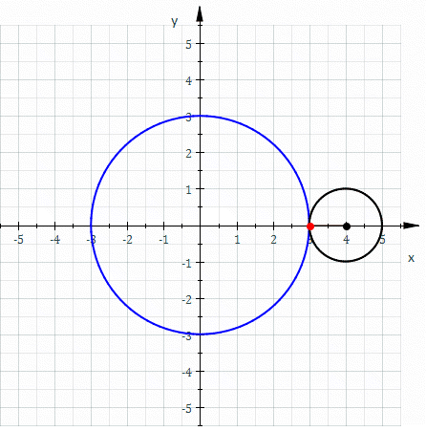
Cycloidal Profile:
A cycloidal profile is a curve generated by a point on the circumference of a circle as it rolls along a straight line without slipping.
Cycloidal gears are known for their robustness and ability to distribute stress more evenly, which can reduce the chances of gear tooth failure.
However, compared to involute gears, cycloidal gears are less commonly used in modern machinery due to their more complex manufacturing process and difficulty in maintaining a constant velocity ratio during operation.

Slide 4
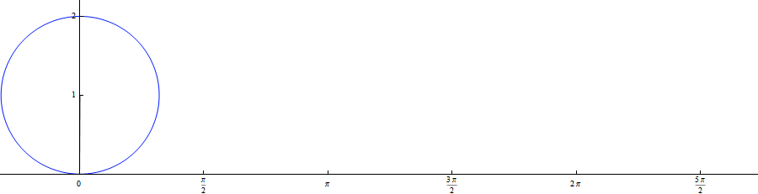
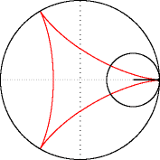

Slide 5
COMPARISION OF PROFILES
Aspect | Involute Profile | Cycloidal Profile
Generation Method | Generated by unwinding a taut string from a base circle. | Generated by a point on the circumference of a circle rolling along a straight line.
Application in Gears | Commonly used in modern gear design due to its ability to maintain a constant velocity ratio. | Less common in modern gear design; used historically in clock gears and some specialized applications.
Manufacturing Ease | Easier to manufacture with standard gear cutting tools; widely used in industry. | More complex to manufacture due to the intricate shape of the teeth; less commonly used.
Stress Distribution | May concentrate stress at specific points, though generally efficient for most applications. | Distributes stress more evenly across the gear teeth, reducing the likelihood of gear tooth failure.

Slide 6
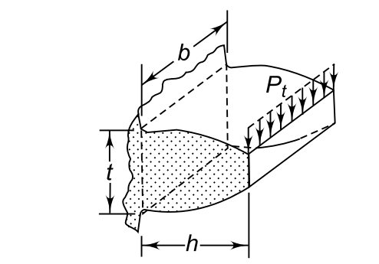
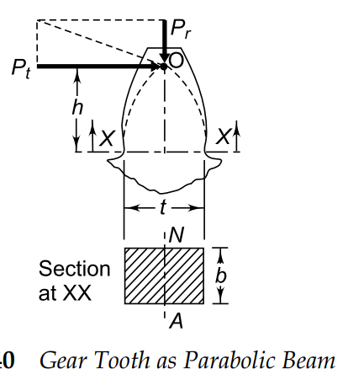
BEAM STRENGTH OF GEAR TOOTH
The Lewis equation is based on the following assumptions:
The effect of the radial component (Pr), which induces compressive stresses, is neglected.
It is assumed that the tangential component (Pt ) is uniformly distributed over the face width of the gear. This is possible when the gears are rigid and accurately machined.
The effect of stress concentration is neglected.
It is assumed that at any time, only one pair of teeth is in contact and takes the total load.
Gear Tooth as Cantilever
Gear Tooth as Parabolic Beam

Slide 7
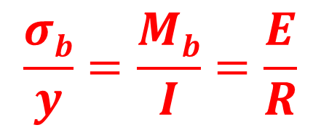
EQUATION OF BENDING
$$\frac{σb}{y}=\frac{Mb}{I}=\frac{E}{R}$$
σ_{b} = Bending Stress
M_{b} =Bending moment
y =Distance from the neutral axis
I =Moment of inertia
E= Young’s Modulus of Elasticity
R= Radius of Curvature of Beam

Slide 8
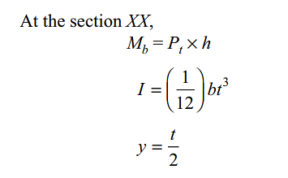
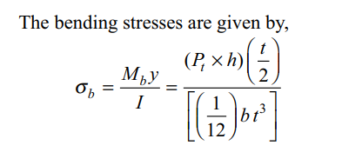
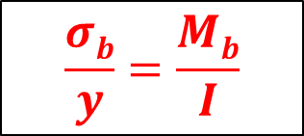
$$\frac{σb}{y}=\frac{Mb}{I}$$
Put the values of M_{b} , I and y in the bending equation

Slide 9
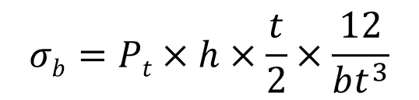
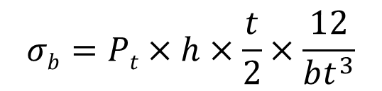
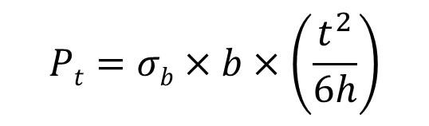
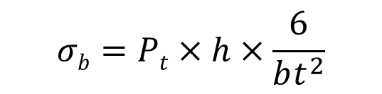
$$σb=Pt×h×\frac{t}{2}×\frac{12}{bt^{3}}$$
$$σb=Pt×h×\frac{t}{2}×\frac{12}{bt^{3}}$$
$$σb=Pt×h×\frac{6}{bt^{2}}$$
$$Pt=σb×b×\left(\frac{t^{2}}{6h}\right)$$
Multiplying the numerator and denominator of the right-hand side by m,

Slide 10
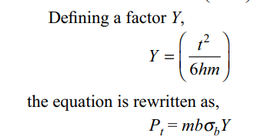

$$Pt=σb×b×m×\left(\frac{t^{2}}{6hm}\right)$$
In the above equation, Y is called the Lewis form factor.

Slide 11

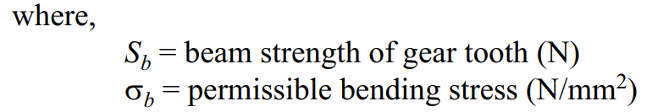
Therefore, the beam strength (S_{b}) is the maximum value of the tangential force that the tooth can transmit without bending failure. Replacing (P_{t} ) by (S_{b})

