Slide 1
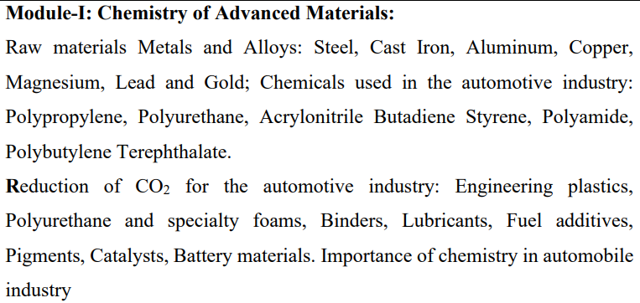

Slide 2
MATTER
Matter is anything that has mass and takes up space. Matter is made up of tiny particles called atoms. Matter is the fundamental building block of the physical universe and is subject to the laws of physics and chemistry.
Matter
Solid
Liquid
Gas
Plasma

Slide 3
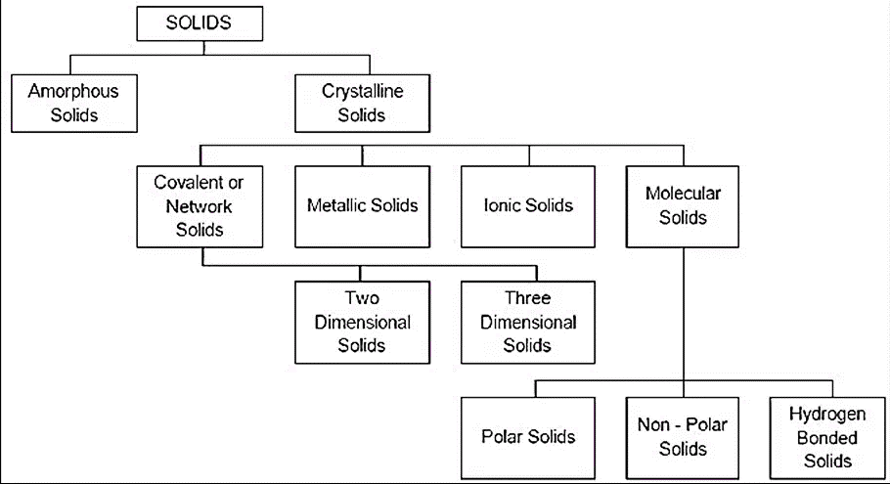

Slide 4
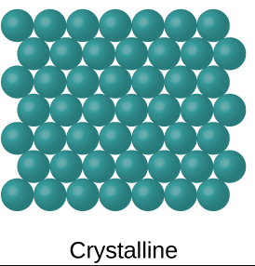
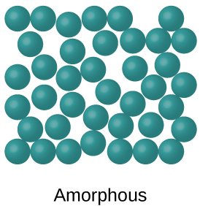
CRYSTALLINE SOLIDS
In crystalline solids, the atoms, ions, or molecules are arranged in a highly ordered and repeating three-dimensional pattern, called a crystal lattice. Crystalline solids have distinct melting points and well-defined geometrical shapes. Examples include salt (sodium chloride) and diamond.
AMORPHOUS SOLIDS
Amorphous solids lack a well-defined, repeating structure. The arrangement of particles in amorphous solids is more random, resulting in properties like a gradual softening rather than a sharp melting point. Examples include glass and certain plastics.

Slide 5
CRYSTALLINE METALS
AMORPHOUS METALS
Copper (Cu)
Aluminum (Al)
Iron (Fe)
Silver (Ag)
Gold (Au)
Platinum (Pt)
Lead (Pb)
Zinc (Zn)
Nickel (Ni)
Titanium (Ti)
Glass
Polymers (e.g., polyethylene)
Silica (e.g., fused quartz)
Carbon (e.g., carbon black)
Pharmaceuticals
Metals (e.g., Vitreloy)
Ceramics
Semiconductors
Ice (under specific conditions)
Alloys

Slide 6
MECHANICAL PROPERTIES
  Mechanical Properties
    Strength
    elasticity
    plasticity
    stiffness
    resilience
    toughness
    malleability
    ductility
    brittleness
    hardness

Slide 7
MECHANICAL PROPERTIES
Strength is deﬁned as the ability of the material to resist, without rupture, external forces causing various types of stresses.
Elasticity is deﬁned as the ability of the material to regain its original shape and size after the deformation, when the external forces are removed.
Plasticity is deﬁned as the ability of the material to retain the deformation produced under the load on a permanent basis.
Stiffness or rigidity is deﬁned as the ability of the material to resist deformation under the action of an external load.
Resilience is deﬁned as the ability of the material to absorb energy when deformed elastically and to release this energy when unloaded.
Toughness is deﬁned as the ability of the material to absorb energy before fracture takes place.

Slide 8
Malleability is deﬁned as the ability of a material to deform to a greater extent before the sign of crack, when it is subjected to compressive force.
Ductility is deﬁned as the ability of a material to deform to a greater extent before the sign of crack, when it is subjected to tensile force.
Brittleness is the property of a material which shows negligible plastic deformation before fracture takes place.
Hardness is deﬁned as the resistance of the material to penetration or permanent deformation.

Slide 9
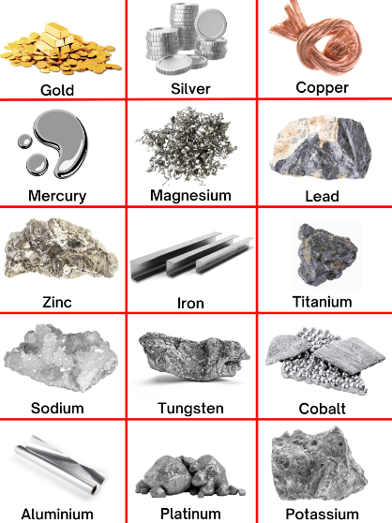
METALS
Metals are elements known for their luster, high electrical and thermal conductivity, malleability, and ductility. They are typically solid at room temperature, with high melting and boiling points. Metals play essential roles in various industries due to their unique properties, from construction to electronics. Some common examples include iron, copper, and aluminum.

