Slide 1
ENGINEERING SCIENCES
(BME 2105)
LECTURE 1 MODULE 1
Dinesh Kumar
Assistant Professor
School of Engineering

Slide 2
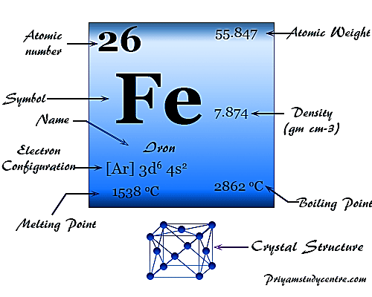
RAW MATERIALS (METALS AND ALLOYS)
IRON
Iron is a chemical element with the symbol Fe and atomic number 26. It is one of the most abundant and widely used metals in the world. Iron is characterized by its silver-gray color, metallic luster, and strong magnetic properties. ron is also a crucial material in industry, being used in the production of steel and various other alloys, making it indispensable in construction, manufacturing, and infrastructure development.

Slide 3
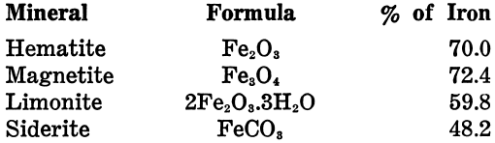
IRON ORE

Slide 4
PHYSICAL PROPERTIES OF IRON
It rusts in damp air, but not in the dry air.
It dissolves readily in dilute acids.
At room temperature, this metal is in the form of ferrite or α-form.
At 910°C, it changes to γ-iron, which is much softer in nature.
It melts at 1536°C and boils at 2861°C.
Being a metal is magnetic in nature.

Slide 5
USES OF IRON
It is used to manufacture steel and also used in civil engineering like reinforced concrete, girders etc.
Iron is used to make alloy steels like carbon steels with additives such as nickel, chromium, vanadium, tungsten, and manganese.
These are used to make bridges, electricity pylons, bicycle chains, cutting tools and rifle barrels.
Cast iron contains 2–5% carbon. It is used for pipes, valves, and pumps.
Iron catalysts are used in the Haber process for producing ammonia.
Magnets can be made of this metal and its alloys and compounds.

Slide 6
STEEL
Steel is a strong alloy of iron and carbon, with varying carbon content affecting its strength and hardness. It's widely used across industries due to its durability and versatility, seen in structures, machinery, vehicles, and tools. Its composition can be adjusted to achieve specific properties, making it a cornerstone material in modern construction and manufacturing.

Slide 7
Classification of steels
Dead Steel
Low Carbon Steel
Medium Carbon Steel
High Carbon Steel
Alloy Steel

Slide 8
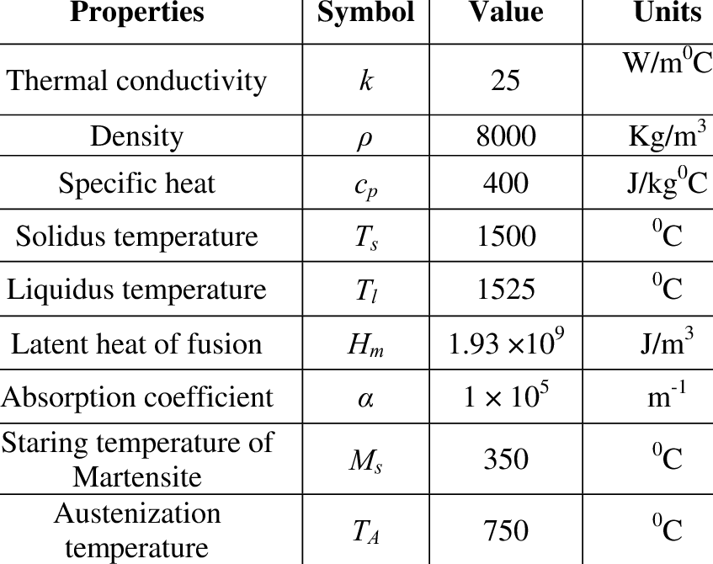
STEEL PROPERTIES

Slide 9
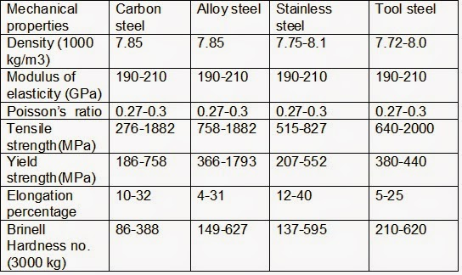
STEEL PROPERTIES

Slide 10
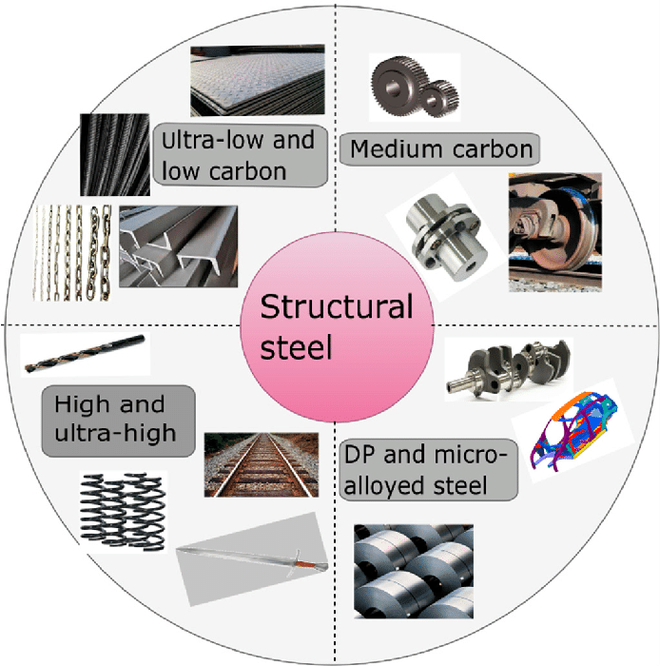
APPLICATIONS OF STEEL
Engineering applications
Tubular products
Building and construction projects
Electro and electronic equipment
Metal goods
Transportation goods

Slide 11
ALLOYING ELEMENTS
Carbon (C): Primary element affecting steel hardness, strength, and toughness.
Manganese (Mn): Enhances strength, workability, and hardenability in steel.
Silicon (Si): Deoxidizer and contributor to electrical properties in certain steels.
Sulfur (S): Can improve machinability but needs careful control due to brittleness.
Phosphorus (P): Generally minimized due to negative impact on mechanical properties.
Chromium (Cr): Boosts corrosion resistance, hardness, and wear resistance.
Nickel (Ni): Increases toughness, ductility, and corrosion resistance.

Slide 12
8. Molybdenum (Mo): Enhances strength, hardness, and high-temperature stability.
9. Vanadium (V): Contributes to strength and hardenability in steel.
10. Tungsten (W): Improves wear resistance and high-temperature stability.
11. Cobalt (Co): Used in high-strength, high-temperature applications and specialty alloys.
12. Copper (Cu): Enhances corrosion resistance, especially with sulfur compounds.
13. Nitrogen (N): Adds strength and toughness, common in austenitic stainless steels.
14. Boron (B): Improves hardenability and depth of hardening in steel.

Slide 13
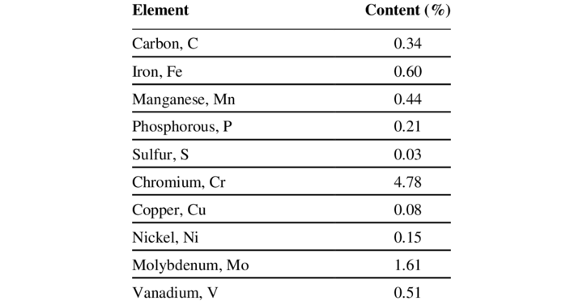
COMPOSITION OF MEDIUM CARBON STEEL

