Slide 1
ENGINEERING SCIENCES
(BME 2105)
LECTURE 10 MODULE 2
Dinesh Kumar
Assistant Professor
School of Engineering

Slide 2
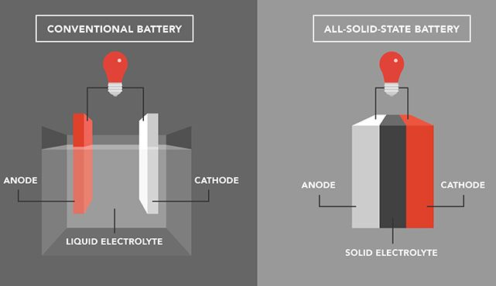
LEADING BATTERY ALTERNATIVES
1. SOLID-STATE BATTERIES:
These batteries replace the liquid or gel electrolytes found in conventional lithium-ion batteries with solid electrolytes. Solid-state batteries offer higher energy density, reducing the risk of fire and allowing for faster charging.
Benefits include increased safety, longer lifespan, and potentially higher energy density. However, challenges such as manufacturing costs and scalability need to be addressed for wider adoption.

Slide 3
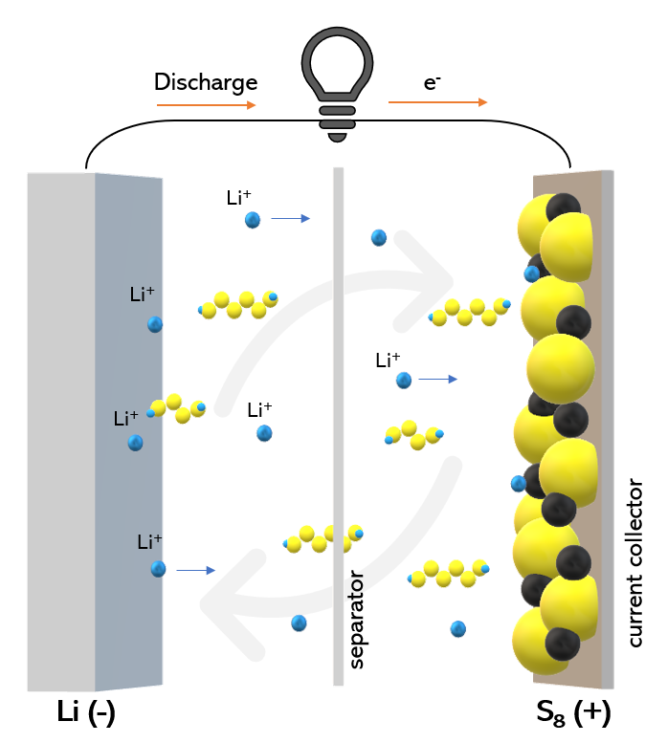
2. LITHIUM-SULFUR BATTERIES:
Lithium-sulfur batteries use sulfur as a cathode material, offering higher theoretical energy density compared to lithium-ion batteries. They are lighter and potentially more cost-effective.
Challenges include the degradation of sulfur cathodes over charge cycles, which reduces lifespan. Research is ongoing to overcome these limitations.

Slide 4
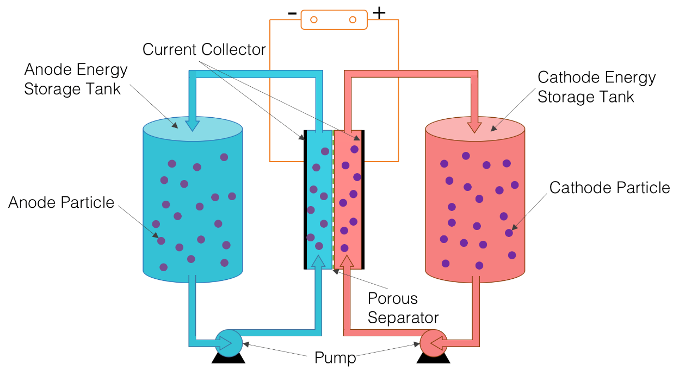
3. FLOW BATTERIES:
Flow batteries store energy in chemical fluids contained in external tanks. They are scalable and offer longer cycle life since their energy capacity is independent of the charge-discharge cycle.
They are suitable for grid-scale energy storage but are less energy-dense compared to lithium-ion batteries, making them less suitable for portable applications.

Slide 5
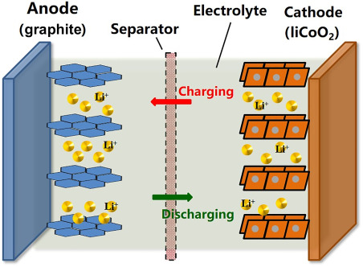
4. GRAPHENE-BASED BATTERIES:
Graphene, a single layer of carbon atoms, shows promise in battery technology due to its excellent conductivity and strength. Batteries incorporating graphene may offer faster charging rates and higher energy densities.
Challenges involve the cost of large-scale production and the integration of graphene into battery architectures.

Slide 6
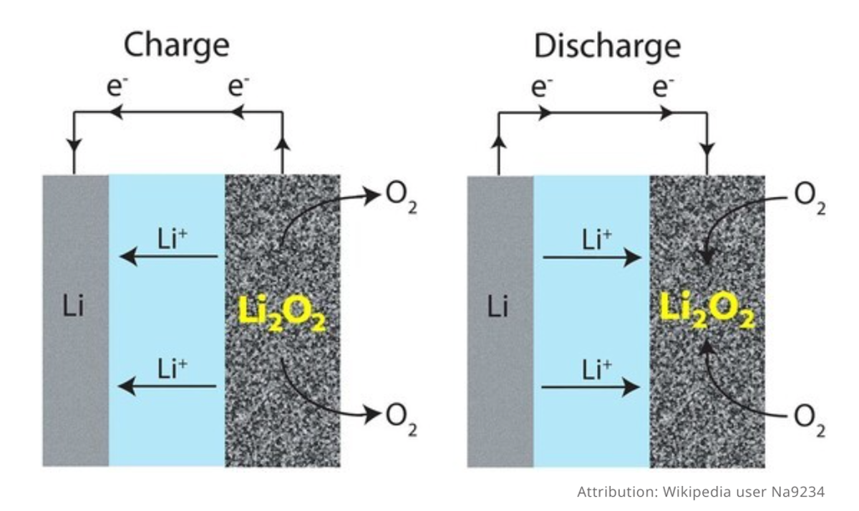
5. LITHIUM-AIR BATTERIES:
Lithium-air batteries use oxygen from the air to react with lithium, theoretically offering extremely high energy densities. However, challenges related to stability, efficiency, and lifespan need to be addressed for practical applications.

Slide 7
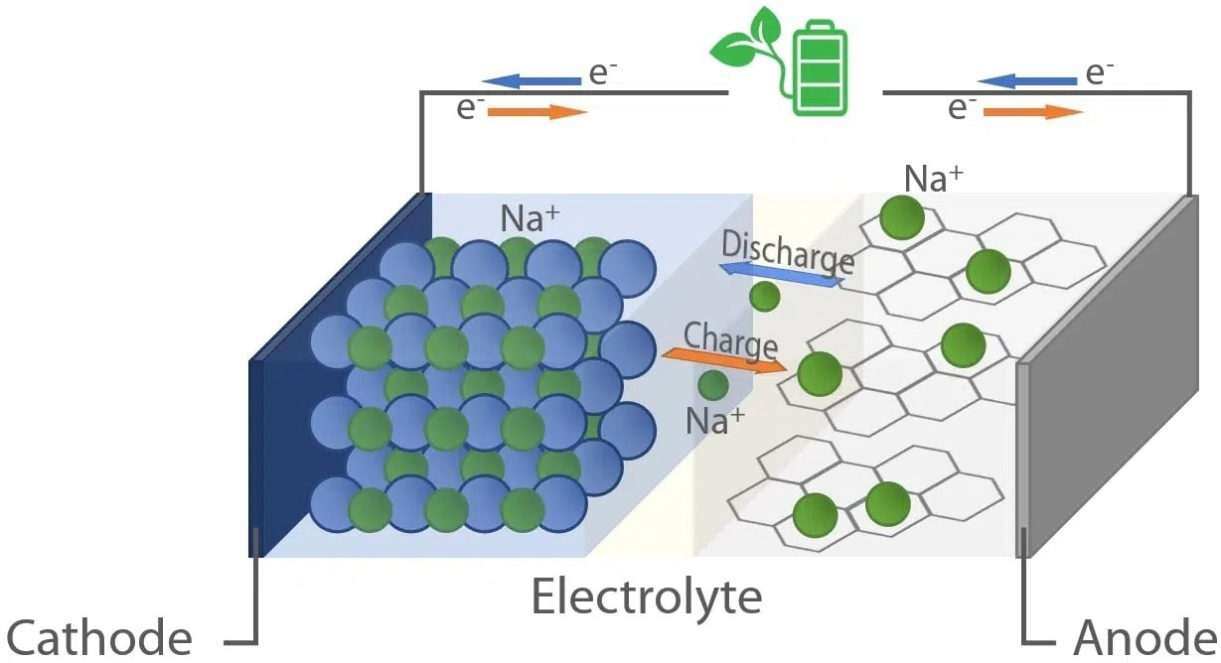
6. SODIUM-ION BATTERIES:
These batteries use sodium ions instead of lithium ions, offering a potential alternative due to the abundance of sodium resources. They might be more cost-effective than lithium-ion batteries.
Challenges include lower energy density and issues related to the larger size of sodium ions compared to lithium ions.

Slide 8
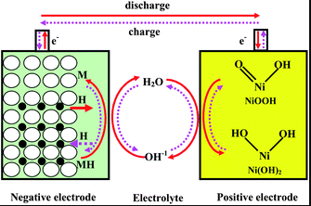
NICKEL METAL HYDRIDE (NMH)
Nickel Metal Hydride (NiMH) battery is a type of rechargeable battery that utilizes a Nickel Hydroxide (Ni(OH)₂) cathode and a hydrogen-absorbing alloy as the anode, usually made of a metal hydride.

Slide 9
CONSTRUCTION:
Positive Electrode (Cathode):
  The cathode of a NiMH battery typically consists of a nickel hydroxide (Ni(OH)2) compound. This material provides the basis for storing and releasing the positive charge during the battery's operation.
Negative Electrode (Anode):
  NiMH batteries use a hydrogen-absorbing alloy as the anode. This alloy, often composed of a mixture of metals such as nickel, cobalt, manganese, and rare earth metals, stores hydrogen ions during charging.

Slide 10
3. Separator:
  Separators made of porous materials are placed between the cathode and anode to prevent short circuits while allowing the flow of ions between them.
4. Electrolyte:
  The electrolyte in NiMH batteries is typically an alkaline solution, commonly potassium hydroxide (KOH) or sodium hydroxide (NaOH), facilitating the movement of ions between electrodes during charging and discharging.

Slide 11
WORKING PRINCIPLE:
Charging:
During the charging process, an external electrical current is applied to the battery. This forces electrons to flow from the external circuit through the battery, causing a chemical reaction.
At the cathode, nickel hydroxide undergoes an oxidation reaction, releasing oxygen ions and accepting electrons, turning into nickel oxyhydroxide (NiOOH).
Meanwhile, at the anode, the hydrogen-absorbing alloy absorbs hydrogen ions (H⁺) and electrons, forming a hydride compound.

Slide 12
Discharging:
When the battery is in use, the stored chemical energy is converted back into electrical energy.
Electrons flow through the external circuit, providing power for devices.
At the cathode, the nickel oxyhydroxide reacts with the hydrogen ions and electrons from the anode, reverting back to nickel hydroxide.
Simultaneously, at the anode, the hydrogen-absorbing alloy releases the stored hydrogen ions and electrons, reforming into its original state.

