Slide 1
ENGINEERING SCIENCES
(BME 2105)
LECTURE 12 MODULE 2
Dinesh Kumar
Assistant Professor
School of Engineering

Slide 2
BARRIERS TO WIDE-SCALE ADOPTION
1. Cost and Scalability:
Manufacturing Costs: Developing and producing new battery technologies often involve high initial costs due to specialized materials and manufacturing processes.
Economies of Scale: Scaling up production to meet demand while maintaining cost efficiency is a challenge for emerging technologies.

Slide 3
2. Performance and Reliability:
Cycle Life and Durability: Ensuring consistent performance over numerous charge and discharge cycles without significant degradation is crucial for consumer acceptance.
Safety Concerns: Addressing safety risks associated with new chemistries or technologies, especially in high-demand applications like electric vehicles or grid storage, is vital.

Slide 4
3. Energy Density and Efficiency:
Energy Density: Achieving higher energy density is crucial for longer-lasting batteries with more extended ranges in electric vehicles and smaller form factors in consumer electronics.
Efficiency: Ensuring efficient charging and discharging processes to minimize energy loss and heat generation is important for overall battery efficiency.

Slide 5
4. Material Availability and Sustainability:
Resource Constraints: Dependency on rare or scarce materials can impact the scalability and long-term viability of a technology.
Environmental Impact: Ensuring that new battery technologies are environmentally friendly throughout their lifecycle, including manufacturing, usage, and disposal, is crucial for sustainability.

Slide 6
5. Regulatory and Standards Challenges:
Regulatory Hurdles: Compliance with regulations and standards for safety, transportation, and disposal of new battery technologies poses challenges.
Industry Standards: Establishing uniform standards for different types of batteries to ensure interoperability and safety is essential for market acceptance.

Slide 7
6. Infrastructure and Compatibility:
Charging Infrastructure: Developing adequate charging infrastructure to support new battery technologies, especially for electric vehicles and grid-scale applications, is crucial.
Compatibility: Ensuring compatibility with existing technologies and infrastructure is essential for seamless integration and adoption.

Slide 8
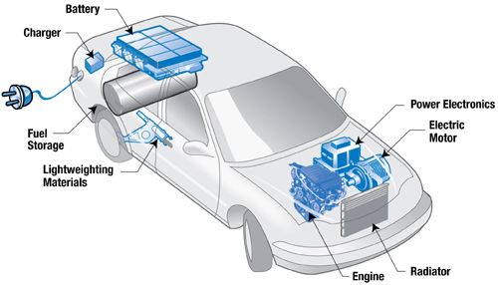
PLUG-IN CARS
Plug-in cars, often referred to as plug-in hybrid electric vehicles (PHEVs) or battery electric vehicles (BEVs), are automobiles that use electric power as their primary source of propulsion.

Slide 9
TYPES OF PLUG-IN CARS:
Plug-in Hybrid Electric Vehicles (PHEVs):
  PHEVs combine an internal combustion engine (ICE) with an electric motor and a battery. They can be charged by plugging into an electrical outlet and can also utilize gasoline or diesel.
  These vehicles offer the flexibility of running on electric power for shorter distances and switching to the internal combustion engine for longer trips, providing extended range compared to purely electric vehicles.

Slide 10
Battery Electric Vehicles (BEVs):
BEVs operate solely on electric power stored in their batteries. They do not have an internal combustion engine and rely entirely on electric motors for propulsion.
These cars are charged by plugging into an electrical outlet or dedicated charging stations, offering zero tailpipe emissions and lower operational costs compared to traditional ICE vehicles.

Slide 11
Components of Plug-in Cars:
Electric Motor:
  The electric motor is the primary source of propulsion in plug-in cars. It converts electrical energy from the battery into mechanical energy to drive the vehicle.
Battery Pack:
  The battery pack stores electrical energy for use by the electric motor. In PHEVs, it is smaller compared to BEVs, as PHEVs also have an internal combustion engine for backup power.

Slide 12
3. Charging Port:
  Plug-in cars have a charging port that allows them to connect to electrical outlets or charging stations to replenish their battery.
4. Control System:
  An onboard control system manages the flow of electricity from the battery to the motor, monitors battery health, and controls the vehicle's overall operation.
5. Regenerative Braking:
  Plug-in cars often utilize regenerative braking, where the electric motor acts as a generator during braking, converting kinetic energy back into electrical energy to recharge the battery.

Slide 13
