Slide 1
ENGINEERING SCIENCES
(BME 2105)
LECTURE 13 MODULE 2
Dinesh Kumar
Assistant Professor
School of Engineering

Slide 2
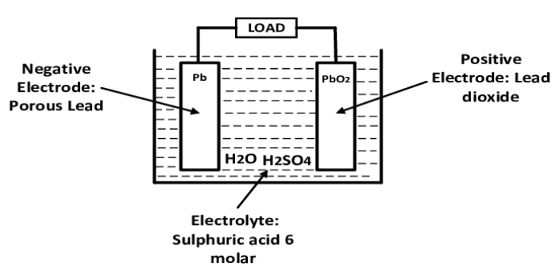
WORKING OF LEAD ACID BATTERY
A lead-acid battery is a rechargeable battery that uses a chemical reaction between lead and lead dioxide with sulfuric acid as the electrolyte to generate electricity.

Slide 3
CONSTRUCTION:
Container/Casing: Usually made of durable plastic, it houses the internal components and protects the battery from damage.
Positive Plate: Made of lead dioxide (PbO₂).
Negative Plate: Consists of sponge lead (Pb).
Separator: A material, often made of porous material like rubber or plastic, placed between the positive and negative plates to prevent short circuits.
Electrolyte: A solution of sulfuric acid (H₂SO₄) and water that facilitates the chemical reaction between the plates.
Cell Connectors: These conductive materials link the plates together and allow the flow of electrons.

Slide 4
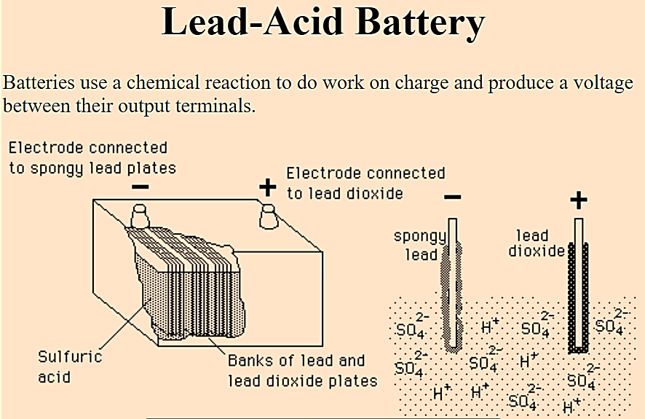

Slide 5
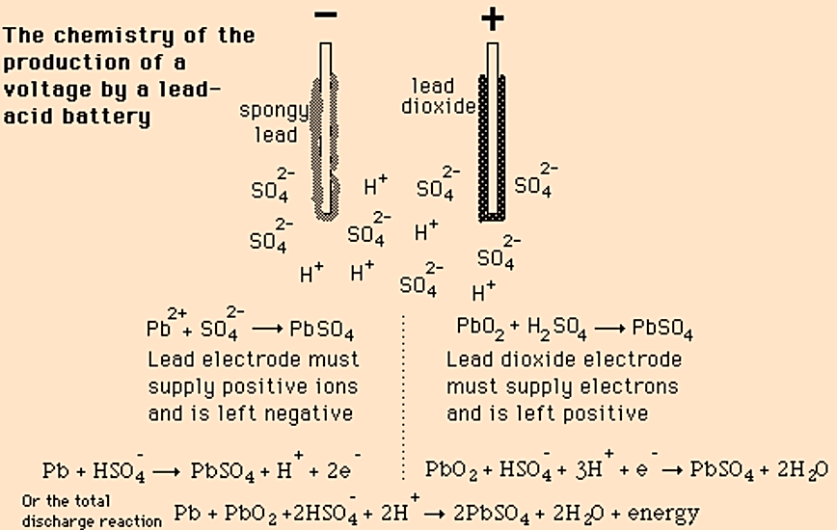

Slide 6
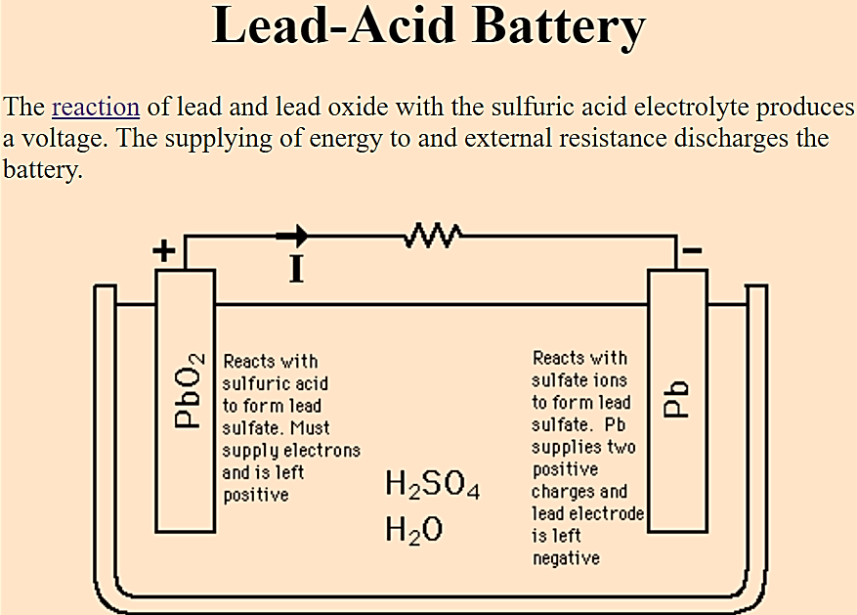

Slide 7
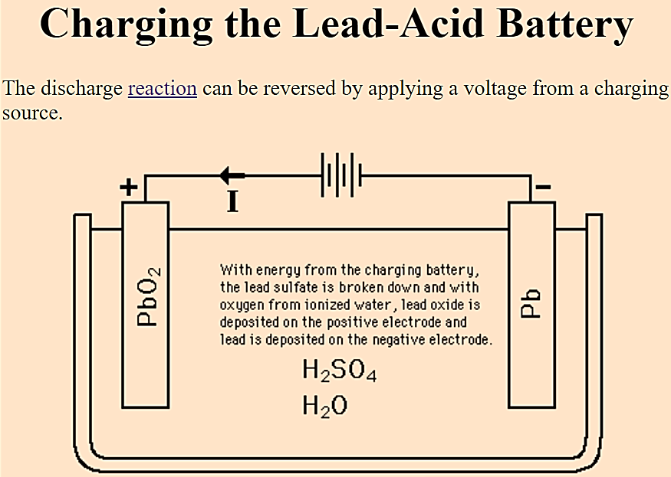

Slide 8
APPLICATIONS:
Automotive: Lead-acid batteries are extensively used in vehicles for starting, lighting, and ignition (SLI) systems due to their ability to deliver high bursts of power. They are also employed in electric vehicles (EVs) and hybrid vehicles.
Uninterruptible Power Supplies (UPS): They are commonly used in backup power systems to provide temporary power during outages in hospitals, data centers, and various industrial applications.
Renewable Energy Storage: Lead-acid batteries are utilized in off-grid and grid-tied renewable energy systems (like solar and wind power) to store excess energy for later use.
Marine Applications: They power electrical systems in boats, yachts, and marine vessels due to their robustness and reliability.

Slide 9
ADVANTAGES:
Low Cost: Lead-acid batteries are cost-effective compared to many other types of batteries, making them widely accessible.
Mature Technology: Their technology is well-understood and established, allowing for easy manufacturing and maintenance.
High Surge Currents: They can deliver high currents, which is useful for applications requiring quick bursts of power like starting an engine in vehicles.
Recyclability: Lead-acid batteries are one of the most recycled consumer products, with a high recycling rate. Up to 99% of the components can be recycled.

Slide 10
DISADVANTAGES:
Weight and Size: They are relatively heavy and have lower energy density compared to some newer battery technologies like lithium-ion batteries. This affects their portability and energy-to-weight ratio.
Limited Cycle Life: Lead-acid batteries have a limited number of charge-discharge cycles compared to some other types of batteries, which affects their overall lifespan.
Maintenance: They require periodic maintenance such as topping up electrolyte levels and ensuring proper ventilation to prevent gas buildup.
Environmental Concerns: Lead-acid batteries contain lead, which is toxic. Improper disposal or recycling can lead to environmental pollution if not handled correctly.

Slide 11
Comparison between Lead Acid battery and Lithium ion battery
ASPECT | LEAD-ACID BATTERY | LITHIUM-ION BATTERY
Energy Density | Lower energy density | Higher energy density
Weight | Heavier | Lighter
Cycle Life | Limited cycle life | Longer cycle life
Maintenance | Requires periodic maintenance (water top-up) | Maintenance-free
Charge Rate | Slower charging | Faster charging
Depth of Discharge | Less efficient at deep discharges | More efficient at deep discharges

Slide 12
Comparison between Lead Acid battery and Lithium ion battery
ASPECT | LEAD-ACID BATTERY | LITHIUM-ION BATTERY
Self-Discharge Rate | Higher self-discharge rate | Lower self-discharge rate
Cost | Lower initial cost | Higher initial cost
Environmental Impact | Contains lead, a toxic material | Generally considered more environmentally friendly
Application | Commonly used in automotive, backup power systems | Widely used in consumer electronics, electric vehicles, and renewable energy storage

